Slide 1
State Grant Training for Financial Aid Administrators
Presented by Meghan Flores, Shannon Olson and Shawn Reynolds
October 13, 2022

Slide 2
Agenda
MN State Grant 9am – 12pm
  Welcome
  Application and Correction Process
  Screening Program Eligibility Requirements
  Verification and Professional Judgment
**Break**
  State Grant Award Formula
  Award Adjustments and Disbursements
  Award Recalculation and Refunds
  Funds Management
  State Grant Reporting Requirements and Output Reports
  Questions
**Lunch Break**
Post-Secondary Childcare Grant 1pm – 3:30pm

Slide 3
Welcome
Brenda Larter: Post-Secondary Childcare Grant, MN Work-Study, and MN Dream Act
Meghan Flores: State Financial Aid Programs - Manager
Shannon Olson: MN State Grant – State Grant File, Payments, Refunds, etc
Shawn Reynolds: MN State Grant and MN Dream Act
Housekeeping
Update your Name to First Last (Name of College / University)
Please use Chat function to ask any questions

Slide 4

Office of Higher Education Websites
Just for you!

Slide 5
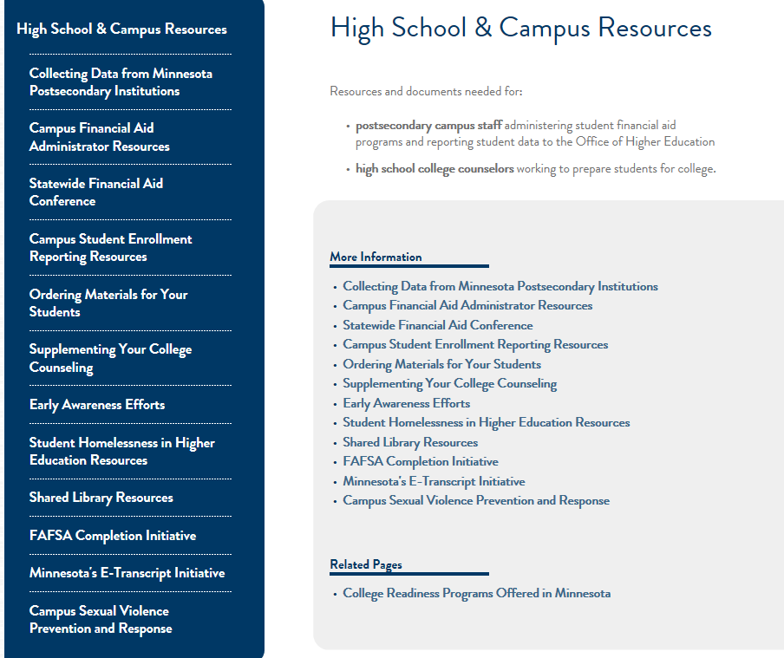
OHE.State.MN.US

Slide 6
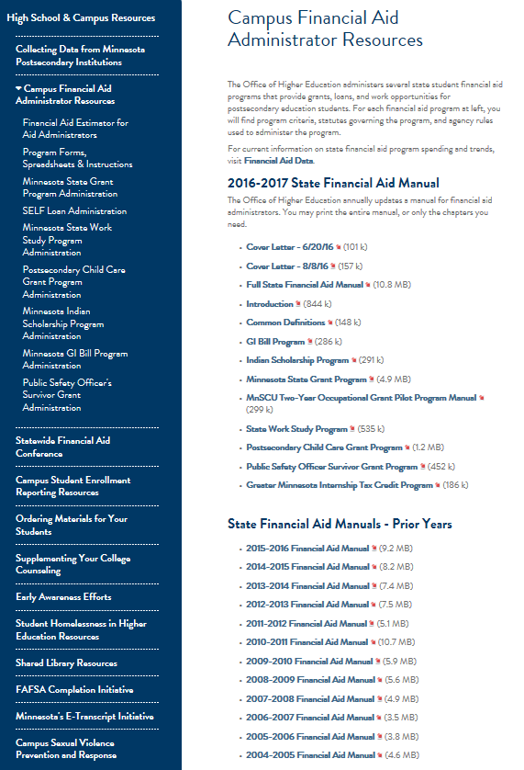
Office of Higher Education Web Sites
FAA Resources
Financial Aid Estimator
Program Forms,
Spreadsheets,
and Instructions
Administrative Information for Each State Financial Aid Program
Financial Aid Program Manual Chapters
(Prior Years are Available Below.)

Slide 7
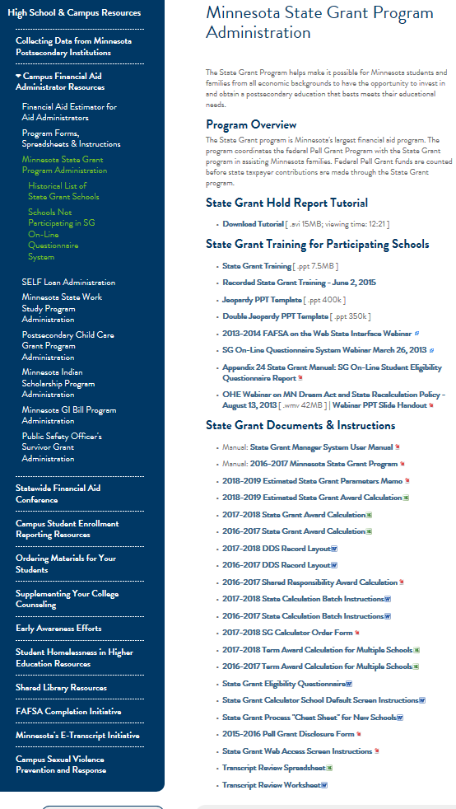
Office of Higher Education Websites
State Grant Page
Contact information for locating closed school transcripts.
State Grant Research Data
(Historical, Spending, Spending by College, Award Parameters etc.)
State Grant Manual
(Includes Laws/Rules)
Historical List of All Schools Participating in State Grant.
State Grant PowerPoint Presentation.

Slide 8
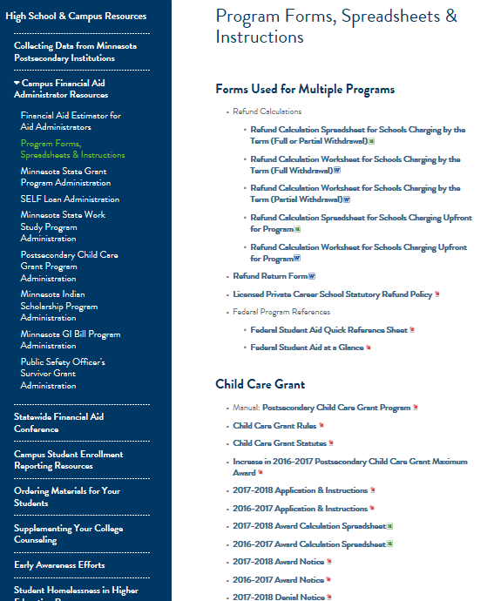
Office of Higher Education Websites
Forms for FAAs
Refund Forms, Transcript Review
Spreadsheet/Worksheet
Child Care Grant Forms

Slide 9
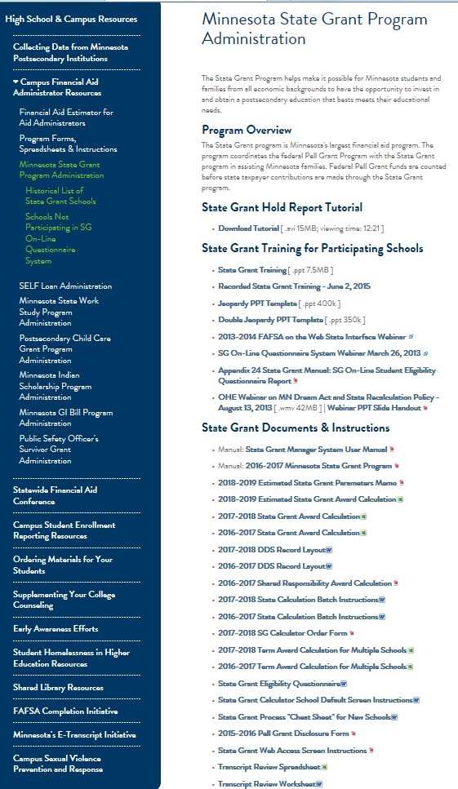
Office of Higher Education Web Sites
Forms for FAAs
State Grant Documents and Instructions

Slide 10
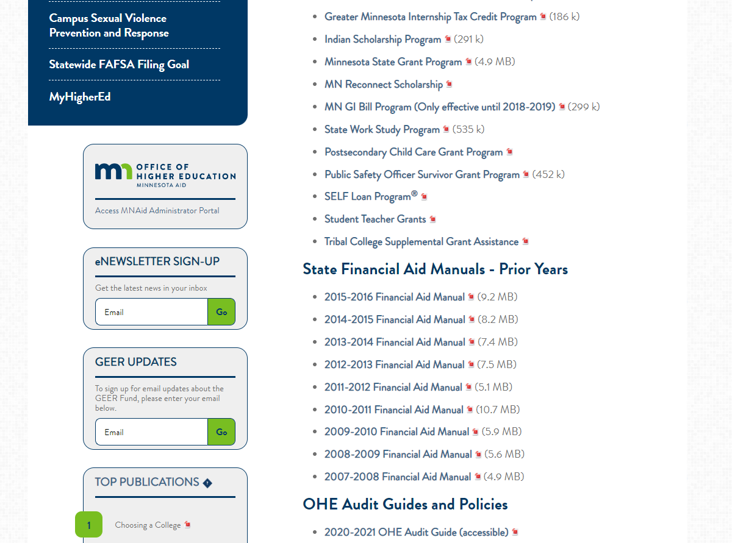
New MNAid System

Slide 11
Office of Higher Education
Grant Unit (651) 642-0567 Option 2
Meghan Flores, State Financial Aid Manager: Manages Team and Programs below Meghan.flores@state.mn.us (651) 355-0610
Adam Johnson: Fostering Independence Grant, MNAid - adam.johnson@state.mn.us (651) 355-0617
Brenda Larter: Work-study, Postsecondary Child Care Grant, Public Safety Officer’s Survivor Grant, Summer Academic Enrichment, Dream Act processing (status of application, payments, and refunds). brenda.larter@state.mn.us (651) 355-0612
Jodi Rouland: Tuition Reciprocity applications, enrollment data collection, eligibility reports, Dream Act processing (status of application) Jodi.Rouland@state.mn.us (651)355-0614
Shannon Olson: SG eligibility questions, SG batch processing, SG fund advances, SG online budget questionnaire Shannon.l.olson@state.mn.us (651) 355-0611
Shawn Reynolds: MN State Grant, MN Dream Act, MNAid OHE FA Estimators shawn.Reynolds@state.mn.us , 651.355.0615

Slide 12
Office of Higher Education
Grant Unit (651) 642-0567 Option 2
Megan FitzGibbon, State Financial Aid Manager: MN Indian Scholarship Programs and manages team and programs below. megan.fitzgibbon@state.mn.us 651.355.0606
Jaquelynn Mol Sletten: Dual Training Grant, Next Generation Certified Nursing Assistant Training, Intellectual & Developmental Disability Grant
jacquelynn.mol.sletten@state.mn.us 651.355.0609
Joanna Moua: Student Teacher Grants, Teacher Shortage Loan Repayment Program, Agricultural Education Loan Repayment Program, Aviation Degree Loan Repayment Program - ***Coming Fall 2022** Aspiring Teachers of Color Scholarship. Joanna.moua@state.mn.us 651.355.0613
Tara Winchester: MN Future Together Grant tara.winchester@state.mn.us 651.355.0616

Slide 13

Application Process

Slide 14
Application Process
Submit Free Application for Federal Financial Aid (FAFSA) to the Central Processing Center (CPS)
Available October 1st each year
  FAFSA on the WEB (FOTW) at www.studentaid.gov
    FAFSA on the WEB requires a valid federal school code
  Download paper FAFSA
2022-2023 FAFSA (July 1, 2022 – June 30, 2023)
2023-2024 FAFSA (July 1, 2023 -June 30, 2024)

Slide 15
Application Assistance
Application and Verification Guide (AVG) of the Federal Student Aid (FSA) Handbook
  Download at: www.fsapartners.ed.gov
FSA Training Center www.fsatraining.ed.gov
Call federal financial aid hotline at (800) 433-3243 or get help on-line at: www.studentaid.gov
Call State Grant Unit at (651) 642-0567 #2 or (800) 657-3866 #1

Slide 16

MN Dream Act Application Process
Undocumented students meeting criteria in MN Dream Act cannot use FAFSA
OHE annually creates a MN Dream Act Application for these students
  **New Application in Beta**
  Modeled after FAFSA on the Web
  Generally available 10/1
  Questions are in English and Spanish
  Uses Prior Year (PPY)
  Does not use FSA ID, will use MNAid login
  100% verification w/ 1040s
www.ohe.state.mn.us/MNDreamAct

Slide 17
State Grant Application Deadline
Original FAFSA/MN Dream Act Application must be received by the federal application Central Processing Center (CPS)/OHE no later than the 30th day of the term
  e.g., September 30th for term starting September 1
  The FAFSA receipt date appears as Application Receipt Date on the Institutional Student Information Record (ISIR) and Student Aid Report (SAR).
  Deadline applies only to ORIGINAL application
    No deadline for corrections
  Missing deadline for one term won’t affect subsequent terms (if deadline met for those terms)

Slide 18
Application Deadlines
The Office of Higher Education (OHE) will reject term payment submitted by school if student didn’t meet application deadline
  OHE collects term start dates from schools within MNAid on School Profile (screenshots later in presentation)
  OHE uses application receipt date on ISIR
If school combines “mini-terms” into one term, term start date is first day of first “mini-term”
State auditors will review term start dates, application receipt dates during audits

Slide 19
Application Deadlines
For clock hour schools and schools with multiple start dates for term, FAFSA application receipt date (or MN Dream Act application submission date) must be within 30 days of date student’s term or payment period starts
  OHE will be unable to verify
  Schools must monitor on campus

Slide 20
Application Deadlines
Application deadline also applies to MN Dream Act financial aid application
  “Orig Application Receipt Date” on MN Dream Act Database
  Must be received by 30th day of term
  Applies to application itself and not supporting documentation (100% verification for MN Dream Act applicants)

Slide 21
Application FAFSA Output
School must use ISIR/SAR to screen for State Grant eligibility
  If school not on Title IV programs, school must use student’s Student Aid Report (SAR) or download from State Grant Manager
SAR is NOT the same as FAFSA on the Web summary screen print
  Should say Student Aid Report
  OHE does eligibility screening centrally for MN Dream Act applicants

Slide 22
Application State Questionnaire
School must collect and / or review supplemental data to determine MN State Grant Eligibility to collect information not on FAFSA
  School may use MN State Grant Student Eligibility form designed by OHE (Appendix 2 of manual) or incorporate questions into institutional form(s)
  This form collected by school and NOT submitted with FAFSA
  MN State Grant Student Eligibility form not required if school has sufficient information from other sources (i.e. 2022 HS Graduate, Dependent student – parents state of legal residence MN).
  Be aware that NSLDS and State Grant Historical databases are not comprehensive sources of previous post-secondary attendance.
Form must only be completed when student first starts
  School responsible for resolving any conflicting information thereafter
Not required for MN Dream Act applicants, since questions built into the application itself
Effective 2013-2014, schools have choice of using FOTW state interface for this purpose

Slide 23
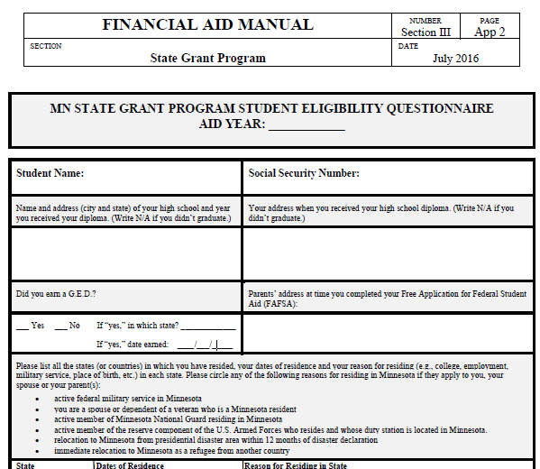
Grant Student Eligibility Questionnaire- App 2

Slide 24
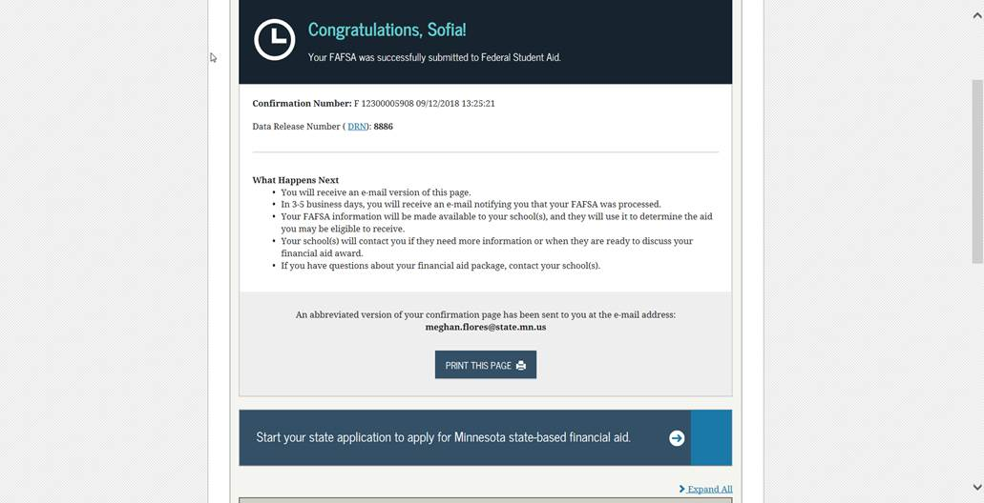

MN Online Student Eligibility Questionnaire
Student must click on MN link on FOTW confirmation page to be redirected to the OHE online questionnaire website.

Slide 25
MN On-Line Student Eligibility Questionnaire
When MN resident student submits the original FOTW, confirmation page will show link/message to access state financial aid application
  Student must list MN as state of legal residence on FOTW to see link on FOTW confirmation page
  Student will receive message on screen about interface when entering ‘MN’ for state of legal residence
  Must be student’s original FOTW, not correction
67% of MN students presented the link completed it using FOTW state interface
  OHE will have secure web site for students to access if they miss the FOTW link (another 31% complete it this way)

Slide 26
MN On-Line Student Eligibility Questionnaire
OHE loads ISIR records each night
Will cross reference on-line questionnaire database to determine if student has successfully completed questionnaire
Will push out email to student with unique link to on-line questionnaire if:
  Student not screened out (see App 24 SG manual); AND
  No on-line questionnaire on file OR
  Incomplete questionnaire on file
Will push out existing on-line questionnaire to any new colleges listed on ISIR

Slide 27
TBD MN On-Line Student Eligibility Questionnaire
If student loses email with unique link to on-line state questionnaire, student can log-in with SSN, name and DOB (as they are on FAFSA) at this site: Link to TBD – process in transition due to MNAid
  Can only access if:
    OHE has loaded student’s ISIR record
      Takes 5 days from original FOTW submission
    Student has not already successfully completed a questionnaire

Slide 28
Participating Schools- View Results
Process is in Transition – will be housed in MNAid
  Select Aid year
  Adjust date range you want to view
  Can view individual student or all students at your school
  Residency status will be confirmed or unconfirmed

Slide 29
Disclosure Statement
Private schools not participating in the Federal Pell Grant program must have students read and sign a disclosure statement
  Informs student s/he won’t be eligible for Federal Pell Grant at that particular school
  Form is Appendix 23 of State Grant manual

Slide 30

Program Eligibility Requirements

Slide 31
Eligibility Screening
School is responsible for verifying students meet all State Grant program eligibility requirements
School financially liable for disbursements to ineligible students

Slide 32
U.S. Citizen or Eligible Non-Citizen
For terms starting after July 1, 2013:
  No longer a requirement for students to be a U.S. citizen or eligible non-citizen
However, students must be lawfully present to meet one of the state residency criteria (except MN Dream Act)
  “Lawfully present” means:
    Citizen or eligible non-citizen
    Undocumented students granted Deferred Action for Childhood Arrivals (DACA), TPS, VISA holders, Political Asylum pending

Slide 33
Minnesota Resident
M.S.136A.101, Subd. 8
Meet ONE of the following criteria:
  Student who graduated from MN high school while residing in MN (must be physically attending college in MN if residing in another state*); OR
  Student who earned GED in MN after residing in MN for one year; OR
  Dependent student whose parents resided in MN when FAFSA completed; OR
  Student who resided in MN for 12 consecutive months without being enrolled for 6 or more credits in any term
*Restriction on distance education applies ONLY if graduating from a MN high school is the ONLY way a student can establish MN residency

Slide 34
Continued- Minnesota Resident
M.S.136A.101, Subd. 8
A member (or spouse or dependent of) of the armed forces of the U.S. stationed in MN on active federal military service as defined in MS 190.05, Subd. 5c; or
A spouse or dependent of a veteran who meets the residency requirement; or
A person (or spouse of) who relocated to MN from an area that is declared a presidential disaster area within the preceding 12 months, if the disaster interrupted the person’s postsecondary education; or
A person defined as a refugee under US Code, Title 8, section 1101 (a)(42) who upon arrival in the US, moved to MN and has continued to reside in MN; or

Slide 35
Continued- Minnesota Resident
M.S.136A.101, Subd. 8
Effective August 1, 2015, the following individuals are also considered MN residents:
  An active member (or spouse or dependent of) of the state’s National Guard who resides in MN
  An active member (or a spouse or dependent of) of the reserve component of the U.S. armed forces whose duty station is located in Minnesota and who resides in Minnesota
  Template letter for verifying active membership in MN National Guard or Reserves (Appendix 26)

Slide 36

Minnesota Resident MN Dream Act
M.S. 135A.043
A person eligible for resident tuition rates under 135A.043 AKA the MN Dream Act
Requirements:
Attend a MN high school for at least 3 years
Graduate from a MN high school or earn a GED in MN
If male, complied with Selective Service registration requirements
Apply for lawful immigration status if a federal process becomes available (does not refer to Deferred Action for Childhood Arrivals/DACA)
  This requirement not yet enforced, since federal process does not yet exist

Slide 37

Minnesota Resident Agency Policy
Student who resided in MN for 12 consecutive months without being enrolled for 6 or more credits in any term
  Does not have to be initial year student lived in MN
  Residency established this was is lost if student later leaves MN for more than 1 year (unless for college, military, missionary service and still file taxes in MN)
  Does not apply to GED recipients

Slide 38
Minnesota Resident Agency Rules
Independent student who originally met residency requirement as dependent because parents resided in MN when FAFSA completed grandfathered once independent if continues to live in MN (4830.0100 Subp. 10E)
Families not penalized for leaving MN to attend college or serve in military or missionary service if still paying taxes in MN (4830.0400 Subp. 2a.)

Slide 39
MN Resident
Graduated from MN high school, lives in Eau Claire, WI and drives to classes at Century College in MN. Yes- if attending in person. No, if was distance education & only way to meet residency requirement was graduating from MN HS.
Graduated from MN high school, lives in MN, taking only distance education classes from MN college. Yes- living in MN, so mode of delivery doesn’t matter
First moved to MN on June 1, 2011. Attended U of M full-time from January 23, 2012 to December 31, 2012. Moved from MN on November 1, 2013, to work in another state. Returned to MN on June 14, 2015 and attended U of M full-time during 14-15 aid year. Is this student a resident for 15-16? No
Dependent student first moved to MN after high school graduation in Colorado. Parents divorced. Mother stayed in CO, but father moved to MN. Mother’s income provided on FAFSA. No

Slide 40
Additional Requirements
Student must be 17 years old OR a H.S. graduate/GED recipient
  No state ability-to-benefit requirement
  Cannot award State Grant to student in high school
Student cannot receive MN State Grant AND receive tuition reciprocity benefits from neighboring state
  Affects only public colleges in MN
  Will be more beneficial for student to turn down reciprocity if attending MN campus that no longer charges non-resident rates

Slide 41
Enrollment in Eligible School
Must be enrolled for 3 or more credits/6 clock hours per week @ a clock hour school
In program leading to diploma, certificate or degree
  Minimum program length is 8 weeks long and 300 clock hours or 12 credits
No requirement that student be accepted in program at each MN school, just one eligible MN school

Slide 42
Satisfactory Academic Progress
Same as Title IV satisfactory academic progress policy
  Qualitative Component
    GPA requirements
  Quantitative Component
    Timely completion of program
On-line tutorial at: FSA Training Center (ed.gov)

Slide 43
Satisfactory Academic Progress
GPA component
  Identical to Title IV GPA requirements
  Prior to end of 2nd academic year, student must meet school’s GPA requirements
  Like Title IV policy, student must have GPA of 2.0 or academic standing consistent with school’s graduation requirements at end of 2nd academic year and thereafter
    This means GPA can be below 2.0 if school’s graduation requirements have a lower GPA standard
    “Academic year” means school’s definition of academic year for federal financial aid programs
      Typically, two semesters or three quarters

Slide 44
Satisfactory Academic Progress
Timely Completion Component
  State SAP policy is identical to Title IV policy for timely completion
  School must define maximum time frame for program completion
    At minimum, cannot exceed 150% of published program length
    For example, 6 academic years to complete 4 year program
      (4 X 1.5 = 6)
    School can have stricter policy than 150%

Slide 45
Satisfactory Academic Progress
Timely Completion Component
  To determine percentage of courses student must complete to meet timely completion component, divide program length by 150% of program length
    Example: 4 years divided 6 years = 67%
  Clock hour schools should set policy based on scheduled hours completed within a given timeframe

Slide 46
Satisfactory Academic Progress
Check Points/Increments
  Program must be divided into equal evaluation periods or increments (i.e. Semester)
  Increment cannot be longer than half the program or one 9-month academic year
  Clock-hour schools may use federal payment periods to check SAP

Slide 47
Satisfactory Academic Progress Definitions
Financial Aid Warning: A status a school assigns to a student who is failing to make satisfactory academic progress. The school reinstates eligibility for aid for one payment period and may do so without a student appeal. This status may only be used by schools that check SAP at the end of each payment period
Termination, Loss of Eligibility, Suspension – Determined that student is not making Satisfactory Academic Progress, resulting in loss of Title IV eligibility.
Appeal: A process by which a student who is not meeting SAP standards petitions the school for reconsideration for Title IV eligibility.
- FSA Handbook 21-22 Chapter 1 School Determined Requirements

Slide 48
Satisfactory Academic Progress Definitions
Financial Aid Probation: A status a school assigns to a student who is failing to make satisfactory academic progress and who successfully appeals. Eligibility for aid may be reinstated for one payment period.
  Academic Plan: If determined, based on the appeal, that the student will require more than one payment period to meet progress standards, you place him on probation and develop an academic plan for the student. You must review the student’s progress at the end of one payment period.
- FSA Handbook 21-22 Chapter 1 School Determined Requirements

Slide 49
Satisfactory Academic Progress
Warning vs. Probationary Period
If school checks SAP each term:
  Students not making SAP can be placed on financial aid warning and receive financial aid for one term
  If still not making SAP, lose aid eligibility unless they successfully appeal (professional judgment due to special circumstance) and are placed on probation for one term. If it will take multiple terms to get off of probation, student can be placed on an academic plan.
If school checks SAP each academic year:
  Student can only be placed on probation and receive financial aid if based on professional judgment appeal for special circumstances
    Must re-check at end of next term

Slide 50
Undergraduate Program
Student must be in undergraduate program and not have bachelor’s degree
  Bachelor’s degrees earned at foreign schools still count as bachelor’s degrees
  Student can take graduate level classes as long as student enrolled in undergraduate program

Slide 51
Amount of Post-Secondary Education
Student ineligible once enrolled for the equivalent of 8 full-time semesters of postsecondary education
  OHE MNAid System only tracks units of State Grant PAID
  Schools must request and review academic transcripts for students who indicated at least 3 or more years of postsecondary education on the State Grant Student Eligibility Questionnaire
    Includes attendance at current campus
  NSLDS student loan history on SAR/ISIR is another possible resource of previous attendance

Slide 52
Reviewing Academic Transcripts
Separate transcript from each school -does not need to be official transcript
School can make good faith effort to assign units when transcript lacks information needed to make accurate determination
  Course work not separated by term, no start or end date, no credits shown for any course work
  If course shows grade of ‘W’ with no attempted credits, use assumed value of 4 credits (unless all other classes show otherwise)
Written statement from student reconstructing history when transcript can’t be obtained due to school closure, destruction of records, civil war, etc.

Slide 53
Reviewing Academic Transcripts
Can’t use if school holding transcript due to unpaid bill
However, FERPA and MN Data Practices Act allow student to inspect education records
Voluntary waiver of SG & CCG form if can not obtain transcript (Appendix 25) -
*New MN Transcript Access Law* -
College must not refuse to provide a transcript if:
  Debt owed is less than $250
  Student has entered into and, per by the college, is in compliance with a payment plan
  The transcript request is made by a prospective employer
  The schools has sent the debt to Department of Revenue or to a collection Agency
  Remember that reviewing Academic Transcripts is a MN State Grant Requirement – not always a Requirement of Federal Student Aid

Slide 54
Reviewing Academic Transcripts
ALL course work counts EXCEPT:
  ***Developmental Education or below college-level coursework taken on or after 07/01/2021.
  Term during which student withdrew for active military service after December 31, 2002
  Term during which student withdrew due to serious health condition for themselves or family. Appeals directly to the college / university and notifies MN OHE.
  Courses taken during high school under the Post-Secondary Enrollment Options (PSEO);
  CLEP/AP course work (tests out of class w/o attending);
  ‘FN’ grade at MinnState campus (failed - never attended)

Slide 55
Reviewing Academic Transcripts
ALL course work counts EXCEPT:
  Programs under 8 weeks in duration (or under 300 clock hours- Nursing Assistant);
  Course work not offered by a post-secondary school (e.g., Red Cross training, Military Training) even if a college later grants college credit for the training;
  Course work or training assigned –CEUs (continuing education units);
  Courses the student audited;
  Course work at Minnesota schools not participating in the State Grant Program and from which no course work transferred to the current school. Historical list of State Grant schools on OHE web site http://www.ohe.state.mn.us/mPg.cfm?pageID=1406

Slide 56
Reviewing Academic Transcripts
Be sure to include:
Unaccredited or non-transferable course work
Course work completed outside the U.S. or in other states,
Course work taken at a post-secondary school during military service (as opposed to military training)
Courses with grades of “F,” “NC,” “W,” “I”, “FW” (unless student withdrew for active military service after 12/31/2002 or serious health condition for the student or while providing care for a family member that limited student’s ability to complete)

Slide 57
Reviewing Academic Transcripts
Be sure to include:
Remedial course work credit equivalencies, taken prior to 07/01/2021.
Independent study courses
Course work taken during a term for which the student was not eligible for a State Grant (e.g., missed application deadline, not eligible at student’s enrollment level, etc.)
Use Appendix 7 of State Grant Manual or Transcript Review Spreadsheet to review transcripts and record units [hand out copy of spreadsheet and sample case]

Slide 58
Units of Postsecondary Education
(Units Shown for Full-Time Enrollment)
Quarter System |  |  | Units per Acad Year | Semester System
8 | 8 | 8 | = 24 = | 12 | 12
8 | 8 | 8 | = 24 = | 12 | 12
8 | 8 | 8 | = 24 = | 12 | 12
8 | 8 | 8 | = 24 = | 12 | 12
Cutoff if current college is on quarter system = 94.4 |  |  | 96 units = 8 FT semesters | Cutoff if current college is on semester system = 93.6
Student ineligible if units EXCEED cutoff. If units are at or under the cutoff, student can continue to be paid State Grant for any enrollment level until units cutoff is exceeded.

Slide 59
Units are Based on Term Enrollment Level
(Full-Time Definition Changed from 12 to 15 Credits July 1, 1992)
Pre-July 1, 1992 Course Work QTR SEM 12+ credits 8 12 9-11 credits 6 9 6-8 credits 4 6 1-5 credits bank* bank* *total credits in each bank divided by 12 to determine the number of full-time quarters or semesters Example: 18 Qtr credits / 12 = 1.5 FT quarters 1.5 X 8 units = 12 units | Post-July 1, 1992 Course Work QTR SEM 15+ credits 8 12 14 credits 7.5 11.2 13 credits 6.9 10.4 12 credits 6.4 9.6 11 credits 5.9 8.8 10 credits 5.3 8.0 9 credits 4.8 7.2 8 credits 4.3 6.4 7 credits 3.7 5.6 6 credits 3.2 4.8 5 credits 2.7 4.0 4 credits 2.1 3.2 3 credits 1.6 2.4 2 credits 1.1 1.6 1 credit .5 .8

Slide 60
Transcript Review Tool

Slide 61
Reviewing Clock Hour Transcripts
To determine the amount of post-secondary education at a progressive clock hour school (other than your school):
  Divide total number of clock hours in program by number of weeks in program to get average hours per week
    Determine enrollment level based on average hours per week
  Divide number of weeks in program by 12 to get approximate number of quarters in program
  Determine units of post-secondary education by multiplying the number of quarters in program by the units for enrollment status
Assume continuous enrollment without breaks unless the transcript states otherwise (approved Leave of Absence (LOA))
If total clock hours do not appear on a cosmetology transcript, assume these total hours: Cosmetology = 1,550 hours, Barbering = 1,500 hours, Esthetician = 600 hours, and Nail Tech = 350 hours

Slide 62
Enrollment Status at Clock Hour School

Slide 63
Reviewing Clock Hour Transcripts
Example:
Period of Enrollment was 9/1/89 to 8/26/90 = 51 weeks
Total Hours Completed = 1550
Average Hours Per Week = 1550/51 = 30
Assumed Enrollment Status = full-time
Number of Quarters in Period = 51/12 = 4.25
Number of PSE Units = 4.25 x 8 units = 34 units
  Enter the info above in the transcript review tool

Slide 64
Federal Student Loan Default
Students in default of federal loan not eligible for State Grant
When FAFSA processed, interface run with NSLDS database
  Students in default have indicator on SAR or ISIR
**Fresh Start Program for Defaulted Loans**
Regaining eligibility extended retroactively to current aid year for State Grant

Slide 65
Default on SELF Loan
Student not eligible if defaulted on SELF loan
  Does NOT affect eligibility for federal aid
If loan not in collections, eligibility regained by paying off loan or making 4 to 6 monthly payments
  Eligibility retroactively extended to beginning of current aid year
If loan is in collections, must fully repay to regain eligibility
Regular interface run between SELF and State Grant databases at OHE
  OHE notifies schools via State Grant on-line hold report, which can be viewed via MNAid Hold Reports and Student Quick View

Slide 66
Child Support Hold
Student not eligible if 30+ days in arrears on child support obligation
Student regains eligibility by paying off past due amount or complying with monthly payment plan approved by caseworker
  Eligibility retroactively extended to beginning of current aid year
Weekly interface run between Department of Human Services (DHS) and State Grant database at OHE
  OHE notifies schools of holds via the MNAid online hold report.
Students should be referred to county

Slide 67
Eligibility Notification
Student loses eligibility as of month/year student placed on hold (regardless of when school notified)
School liable for overpayment if school paid AFTER receiving notification student on hold
OHE notifies school via MNAid within the Hold Report and the student Quick View

Slide 68
Eligibility Screening Tools
FAFSA output – ISIR or SAR
SG Student Eligibility Questionnaire
Documentation at school (transcripts, admissions forms, etc.)
MNAid System
MN Hold and >72 Unit Report
Appendix 6 of manual has a full list of all State Grant eligibility requirements in a chart format

Slide 69
Eligibility Screening
State Grant On-Line Hold Report
  OHE downloads ISIRs each night
  Data written to school’s on-line hold report each night if:
    Student has new hold/warning or released hold; and
    School listed on ISIR or DDS record previously submitted by school
  School notified via email if data added/revised
  School can print comprehensive report or alter date range to select only new/revised records
  Does not include MN Dream Act applicants

Slide 70
Eligibility Screening
Hold data displayed on report:
  Child support arrears
  SELF loan default
  Units of State Grant PAID through current year
  Previous State Grant Overpayment (rare)
  Continuously monitor the hold reports- students can have a hold, have it removed and go back on hold within the same aid year

Slide 71
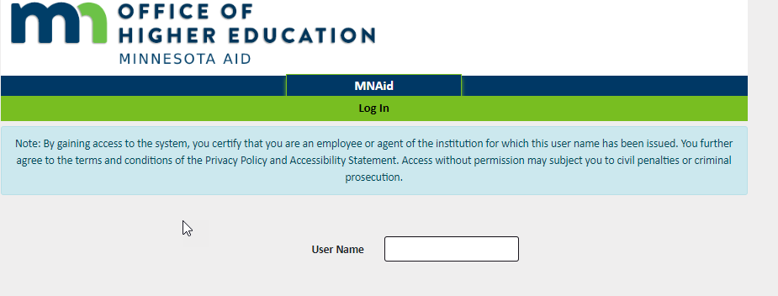
MNAid System
MNAid System Login (guarantorsolutions.com)
School’s designate financial aid staff members who need access to the MNAid system. Those staff members are assigned a username, password, and a designated role within the MNAid system.

Slide 72
MNAid System
Student Quick View can be used to determine:
  Holds (child support arrears, SELF default, federal loan default, State Grant overpayment)
  Units of State Grant payments (just payments, not attendance)
  Awards and payments for current year
School must be listed as college on student’s current ISIR in order for school to access State Grant database

Slide 73
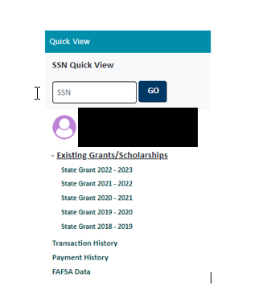
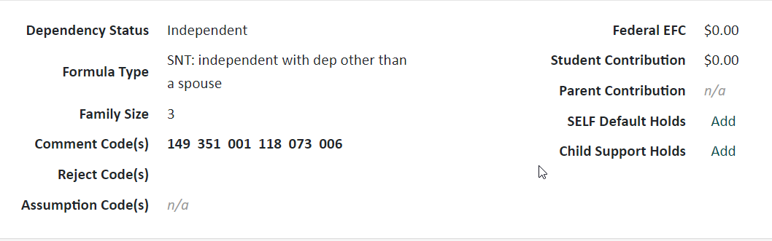

Student Look-up - Holds Review –Total Units

Slide 74
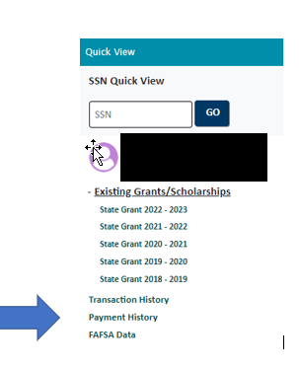
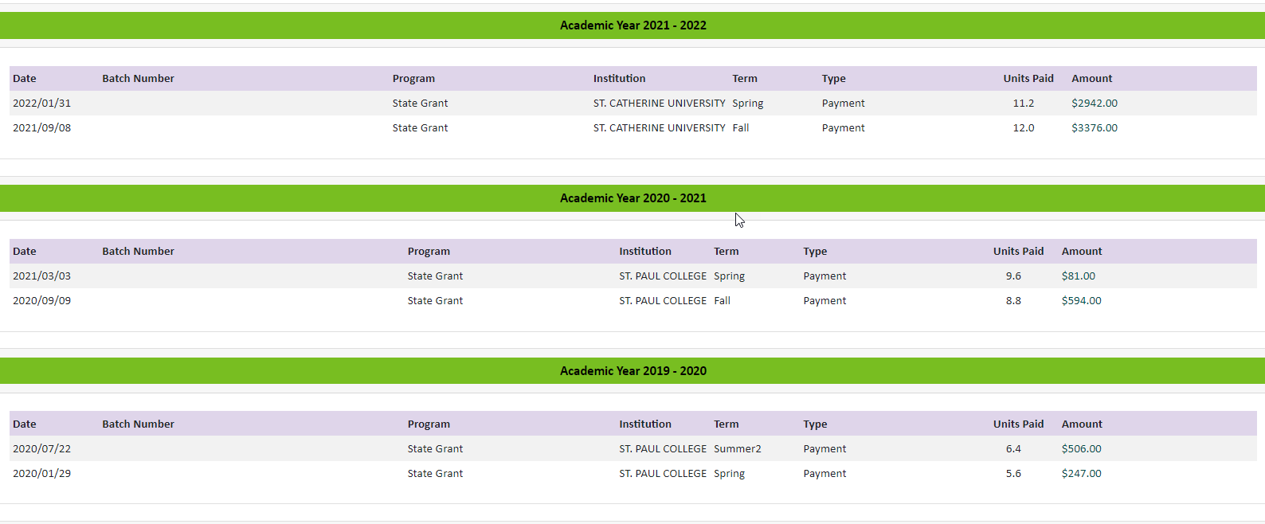
Student Look-up - Payment and Unit History

Slide 75
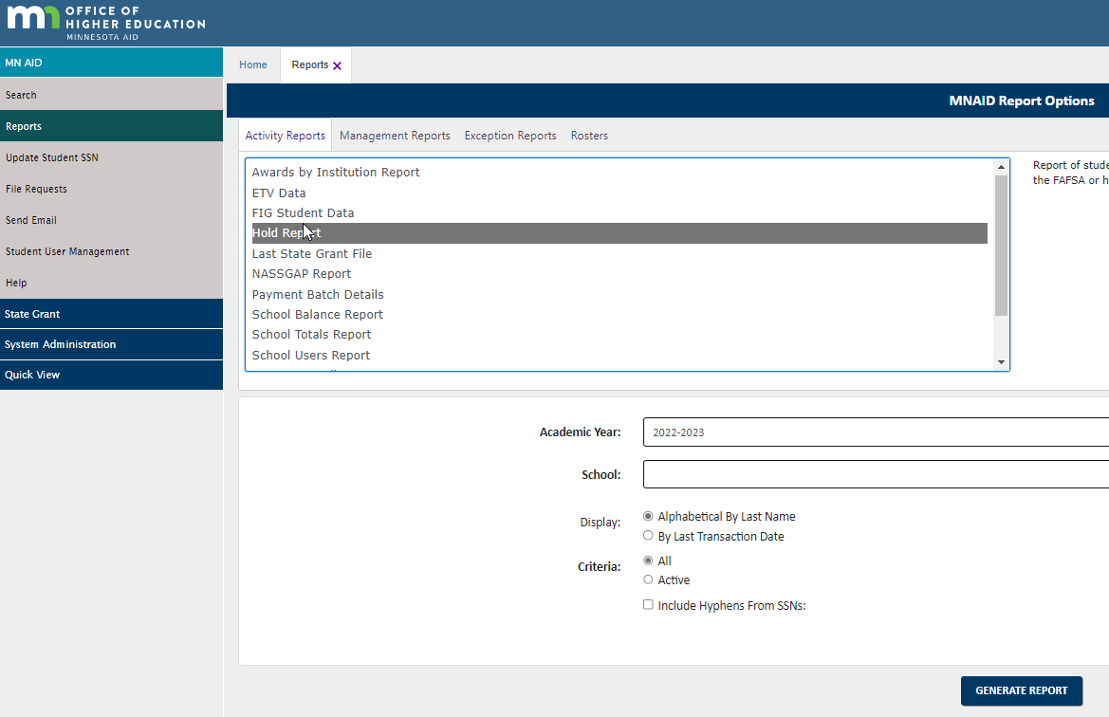
MNAid Holds Report

Slide 76
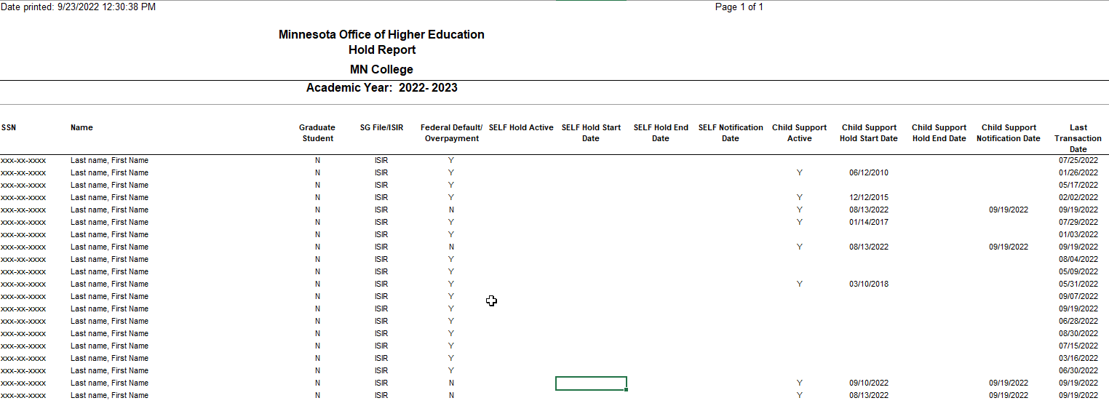
Student Look-up and Holds Review

Slide 77
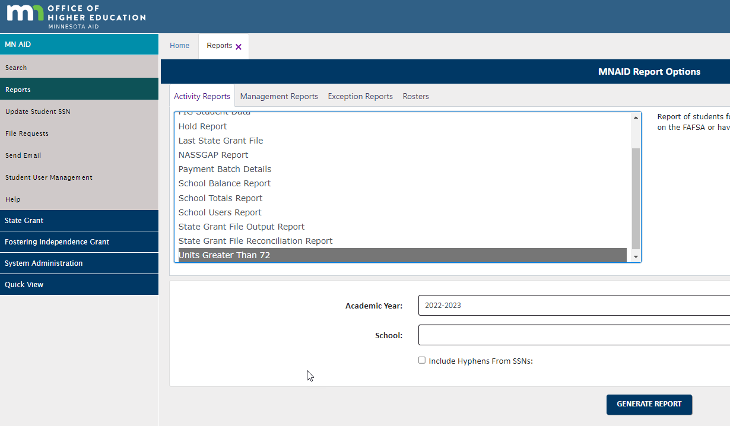
> 72 Units Report Reports

Slide 78
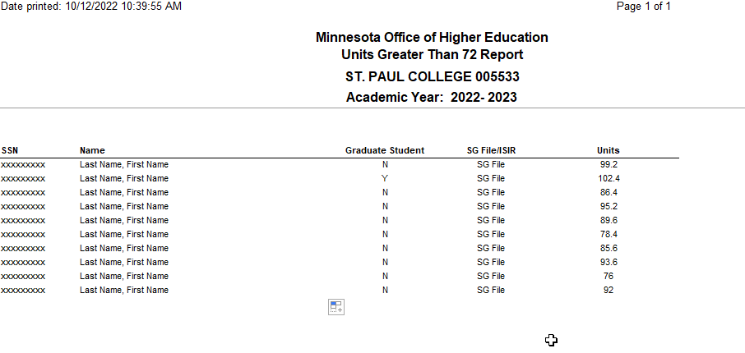
> 72 Units Report Reports

Slide 79

Verification

Slide 80
Verification
Must verify certain items reported on FAFSA if selected for verification
Text of student’s SAR will indicate if application was selected for verification, as will Verification Flag = Y shown under ‘For Financial Aid Office Use Only’
  SAR will also have asterisk following the EFC if selected for verification
ISIR record will indicate if the application was selected for verification
OHE will perform verification for ALL MN Dream Act state financial aid applicants (100% verification)

Slide 81
Verification
School must use federal guidelines and forms for verification (even if not participating in federal aid programs)
2022-2023 Federal Student Handbook Verification *** WAIVED***
Verification, Updates, and Corrections | 2022-2023 Federal Student Aid Handbook
V-1 Standard Verification Group
Adjusted gross income (AGI), U.S. income tax paid, Education credits
Household size, Number in college
Income earned from work
Untaxed portions of IRA distributions , Untaxed portions of Pension, IRA deductions and payments
Tax-exempt interest income
V-4 Custom Verification Group
Identity/statement of educational purpose
  School liable for any overpayments if verification not performed
Must resolve Comment Codes (“C” Codes) on ISIR – prior to disbursing funds. “C” codes indicate that there are problems the student or school must resolve.
Examples: SSN / Identify mismatch, Defaulted Loans, Overpayments,

Slide 82
Conflicting Information
School also responsible for resolving any conflicting information on student’s financial aid application and other documentation collected by the school. Must have adequate internal system to identify conflicting information regardless of source and regardless of whether the student was selected for verification.
Sources of Conflicting Information
  Internal – FA Office / Other Offices within Institution
  External – Scholarship, DOE website, etc

Slide 83
Conflicting Information Examples
Example 1: Student reported not having a high school diploma, but reports having a high school diploma on FAFSA.
Example 2: Student reports being married as of 03/01/2019 on the FAFSA, but during verification you find that he/she filed as head of household on her 2020 taxes.
Example 3: Student reported not filing taxes, but reported having earnings above the minimum threshold required to file taxes.
Example 4: Dependent siblings attending the same college, family size of 4, two in college with same parents, but different parent income for each sibling.

Slide 84
Professional Judgement

Slide 85
Professional Judgment
Schools must use Title IV guidelines for professional judgment
  Federal Student Aid Handbook – Application and Verification Guide Special Cases | 2022-2023 Federal Student Aid Handbook is a resource
Adjustments must be based on unusual circumstances that can be adequately documented, preferably by someone outside the family
Adjustments must be done on a case-by-case basis and not applied to a broad class of students

Slide 86
Professional Judgement
Common examples include:
Significant change in income from past tax year based on unemployment, underemployment, death, divorce, military service or natural disaster
Unusually high medical expenses
Nursing home expenses
Elementary or secondary school tuition
Significant college costs for dependent student’s parent attending college
Dependency override
Family should contact financial aid administrator to discuss unusual circumstances

Slide 87
Professional Judgement
Dependency override allows dependent student to apply as independent
  Examples: Left parental household due to abuse, inability to locate parents
Dependency override should not be done merely because:
  Parents unwilling to complete FAFSA
  Student lives independently of parents after graduating from high school
Aid administrators can use professional judgment to adjust the cost of attendance used for state campus-based programs, such as State Work Study, but NOT State Grant budget

Slide 88
Professional Judgment
Aid administrators cannot use professional judgment to override a State Grant Program eligibility requirement (e.g., application deadline, residency, citizenship, etc.).
Can adjust financial data elements to end up with different EFC but cannot make bottom-line change to EFC
OHE will perform professional judgment adjustments for undocumented students completing the MN Dream Act application

Slide 89



Break Time

Slide 90

State Grant Enrollment Levels

Slide 91
State Grant Enrollment Levels
Average % of Full-Time
Credits Clock Hours Enrollment State Grant
Per Term Per Week Level Budget Used
15+ 30+ Level 15 100%
14 28-29 Level 14 93.3%
13 26-27 Level 13 86.7%
12 24-25 Level 12 80.0%
11 22-23 Level 11 73.3%
10 20-21 Level 10 66.7%
9 18-19 Level 9 60.0%
8 16-17 Level 8 53.3%
7 14-15 Level 7 46.7%
6 12-13 Level 6 40.0%
5 10-11 Level 5 33.3%
4 8-9 Level 4 26.7%
3 6-7 Level 3 20.0%

Slide 92

State Grant Award

Slide 93
State Grant Award Notice
School must calculate the student’s State Grant award on campus and notify student
  OHE performs this function for MN Dream Act applicants; however, schools should incorporate the award into their campus financial aid award letter as well.
Award notice should indicate that State Grant will vary based on enrollment level
Shared Responsibility formula is used to calculate award
Shared Responsibility formula is described in text of State Grant Manual and Appendices 8 and 9

Slide 94
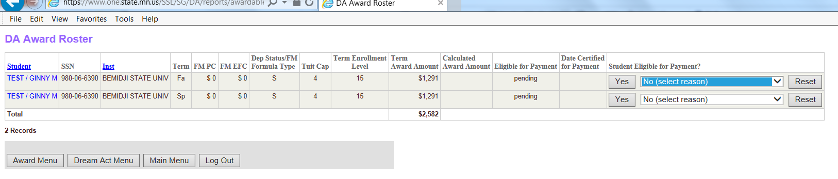
MN Dream Act State Grant Award Roster Screen

Slide 95
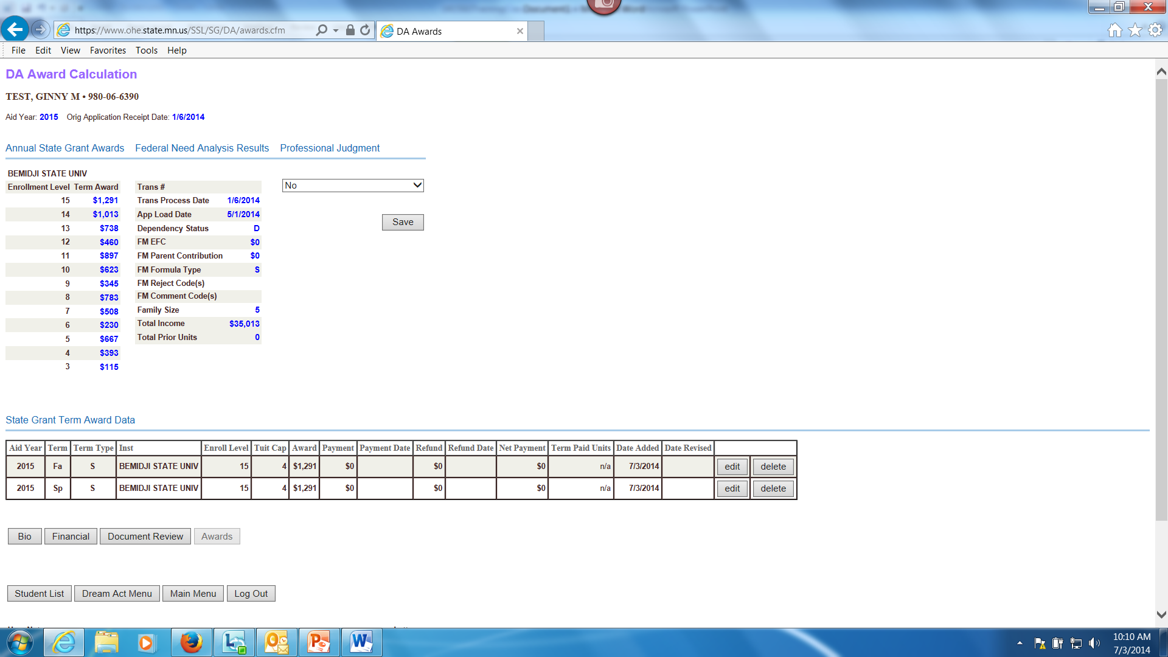
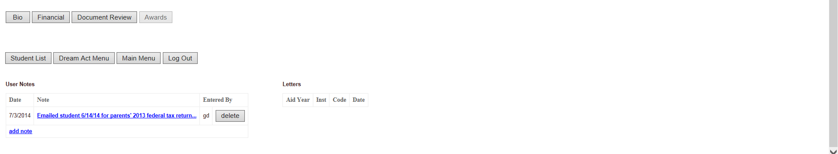
MN Dream Act State Grant Student Award Screen

Slide 96
Design for Shared Responsibility
2022-2023 Annual Award Calculation
Average Tuition & Mandatory Fees* (30 sem/45 qtr credits)
+ Living and Misc Expense Allowance (LME)** ($11,418)
= State Grant Budget
50% Assigned Student Responsibility
Annual 9-month FM PC (dependent) X .79
Annual FM EFC X .71 (independent with deps) or
Annual FM EFC X .35 (independent w/o deps)
Pell Grant Award***
= State Grant Annual Award (minimum $100)
*Subject to tuition & fee caps: $16,106 for 4-yr program; $6,484 for 2-yr or less program
**LME $0 for those in correctional facility
***From 2022-2023 Federal Pell Grant Disbursement Schedule. Amount based
on student’s EFC. Amount subtracted even if student not actually receiving Pell.

Slide 97
Award for Non-Standard Term
“Non-standard” term means semester less than 15 weeks or quarter less than 10 weeks
Award for non-standard term is same as award for standard term
  No adjustments required for shorter term length

Slide 98
Award for Full Fiscal Year
Student may receive State Grant for up to 4 full-time quarters or 3 full-time semesters during a fiscal year
  This translates into 60 quarter credits or 45 semester credits in a fiscal year
Term with 15 or more credits only counts as 15 credits
If student transfers to another school, the new school must limit payment to stay within these credit limits

Slide 99
Fiscal Year Award Limitation for Transfer Student
Example of Transfer Student
Student completes 17 semester credits at School A
Student transfers to School B, which is on the quarter system
School B must translate 15 semester credits to 22.5 quarter credits (15 X 1.5)
(17 credits only counted as 15)
School B can only award the student for the remaining 37.5 quarter credits of eligibility for the aid year

Slide 100
Award for 4th Quarter or 3rd Semester
State Grant award for student’s 4th quarter or 3rd semester within fiscal year is calculated in the same manner as for other terms
Pell Grant student would be eligible to receive for 4th quarter or 3rd semester is subtracted in the State Grant award calculation
  Beginning with summer 2018, “year round” Pell. Students can receive up to 150% of their scheduled Pell award each year.

Slide 101
Attending Multiple Schools
Student can receive separate State Grants at multiple MN schools during the same term based on the cost and credits at each school attended
Can’t receive payment for more than 15 credits per term
  School that reports payment that exceeds 15 credits will have payment rejected by OHE
  School must recalculate payment for enrollment level of remaining credits. Example:
    School A pays for 12 credits and has payment accepted
    School B pays for 6 credits and has payment rejected
    School B must recalculate State Grant to Level 3 instead of Level 6

Slide 102
Attending Multiple Schools
When calculating awards at separate schools for the same term:
  Each school must use the average tuition and mandatory fees, appropriate tuition and fee maximum, and LME for the student’s enrollment level at that school
Example of the award calculation for a student attending two schools for the same term can be found as Example 7 in Appendix 9 of State Grant manual

Slide 103
Combining Credits at ‘Home School’
One eligible MN school may act as the ‘home school’ and base student’s award on the costs for combined credits at both schools
A consortium agreement is not required as long as both schools are eligible MN schools
  However, home school must monitor student’s enrollment at other school to determine if student withdraws or is making satisfactory progress

Slide 104
Combining Credits at ‘Home School’
“Home school” must add the average tuition and fees charged at both schools for up to 15 credits per term
  Home school can use its own tuition and fees if the other school is within the same system (MNState, U of M, Private 4-year, Private 2-year)
  The lesser of the tuition and fees or the applicable tuition and fee maximum for the student’s degree program must be used in the award calculation
LME used in State Grant award calculation cannot exceed the full-time LME for 15 credits
Example award calculation can be found as Example 8 in Appendix 9 of the State Grant manual
  Multiple school award calculation spreadsheet available at: www.ohe.state.mn.us

Slide 105
Attending Multiple Schools
A student cannot receive a State Grant at an ineligible school unless the school has a consortium agreement with an eligible MN school and the student is accepted into a degree, certificate or diploma program at the eligible MN school
  The eligible MN school must act as the ‘home school’ and award the State Grant

Slide 106
Crossover Term Award
Overlaps fiscal years (starts before and ends after July 1st)
Award may be funded from either aid year
  Decision on which aid year’s FAFSA to use can differ on student-by-student basis
  Must match aid year selected for Federal Pell Grant
  Considerations:
    Which year’s FAFSA might yield the highest State Grant award?
    Has the student met the application deadline for both years?
    Has the student already been awarded for 3 FT semesters or 4 FT quarters for the current aid year?
Laws, regs and policies for aid year selected apply

Slide 107

Disbursement

Slide 108
Initial Funds Advances
Initial State Grant File is uploaded and school and OHE can review the State Grant File Output to verify award amounts. Once awards are verified schools can begin requesting funds
Plan accordingly for peak processing time; it can take 1-2 business days to review and begin pushing out funds
Be sure to closeout previous aid year

Slide 109
Initial Funds Advances
State Grant funds advanced to schools via paper check or EFT transaction
Schools cannot receive funds more than 14 days before term start date – hard coded into MNAid School Fund Request Process
OHE limits advances to the amount of total awards for term in most recent DDS batch
Advances held if school missed close out deadline for prior year or not meeting monthly reporting requirements

Slide 110
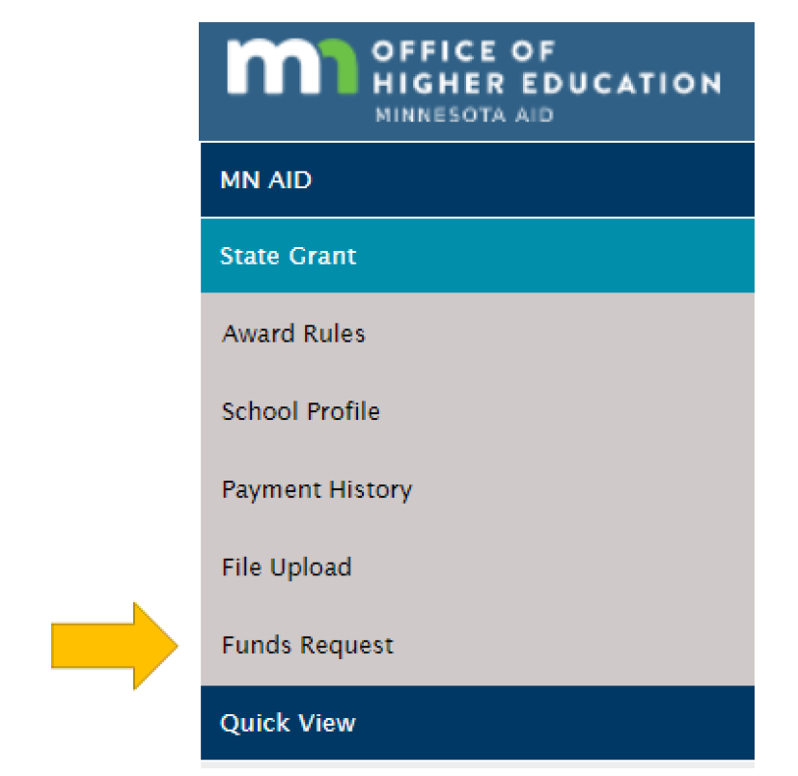
State Grant Funds Request
Request funds using the MNAid System -Login (guarantorsolutions.com)

Slide 111
State Grant Funds Request
Request funds using the MNAid System -Login (guarantorsolutions.com)

Slide 112
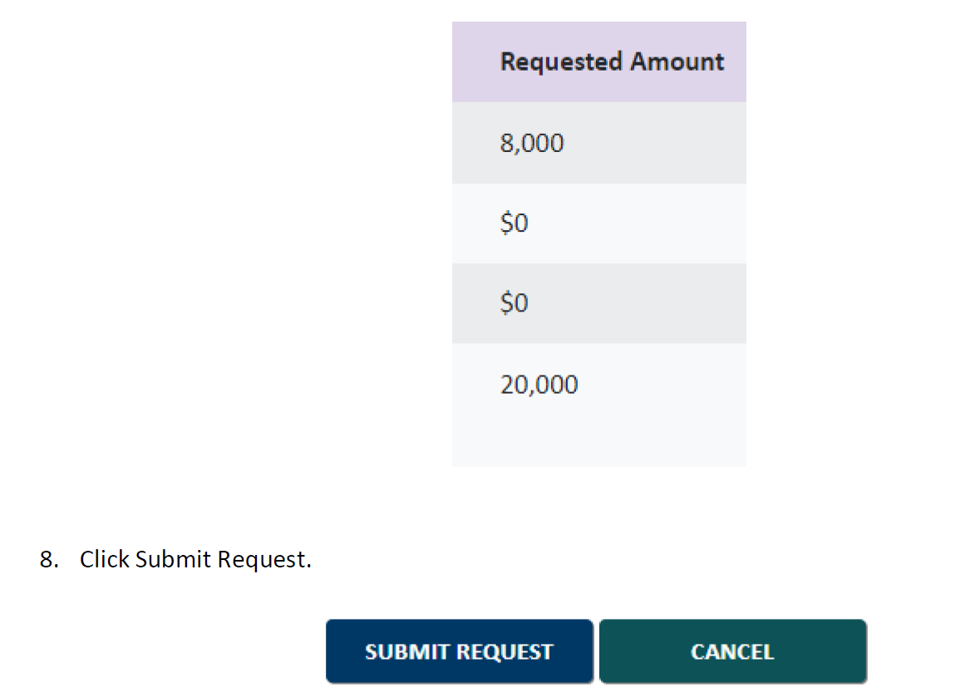
State Grant Funds Request
Request funds using the MNAid System -Login (guarantorsolutions.com)

Slide 113
How Funds Disbursed
State Grant funds must be maintained in separate account or in a manner that allows auditors to adequately track funds
Interest earnings must be used to offset State Grant administrative costs
Schools can disburse State Grant funds to students using any of the following methods:
  by check directly to the student
  by check mailed to the student
  applying funds to the student’s account
  transferring funds via EFT

Slide 114
MN Dream Act State Grant Funds
OHE will send separate State Grant funds via EFT for MN Dream Act recipients
  OHE will email school when funds are sent
  These recipients not included in DDS batches or DDS funds advances
Accompanying payment roster can be generated by school on MN Dream Act system
School can return refunds at end of term using OHE Refund Return Form

Slide 115
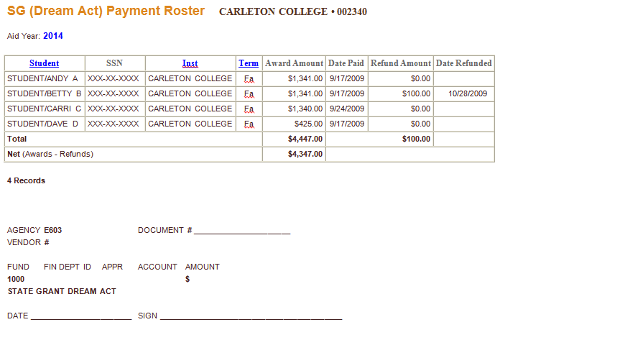
MN Dream Act State Grant Funds

Slide 116
When Funds are Disbursed
School may not disburse funds to a student until the student is registered for a term
  If Disbursing prior to term start, disbursement date is considered to be the first day of the term
If student does not attend, funds must be returned
If school posts State Grant payment with own funds prior to beginning of fiscal year
  Liable for any overpayments related to changes in eligibility requirements, enrollment level, etc.

Slide 117
Disbursement Date
If funds disbursed after term starts, disbursement date is:
  date funds are applied to student’s account or applied to tuition charges; or
  for funds mailed to student or transferred via EFT, date of check or EFT transaction,
  for funds disbursed directly to student via check, date student picks up the check
State Grant payment must always be based on student’s enrollment status AS OF THE DATE OF DISBURSEMENT

Slide 118
Late or Retroactive Disbursement
Can pay late in term or retroactively for completed term (even if student not currently enrolled) if student:
  met the application deadline for the term in question
  currently meets all other program eligibility requirements
Payment must be based on student’s enrollment status for term as of the date of disbursement
  Classes with passing grades or grades of “F,” “NC,” or “I” CAN be included when determining enrollment status as of the end of the term
  Classes with grades of “W,” “FW” or “FN” CANNOT be counted

Slide 119
Student Authorization
School must obtain written authorization from student allowing school to disburse State Grant funds via EFT or to hold excess funds on student’s account
  School cannot require student to authorize these activities
Authorization is provided for one academic year and can be used for future years if school notifies student and offers opportunity to rescind authorization

Slide 120
Student Authorization
Unless otherwise authorized by student, any excess state financial aid funds on student’s account beyond institutional charges must be disbursed to student within 14 days of the later of:
  the date the balance occurs; or
  the first day of classes for the term/period; or
  the date the student rescinds authorization
This includes State Grant payments posted with institutional funds
School must document all disbursements for auditing purposes (for further instructions, see “Method of Disbursement to Students” in the State Grant manual)

Slide 121

Award Recalculation and Refunds

Slide 122
Award Recalculation
State Grant must always be recalculated if student drops/withdraws from credits without having attended
  For example, recalculate Level 15 award to Level 12 if student drops 3 credit class without attending
  For example, Level 12 State Grant disbursed for two combined summer sessions of 6 credits each recalculated to Level 6 if student doesn’t attend second summer session

Slide 123
Award Recalculation
Withdrawals backdated to beginning of term treated as if student never attended
Entire State Grant must be refunded if student drops/withdraws from all classes without attending

Slide 124
Withdrawing/Adding Credits After Beginning Attendance (First effective 2013-2014 aid year)
No state award adjustments required after student has begun attendance in all classes
School can have written policy to adjust awards through a certain date
  E.g. end of drop/add period, end of term, etc.
School can have different policy for different programs
  E.g. day school vs weekend college
Policy must be used for all state financial aid programs requiring adjustments
  Adjustment end date does NOT have to match end date used for Federal Pell Grant program

Slide 125
Withdrawing/Adding Credits After Beginning Attendance
If school has policy opting for award adjustments, they must be done regardless of whether award increases or decreases if they occur before adjustment end date
Action | Result | Adjustment
Add credit(s) | Increases award | Disburse additional State Grant funds to student
Add credit(s) | Decreases award | No adjustment of State Grant award unless Pell Grant actually increased
Withdraw credit(s) | Increases award | No adjustment of State Grant award unless Pell Grant actually decreased
Withdraw credit(s) | Decreases award | Perform partial withdrawal refund for State Grant using OHE Refund Calculation Worksheet

Slide 126
Partial Withdrawal Resulting in Decreased State Grant Award
If student withdraws from attended class after State Grant disbursement:
  School must complete appropriate OHE Refund Calculation Worksheet (Appendix 13 of State Grant Manual or spreadsheet)
  The lesser of the amount of the refund of institutional charges or the difference between the original and revised State Grant is refunded
  School not required to complete OHE Refund Calculation Worksheet/Spreadsheet if no refund of institutional charges
    School must at least review case and make notation in student’s file

Slide 127
Withdrawing/Adding Credits
After Beginning Attendance
When first awarding/disbursing funds AFTER the adjustment end date, award must be based on enrollment level as of the date of disbursement
  No further adjustments after that point
If student has withdrawn class removed from transcript, treat as if student was never enrolled and perform award recalculation
School can have a policy to add credits after state award adjustment end date if:
  Credits would have normally been added during drop/add period and failure to originally add credits was beyond student’s control; or
  Interim credits were registered after fall term award adjustment end date and will be allocated to fall term

Slide 128
Award Adjustments
If a student first withdraws from and then adds credits after beginning attendance and before award adjustment end date:
First do partial withdrawal refund for withdrawn class
Compare revised award for new net enrollment level (don’t include Ws) with previous disbursement retained by student
    If new award is less than what was retained from original disbursement, there is not an overpayment
    If new award is higher than what was retained from original disbursement, disburse additional funds to student
  Consult Appendices 26 and 27 in State Grant manual for more detailed instructions

Slide 129
Refund for Total Withdrawal
If student totally withdraws from school after attending classes, school must complete the appropriate OHE Refund Calculation Worksheet or Spreadsheet
  Not required if no refund of institutional charges, but school must review and make notation in student’s file. MN OHE adopts Dept. of Education definition of Institutional Charges.
Different worksheet/spreadsheet based on how school charges (upfront for entire program or by term)
  Line A: Amount of cash or financial aid applied to original institutional charges (capped at the amount of original institutional charges)
  Line B: Subtract amount of original institutional charges school is allowed to retain according to its refund policy
  Line C: Gross refund (if zero or negative, STOP! )
  Line D: Subtract institutional share of any required refund due to Title IV programs
  Line E: Net refund (distributed proportionally among non-Title IV aid programs except State Work Study)

Slide 130
Refund for Total Withdrawal
If school charges for entire program at onset of program:
  Line A represents all financial aid and cash received to date for the entire program
  This includes funds disbursed to the student for living costs UNLESS they exceed the amount of total program charges
School charges $15,000 for cosmetology program at onset of program
Program normally takes 5 payment periods to complete
School disburses excess financial aid to student each payment period as though school charged by the payment period (e.g., $3,000 charges associated with each period)
All funds received by school to date for program are included on Line A up to $15,000

Slide 131
Award Adjustments
In some cases, both an award recalculation and withdrawal refund calculation must be performed
  Example: Student is paid a State Grant for 12 credits at the beginning of summer semester (6 credits per summer session). Student withdraws during first summer session and does not enroll for second summer session.
    First recalculate Level 12 State Grant to Level 6 because student never attended classes in second summer session
    Perform withdrawal refund calculation for Level 6 State Grant

Slide 132
State Grant Refunds
For main State Grant activity, schools do not return individual student refunds to the OHE throughout school year
  Refunds deposited into the school’s State Grant fund on campus
  Excess funds returned to OHE in lump sum at end of year
For MN Dream Act State Grant recipients, schools perform award adjustments and/or refunds
  Individual student refund amounts returned with payment roster at end of term

Slide 133

Reporting Requirements

Slide 134
Reporting Requirements
Schools are required by law to report State Grant data to OHE on monthly basis throughout the school year
The data record submitted for each student is described under the State Grant File Format - Changes for 2022-2023
  Upload files to OHE using Application Selection (guarantorsolutions.com)
  Schools using an automated FTP process can continue to FTP files to OHE
OHE uses FAFSA Transaction Number reported by calculate awards

Slide 135
Reporting Requirements
Schools should only report data for students who:
  have completed their financial aid applications,
  have a SAR/ISIR that is not rejected,
  plan to enroll at the school for the school year being processed,
  meet all of the State Grant Program eligibility requirements, and
  have been through the State Grant formula to determine whether they are a recipient or no-need applicant
  are not MN Dream Act recipients

Slide 136
State Grant File
Beginning 2022-2023 year, schools report the FAFSA Transaction number that State Grant was paid on, instead or reporting ISIR data.
  Title IV cost of attendance (actual tuition and fees, books, equipment, room and board, transportation, miscellaneous personal expenses)
  Less than half-time Title IV cost of attendance
    Has effect on less than half-time Pell Grant award
    Consists of full-time tuition & fees, books, equipment, and transportation (no room and board or misc expenses)

Slide 137
State Grant File
Term Enrollment Status
  Reported as full-time (15 credits) for terms of standard academic year (fall through spring terms) unless school knows otherwise
  Should be updated later if changes
  Should reflect the student’s enrollment status as of the date of disbursement

Slide 138
State Grant File
Term Tuition and Fee Maximums
    2 = Student in 2-year or less degree program
    4 = Student in 4-year degree program
Term Award and Payment Fields
  If student is not enrolled (or not eligible) for term, term award and payment should be reported as zeroes
Term Disbursement Date Fields
  Used to determine if student was paid before or after being placed on hold

Slide 139
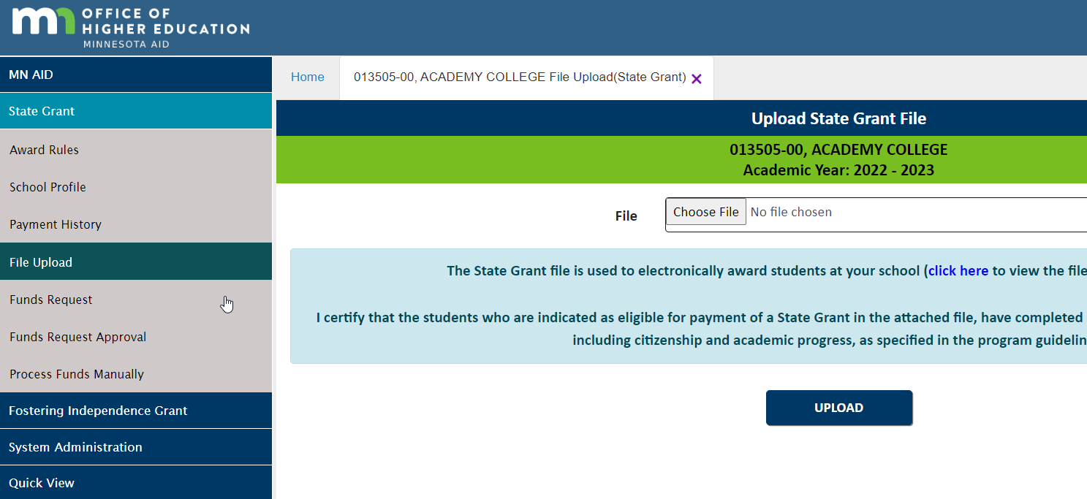
Uploading SG File

Slide 140
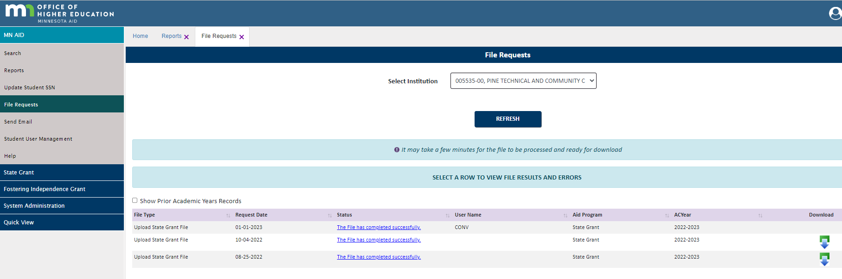
Reviewing Upload Files

Slide 141

State Grant Output Reports

Slide 142
State Grant Output Reports
The school should review the reports and correct any errors prior to submission of its next monthly batch
Key Reports and Items to Review:
  State Grant Output Report
    Roster of Rejected Awards/Payments
    All Warnings and Errors
    Roster of Accepted Payments
  Reconciliation Report
    Accounting totals for batch

Slide 143
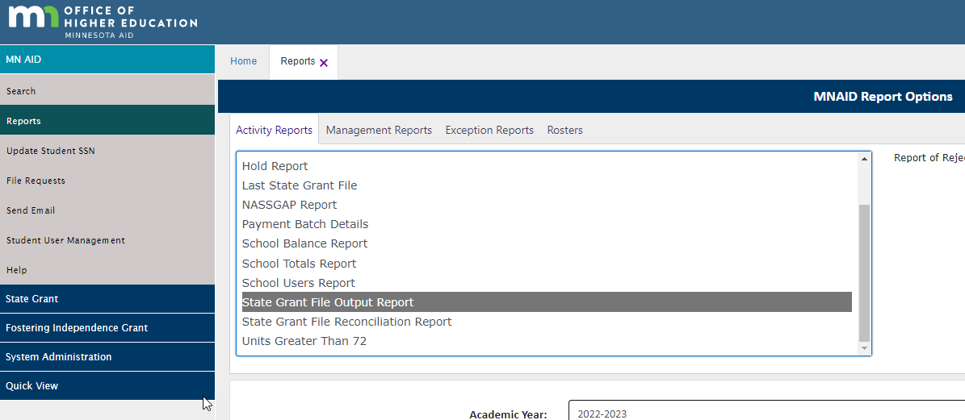
State Grant Output Report
Output reports available after State Grant File Successfully Uploaded and are available (check for pop-up blocker)

Slide 144
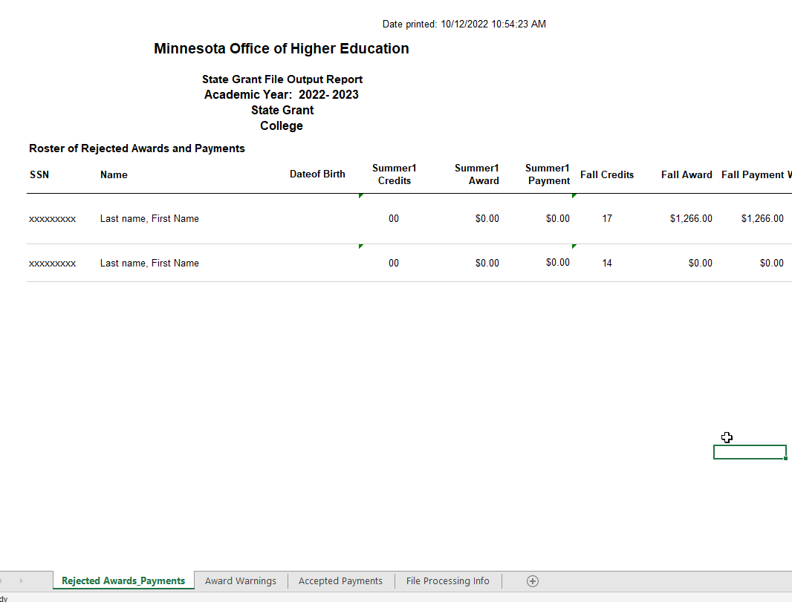
State Grant Output File
Rejected Awards and Payments
Warning Award and Payments
Accepted Payments

Slide 145
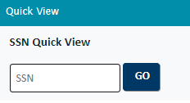
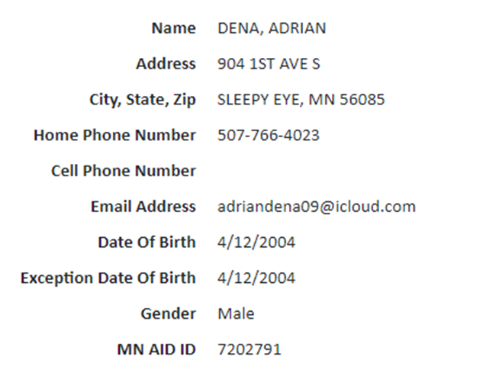

State Grant Output File
Common Errors
Date of Birth Invalid/Student DOB does not match MNAid DOB
  If the DOB reported by the school matches the current year ISIR or the ISIR transaction the school is paying from, OHE will correct the DOB in MNAid and the reject will clear with the school’s next file
  If the DOB reported by the school does not match the current year ISIR DOB, the school must work with the student to determine correct DOB.
4/12/2003
4/12/2004

Slide 146
State Grant Output File
Common Errors (Continued)
SSN Not Found
  SSN was mistakenly used by another student, OHE will correct
  Student is not in MNAid – School must review
FAFSA/Transaction Not Found
  Most often, the ISIR has not been loaded into MNAid yet.
Federal Reject (followed by additional message)
  ISIR is rejected
  Occasionally, student information reported does not match MNAid

Slide 147
State Grant Output File
Common Errors (Continued)
Award/Payment Too High
  Review enrollment vs award/payment
  Could be a timing issue
SELF Default/Child Support Hold Before Fall Disbursement
  Review student profile in MNAid/Hold report
Multiple Payments > 15 Credits
  Using Quick View, review student’s current year Existing Grants

Slide 148

State Grant Output File
When in doubt, reach out!

Slide 149
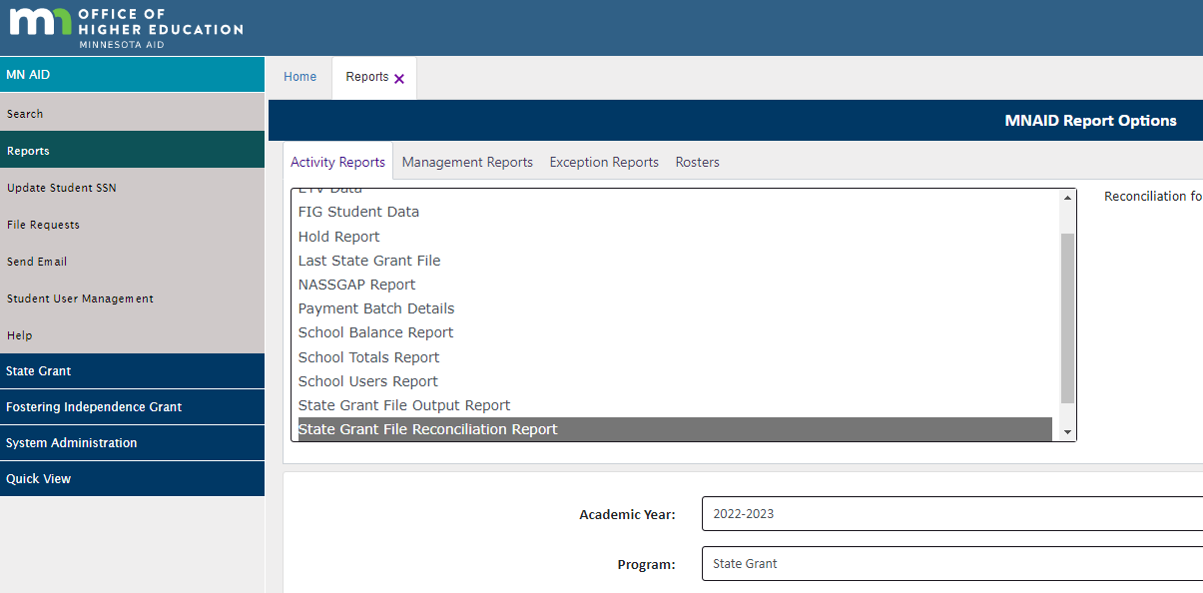
State Grant Reconciliation Report

Slide 150
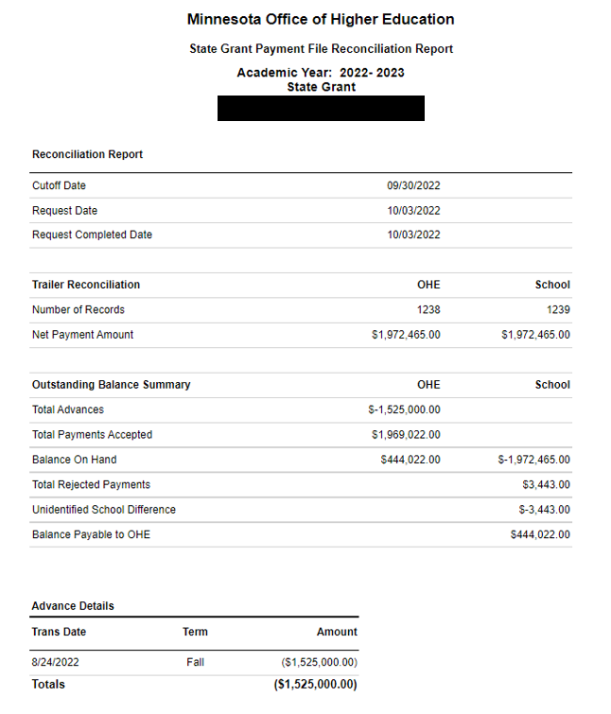
State Grant Reconciliation Report

Slide 151

End of Year Process

Slide 152
End of Year Process
School must return excess State Grant funds and submit error-free final batch to OHE by August 31
Schools should allow adequate time for closing out due to high volume
Schools should use SG web access screen file upload procedure to provide spending figures for final batch when uploading batch
  Do not have to upload batch if school uses automated FTP process
Failure to meet close-out deadline will hold fund advances for the next aid year

Slide 153
Post-Closure Refunds
Return any post-closure refunds to OHE using Refund Return Form RefundReturnForm.docx (live.com)
School does NOT need to re-open batch activity
School should NOT subtract new (post-closure) payments from post-closure refunds

Slide 154
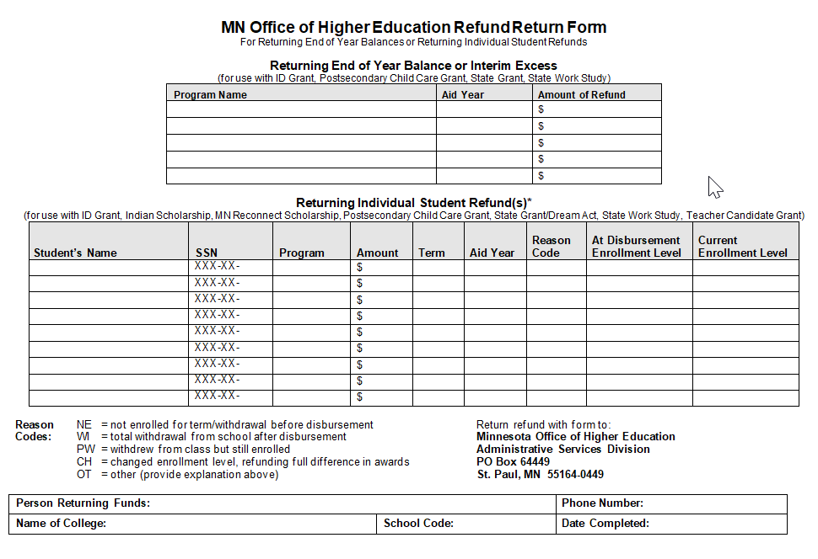
Refund Return Form

Slide 155
Post-Closure Payments
It may be possible for OHE to issue a manual payment to the school
  Contact Grant Unit for assistance
Once State Grant activity is closed out for aid year, school must keep all associated student records for 3 years or until all audit findings for that school year are resolved

Slide 156
Thank you and Questions
Meghan Flores, State Financial Aid Manager: Manages Team and Programs below Meghan.flores@state.mn.us (651) 355-0610
Shannon Olson: SG eligibility questions, SG batch processing, SG fund advances, SG online budget questionnaire Shannon.l.olson@state.mn.us (651) 355-0611
Shawn Reynolds: State Grant, MN Dream Act (general, processing and status of application), OHE FA Estimators shawn.Reynolds@state.mn.us , 651.355.0615

