Slide 1



PIPELINE Project:
Dual Training Grants
June 19, 2017
Firstname Lastname | Job Title
Date

Slide 2

Grant Round #4
Request for Application
Jacquelynn Mol Sletten, OHE Financial Aid Administrator
jacquelynn.mol.sletten@state.mn.us
(651) 355-0609
Janell Westveer, DLI Project Consultant
janell.westveer@state.mn.us
(651) 284-5890

Slide 3
Agenda
Topics
PIPELINE Project Overview
Dual Training Grant Highlights
Application
Reference Documents
Dates & Deadlines
Submission
Questions?

Slide 4
PIPELINE Project Overview
Dual training is an earn-as-you-learn approach where employers invest in employees by building a training infrastructure, developing career pathways and investing in the education of employees.
Objectives:
Develop and enhance MN skilled workforce
Participation from industry leaders
Expand dual-training and registered apprenticeship in MN
Strategies:
Industry Councils
Competency Councils
Dual-Training Development

Slide 5
PIPELINE Project Overview
INDUSTRY | OCCUPATION
Advanced Manufacturing | Flexo Technician | Machinist / CNC Operator | Maintenance and Repair Worker | Mechatronics | Quality Assurance / Food Safety Supervisor | Welder
Agriculture | Agronomist | Mechanic, Industrial Truck | Swine Manager | Swine Technician (Grow Finish) | Swine Technician (Sow Farmer) | Quality Assurance / Food Safety Supervisor
Health Care Services | Health Support Specialist | Medical Assistant | Psychiatric / Mental Health Technician In-Patient | Psychiatric / Mental Health Technician Out-Patient | Senior Living Culinary Manager
Information Technology | Security Analyst | Service Desk / Front Line Support or Computer User Support Specialist | Software Developer | Web Developer – Back End | Web Developer – Front End

Slide 6

Dual Training Grant Highlights
Funding Availability
$2,546,000
Eligibility:
Applicant must be an employer or a group of employers
Dual training program with (1) Related Instruction & (2) On-the-Job Training
“Employed” student/employee
  Has not obtained competency standards
  Permanent work location in MN
Minimum Requirements:
Submit all Application content by July 7th
25% cost match (annual revenue $25,000,000+) or documents showing applicant will not provide match

Slide 7
Dual Training Grant Highlights
Related Instruction
Must earn industry recognized degree, certificate, or credential
Qualified Training Provider
    Accredited institution under CHEA or the U.S. Department of Education;
    Licensed or registered by OHE; or
    Meet “Standards of Instructors” as defined by Minnesota Administrative Rule 4880.1900

Slide 8
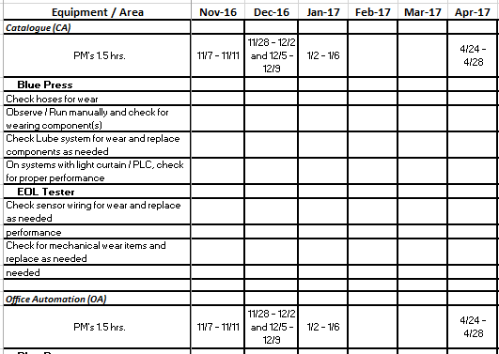
Dual Training Grant Highlights
On-the-Job Training
Advanced Manufacturing Example

Slide 9
Application
1st Step: READ the Request for Application
2nd Step: Review SAMPLE Documents
3rd Step: Submit Application
Exhibit A DTG Industry Application
Exhibit B DTG Occupation Training Plan
Exhibit C DTG Related Instruction Training Provider Form
Exhibit D DTG Affidavit of Non-Collusion

Slide 10
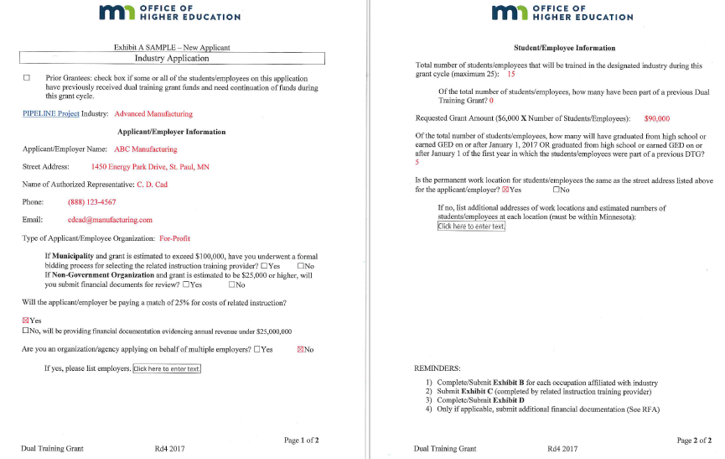
Application: Exhibit A
Start
HERE
Type of Applicant?
Up to $150,000 per applicant
$6,000 per student

Slide 11
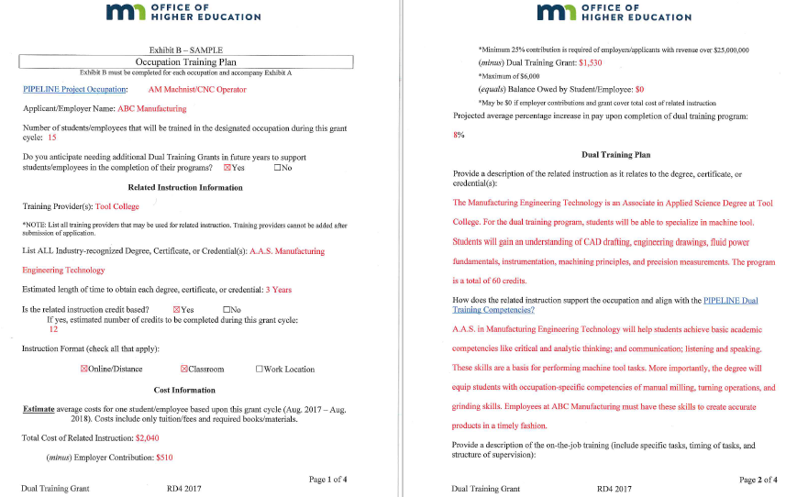
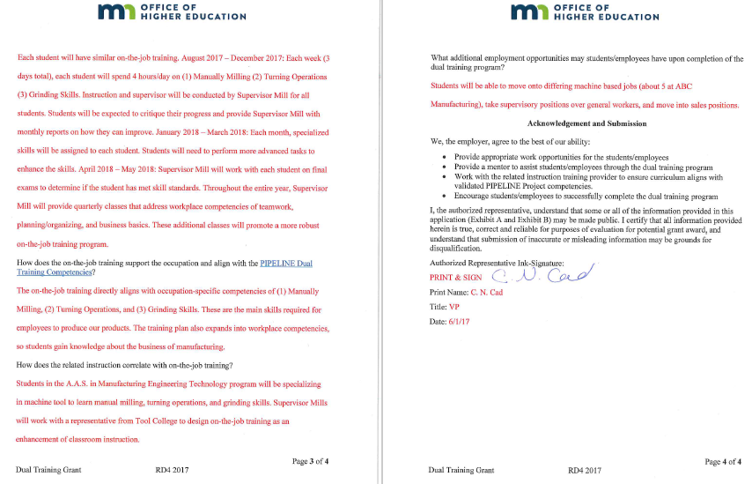
Application: Exhibit B
1 per Occupation
Determining cost to student
Be sure to include Competencies in answers!

Slide 12
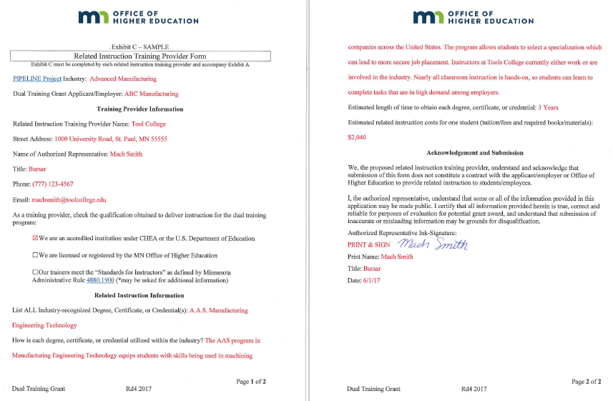
Application: Exhibit C
To be completed by Training Provider
MUST be qualified!!!
Encouraged to attach instruction plan

Slide 13
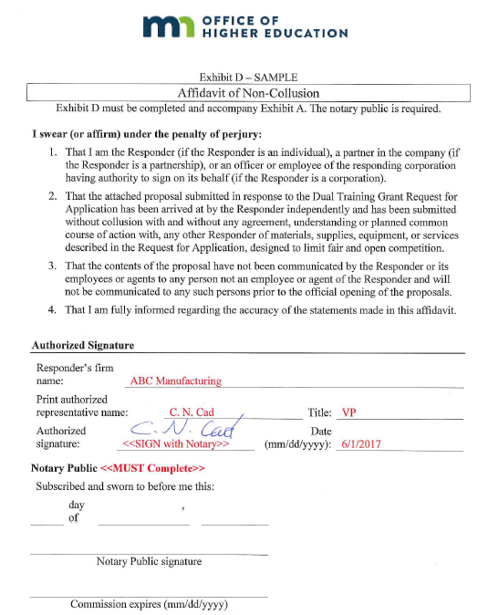
Application: Exhibit D
Now…
submit ALL docs
Notary Required

Slide 14
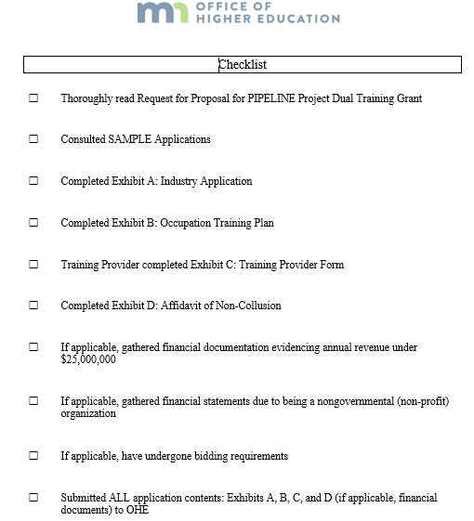
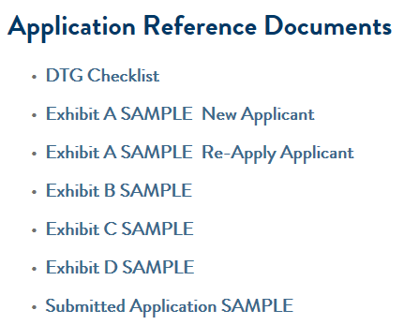
Reference Documents

Slide 15
Dates & Deadlines
June 9th – July 7th, 2017
RFA and Application OPEN
June 19th @ 2:30pm: Webinar
June 23rd @ 5:00pm: Last day to submit questions
July 7th @ 5:00pm: Applications DUE
July 24th: Review Committee in session
July 31st: Recommendations to OHE
August 4th: Notify Grantees
August 8th: Public Announcement
NEXT Steps as Grantee:
Orientation, Contracts, Training Begins

Slide 16
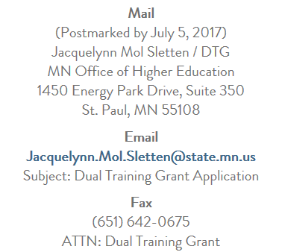
Submission

Slide 17
Recent Questions
If I am a Round #3 Grantee (contract ending in Dec. ‘17), do I apply now during Round #4, so students/employees can finish in spring of 2018?
  NO. You will apply in Oct. ‘17 during Round #5 for those students/employees to finish programs in spring 2018. However, if you have new students/employees, who would like to start programs fall 2017, you should apply now during Round #4
We are a non-profit employer or organization. Are we required to undergo a bidding and financial review process?
  YES. If the grant application includes a request of $25,000 or more. See the RFA (pages 7 & 12).

Slide 18
NEW Questions
Time to Ask …

Slide 19
Thank you!
Jacquelynn Mol Sletten, OHE Financial Aid Administrator
jacquelynn.mol.sletten@state.mn.us
(651) 355-0609
Janell Westveer, DLI Project Consultant
janell.westveer@state.mn.us
(651) 284-5890

