Slide 1
Paying for College FAFSA Overview 2014-2015
Jessica Larson
Outreach Coordinator
Minnesota Office of Higher Ed
January 2014

Slide 2

Getting to College
How parents help their students get ready for college
College Costs
Types of aid
Where to look for Financial Aid
FAFSA Tips
Questions

Slide 3
What extra costs will I pay for college?
Cost of Attendance
Tuition
Fees
Room
Board/Meal Plan
Books & Supplies
Transportation
Personal Supplies
Is this an extra expense due to college enrollment?
Yes
Yes
Maybe
Maybe
Yes
No
No
Is cost included in school bill?
Yes
Yes
If living in campus housing, yes
If sign up for meal plan, yes
No (may purchase on- or off-campus)
No
No

Slide 4

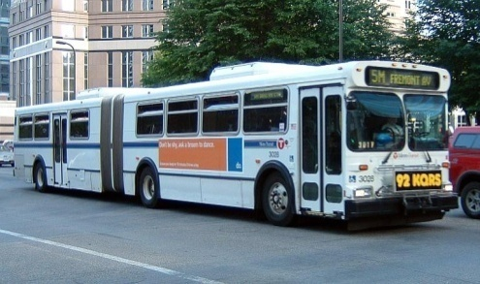

Other College Costs (pages 4, 19)
The cost of attending an institution includes more than just tuition and fees. Also included are $10,000 to $15,000 in…
Room and Board
Books & Supplies
Transportation Personal Expenses

Slide 5
Estimated Average Annual Tuition & Fees (page 19)
2-Year Public
State Universities
University of Minnesota
4-Year Private Colleges
Private Career Schools
Estimated 2014-2015 Annual Tuition & Fees
$5,370
$7,700
$13,620
$35,175
$14,000
% First-Time, Full-Time Freshmen Receiving Institutional Gift Aid
4%
28%
58%
93%
20%

Slide 6
Paying for Post Secondary Education
What is Financial Aid?

Slide 7

Financial Aid - Video

Slide 8
What is Financial Aid?
Funds provided to students and families to help pay for postsecondary educational expenses
Grants
Scholarships
Loans
Work Study

Slide 9
What is a Grant?
Gift aid (free money)
Used to pay educational expenses
Typically based on need
Examples
Federal Pell Grant
MN State Grant
“School” Grant
Paying for College, 2013-2014, pages 14-19

Slide 10
What is a Scholarship?
Gift Aid (free money)
Typically based on merit or circumstance
Examples
Minnesota Indian Scholarship
Athletics
Academic
Leadership
Paying for College, 2013-2014, pages 20-21, 32, 45ff

Slide 11
What is a Loan?
Money needs to be repaid – with interest
Common types of Educational Loans
Federal Perkins
Direct Loans
Direct Subsidized (formerly Subsidized Stafford)
Direct Unsubsidized (formerly Unsubsidized Stafford)
Direct PLUS (Parent Loan for Undergraduate Students)
Minnesota SELF (Student Educational Loan Fund)
Private
Paying for College, 2013-2014, pages 21-27

Slide 12
What is Work Study?
Opportunity to work while going to college
Funding sources
State
Federal
College
Guaranteed?
Types of work
On-campus
Off-campus
Paying for College, 2013-2014, page 28

Slide 13
Where does financial aid come from?
Notes:
13

Slide 14
2012-2013 Minnesota Undergraduate Grants & Scholarships ($1.5 billion)
Private
$66 million
State
$207 million
Federal
$521 million
Colleges & Universities
$795 million
Source: MN Office of Higher Education, Financial Aid Awarded, Fiscal Year 2013, Grants, Loans and Earnings from Work-Study, August, 2013, http://www.ohe.state.mn.us/pdf/highlights2013.pdf

Slide 15

Where to find private scholarships
Research what is available in school, community and parents’ employers
To what organizations and churches does student and family belong?
Application process usually spring of senior year
Small scholarships add up!
www.finaid.org/scholarships
www.fastweb.com

Slide 16
Other ways to reduce net price - Tuition Reciprocity
Allows MN residents to attend in neighboring states at rate similar to what they would have paid in MN (and vice versa)
Apply directly to ND or SD college if recent MN high school graduate
Apply directly to colleges in Manitoba
All other students must submit application to Office of Higher Education in MN around March 1 for following fall www.ohe.state.mn.us/ssl/reciprocity

Slide 17

Other ways to reduce net price - Income Tax Options
American Opportunity Tax Credit
Formerly Hope Tax Credit
Credit of up to $2,500 per eligible student
Lifetime Learning Tax Credit
Tuition and Fees Deduction
Student Loan Interest Deduction
Check with your tax preparer

Slide 18

Need-Based Financial Aid
Notes:
18

Slide 19
3 Applications for Need-Based Aid
CSS Profile (College Board)
Used by select schools to award their gift aid.
MN Dream Act
Used by some students (not U.S. citizens and not eligible non-citizens) to determine eligibility for in-state tuition and Minnesota’s financial aid programs.
Free Application for Federal Student Aid (FAFSA)
Used by all colleges to award Federal financial aid.

Slide 20
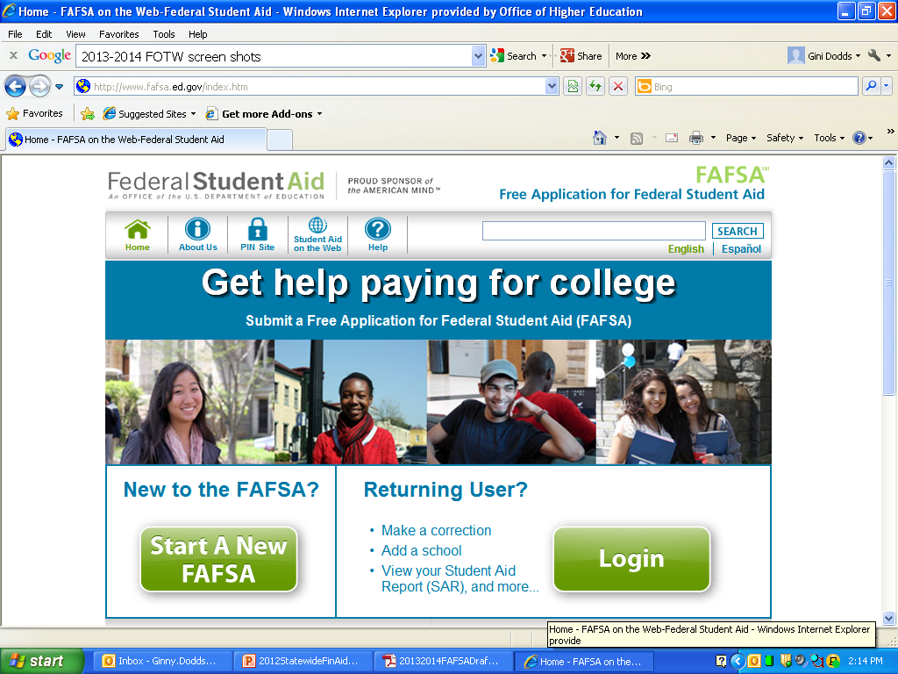
FAFSA on the Web (FOTW) www.fafsa.gov
Available January 1st
Can complete with estimated tax figures and make corrections later
Add additional colleges
Use PIN to sign electronically

Slide 21
Login
Create Password
Used to access saved, unsubmitted, FAFSA application
Can save FAFSA application (unsubmitted) for 45 days
PIN
Sign FAFSA
Make FAFSA corrections
Sign federal loan promissory notes
Look up student’s student loan history
FAFSA takes less than an hour to fully complete

Slide 22
Data needed to complete FAFSA
To complete the Free Application for Federal Student Aid (FAFSA), you will need:
Your Social Security Number, or Alien Registration Number
Your most recent federal income tax returns, W-2s, and other records of money earned.
Bank statements and records of investments (if applicable).
Records of untaxed income from prior year (if applicable)
If you are a dependent student, then you will also need most of the above information for your parent(s).

Slide 23
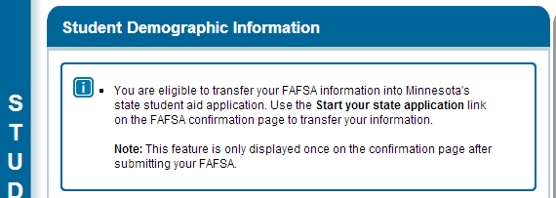
Minnesota’s state student aid application
After completing data on first page of FAFSA, MN residents will be reminded they can transfer FAFSA data into Minnesota’s state student aid application via the “Start your State Application link on the FAFSA confirmation page.

Slide 24
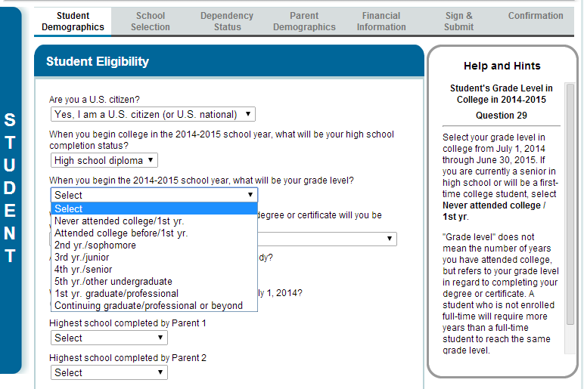
Help Text for Active Field

Slide 25
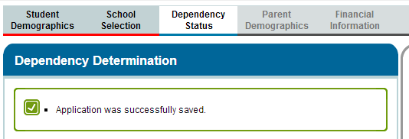
FAFSA automatically saved periodically
After completing School Section, FAFSA saved

Slide 26
Definitions: Independent Student
Born before January 1, 1991?
As of today, is student separated or married?
Enrolled in graduate program (e.g. MBA)?
Active Duty or veteran of U.S. military?
Have children or others that receive more than 50% of their support from you?
At any time since you turned age 13, were both your parents deceased, were you in foster care or were you a dependent or ward of the court?
Are or were you an emancipated minor as determined by a court in your state of legal residence?
Are you or were you in legal guardianship as determined by a court in your state of legal residence?
Homeless?

Slide 27
FAFSA Parent of Record
Beginning with the 2014–15 FAFSA, dependent students will be required to include on the FAFSA income and other information from the dependent student's legal parents (biological or adoptive) regardless of the parents' marital status or gender, if those parents live together.
http://studentaid.ed.gov/sites/default/files/fafsa-parent.pdf
http://studentaid.ed.gov/sites/default/files/dependency-status.wmv

Slide 28

Providing Parents’ Information on FAFSA
Others filling role of parents
Grandparents, foster parents, other relatives and legal guardians are NOT considered parents on the FAFSA unless they legally adopted student
Do NOT substitute information about above parties in parent section on FAFSA

Slide 29

Providing Parents’ Information on FAFSA
Single or Widowed. If biological/adoptive parent is widowed, provide information about surviving parent
If surviving parent remarried, include stepparent’s information, even if stepparent did not adopt student

Slide 30
Providing Parents’ Information on FAFSA
Married. If biological/adoptive parents married, report information for both parents
Divorced or Separated. If biological/ adoptive parents are divorced or separated, provide information for parent:
Student lived with the most in last year
Or, if lived equal periods with each parent, parent who provided the most financial support in last year or most recent year support provided
If that parent remarried, include stepparent’s information, even if stepparent did not adopt student
Note: Unlike FAFSA, CSS Profile form will require information for non-custodial parent

Slide 31
Same sex married couples 2014-2015 FAFSA Changes
Consistent with the Supreme Court decision on the Defense of Marriage Act (DOMA), same-sex couples must report their marital status as married if they were legally married in a state or other jurisdiction (foreign country) that permits same-sex marriage.
Students – FAFSA questions 16-17
Parents – FAFSA questions 59-60

Slide 32
Parents’ Info on FAFSA 2014-2015 FAFSA Changes
Parents unmarried but living together
Beginning with 2014-2015, Dependent student will report information about both legal (biological or adoptive) parents if the parents are living together, regardless of the parents’ marital status or gender
Previously, student only reported information about one parent (typically, custodial parent) if not married
New response added to parents’ marital status – ‘Unmarried and both parents living together’

Slide 33
Tax Information
Filing Status
Already completed
Will file (use 2012 tax return to estimate, or online Income Estimator)
After filing tax return, MUST correct FAFSA
Change filing status from "Will file" to "Already completed," and
Change estimated answers to the final amounts on your 2013 tax return.
Not going to file

Slide 34
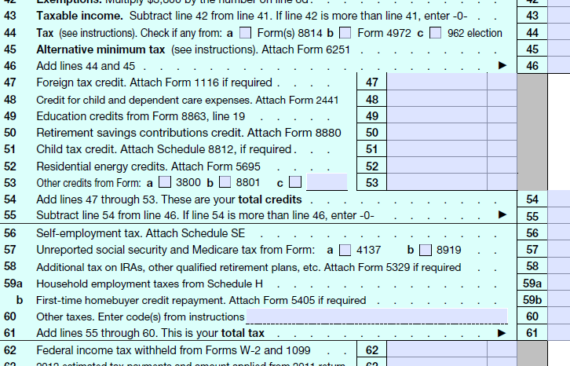
Income Tax
“Enter the amount of your income tax for 2013, found on IRS Form 1040-line 55”

Slide 35

IRS Data that will populate FAFSA
IRS Data Retrieval
Hand Enter on FAFSA
Adjusted Gross Income
Federal Tax Paid
# of Exemptions?
Untaxed Income
IRA deductions
Tax exempt interest
Untaxed IRA distributions
Untaxed pension
Student’s and parents’ income from work if:
Marital status is other than married
If ‘married’, total income from work from tax form will appear on screen and will need to separated by student or parent for entry into FOTW fields
Type of tax return
Additional Financial Info
Child support paid
Work-Study earnings, etc.
Untaxed Income
Payments to tax deferred savings (e.g. 401(k))
Child Support Received
Housing Allowance, etc.
Asset questions

Slide 36
Definitions: Investments
Do Not Include…
Home you live in
Value of life insurance
Retirement plans (pension, annuities, non-education IRAs, Keogh plans, etc)
Prepaid tuition plans

Slide 37
Net Investments
Investments include real estate (do not include the home in which you live), trust funds, UGMA and UTMA accounts, money market funds, mutual funds, certificates of deposit, stocks, stock options, bonds, other securities, installment and land sale contracts (including mortgages held), commodities, etc.
Investments also include qualified educational benefits or education savings accounts such as Coverdell savings accounts, 529 college savings plans and the refund value of 529 prepaid tuition plans. For a student who does not report parental information, the accounts owned by the student (and the student's spouse) are reported as student investments. For a student who must report parental information, the accounts are reported as parental investments, including all accounts owned by the student and all accounts owned by the parents for any member of the household.
Investments do not include the home in which you live, the value of life insurance, retirement plans (401[k] plans, pension funds, annuities, non-education IRAs, Keogh plans, etc.) or cash, savings and checking accounts.

Slide 38
Business Value
Business value does not include the value of a small business if…
You (and if married, your spouse) own and control more than 50 percent, and
has 100 or fewer full-time or full-time equivalent employees.
Investment farm value does not include the value of a family farm that you (and if married, your spouse) live on and operate.

Slide 39
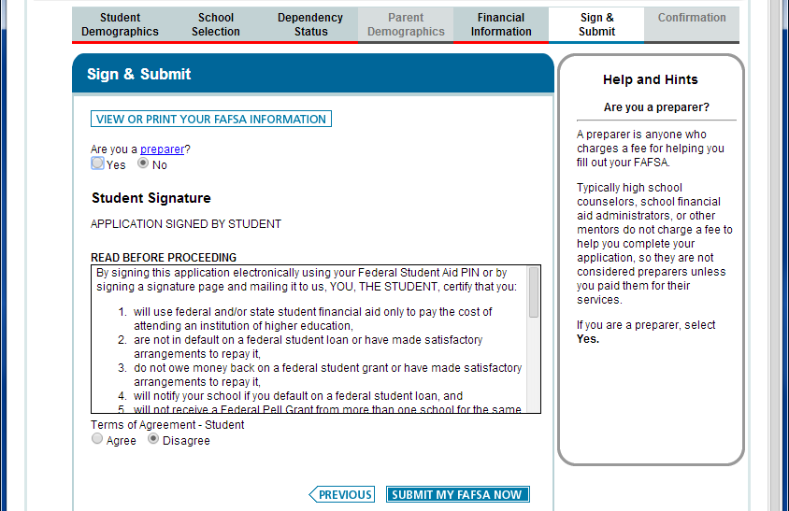
After Entering PIN, still need to Submit

Slide 40
Confirmation Page
Sent to email address recorded in FAFSA
Next steps
Start your state application
Eligibility information (only some federal programs – can be misleading)
Estimated Expected Family Contribution – “a measure of how much you can contribute to the cost of your education…. The EFC is not how much aid you will receive or how much you have to pay for college.”

Slide 41
MN State Grant Student Eligibility Questionnaire
Minnesota State Grant Eligibility - Narrative Response for Graduate Students
You will NOT need to complete the 2014-2015 Minnesota State Grant eligibility questionnaire because:
You have already completed this questionnaire and did not list any additional MN colleges on your 2014-2015 FAFSA; OR
You do not plan to attend a MN college or university that wants its students to complete this on-line questionnaire (your college will collect the necessary information from you); OR
Based on the information provided on your 2014-2015 FAFSA, you fall into one or more of the categories listed below and do not meet State Grant program eligibility requirements:
Are pursuing a master's or doctorate degree
Have already earned your bachelor's degree
Are not a U.S. citizen or eligible non-citizen
Do not plan to attend a college or university located in Minnesota

Slide 42
To Conclude Session
Exit
Logout
Returns to FAFSA Login Screen

Slide 43
What’s next? - Video

Slide 44
Questions?
Contact Guidance Counselor
Contact financial aid offices where your students are applying
Or mail
Jessica.larson@state.mn.us
Presentation at http://cas.bethel.edu/financial-aid/forms/

Slide 45
2014-2015 FAFSA on the Web Preview Presentation http://financialaidtoolkit.ed.gov/tk/learn/fafsa.jsp
December 2013

Slide 46
Dependent Student with Parental Data

Slide 47
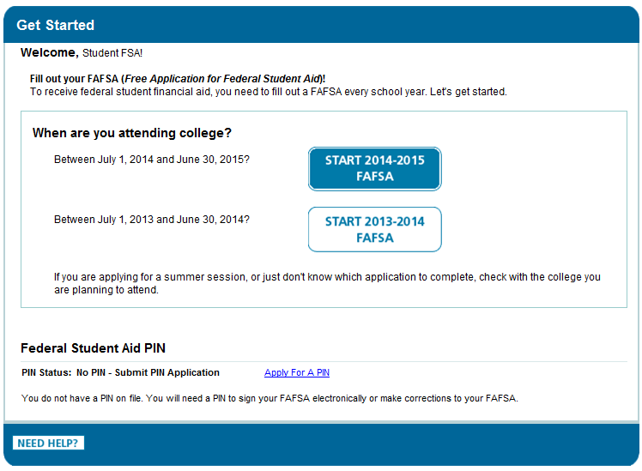

Slide 48
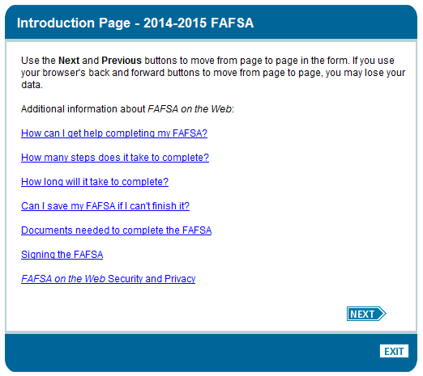

Slide 49
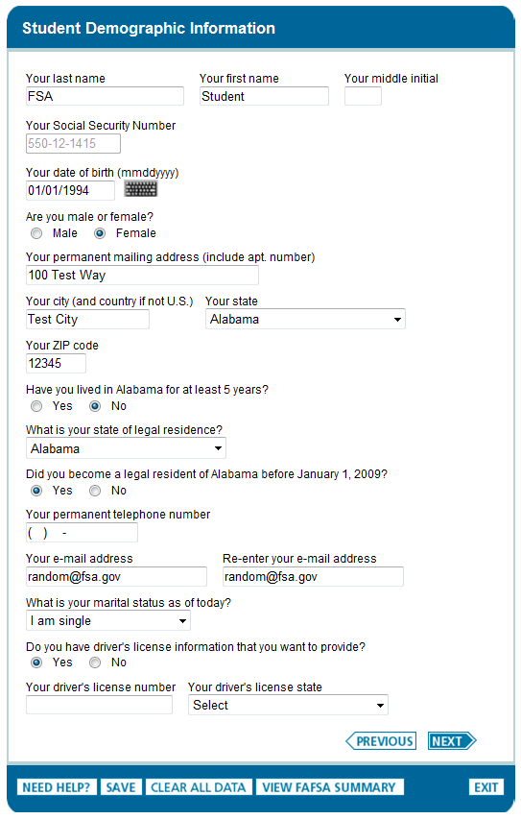

Slide 50
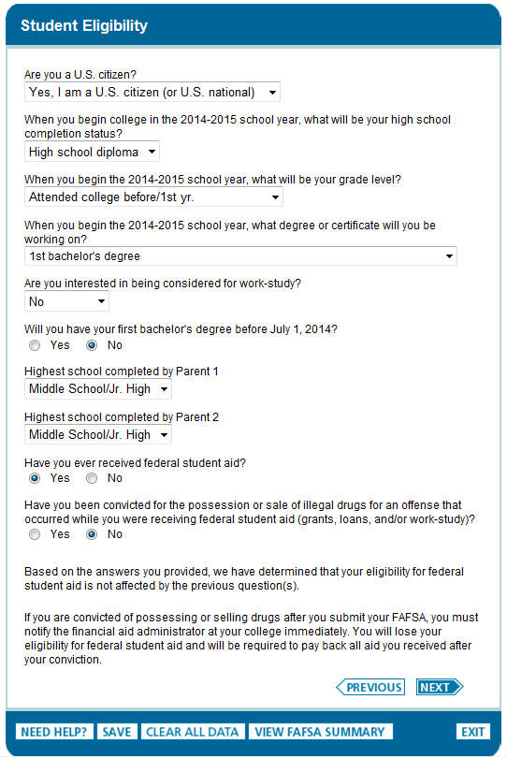

Slide 51
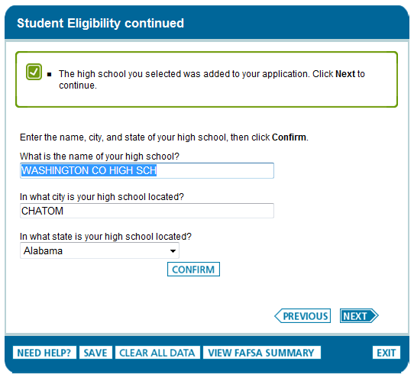

Slide 52
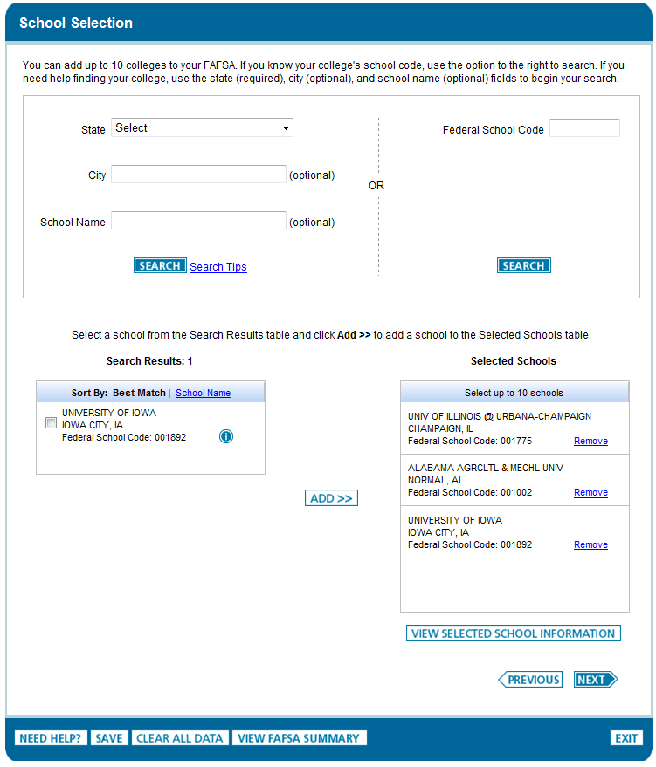

Slide 53
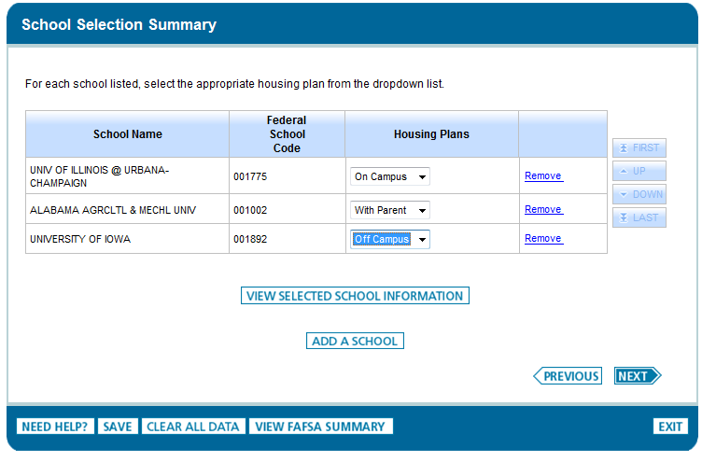

Slide 54
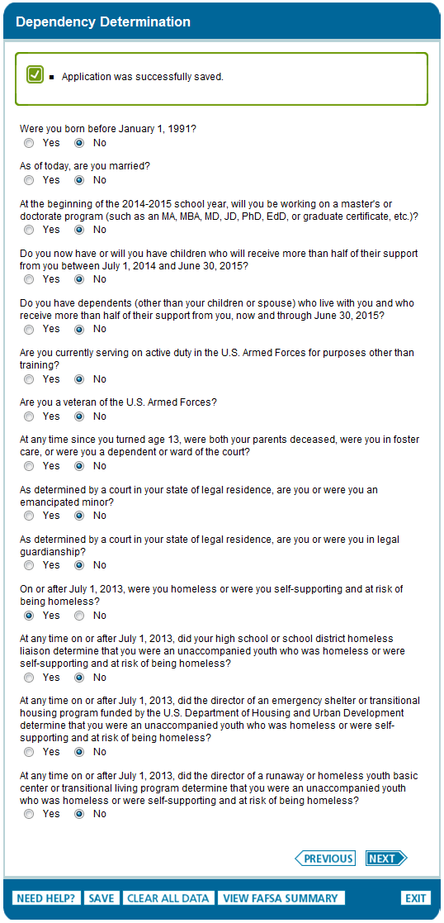

Slide 55
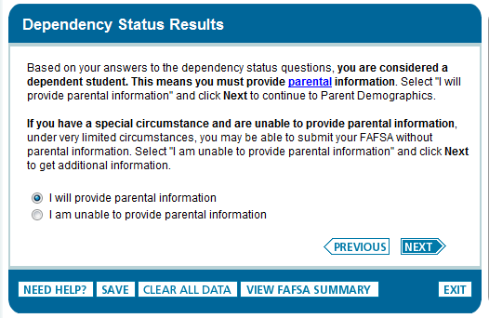

Slide 56
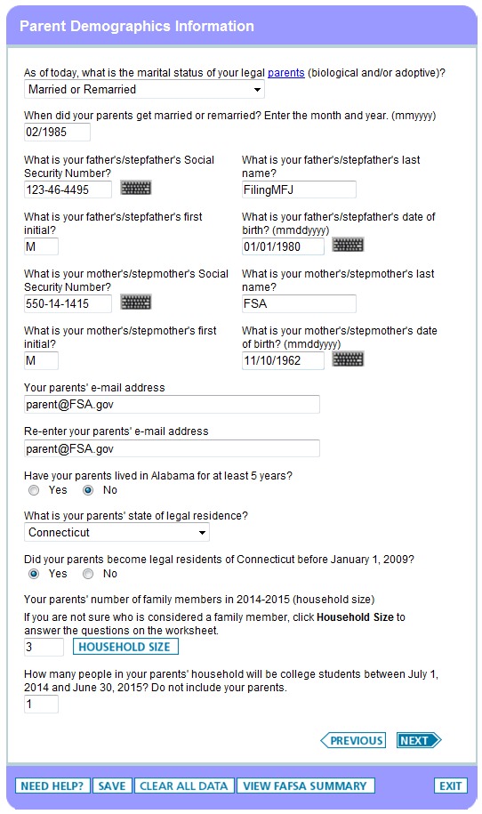

Slide 57
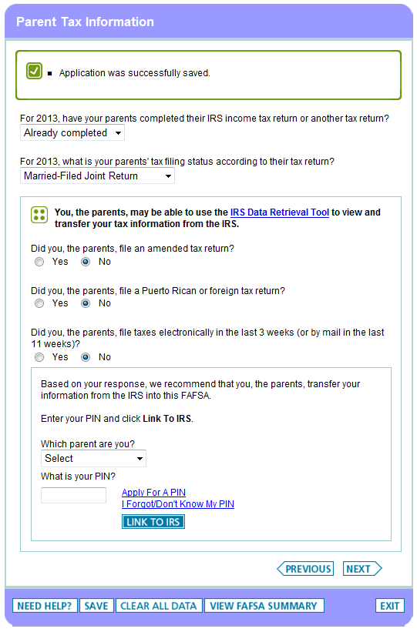
Notes:
Based on the answers to the questions on this page, the system will determine if the user is eligible to use the IRS Data Retrieval Tool. If they are eligible, the system will provide the option to link to the IRS.

Slide 58
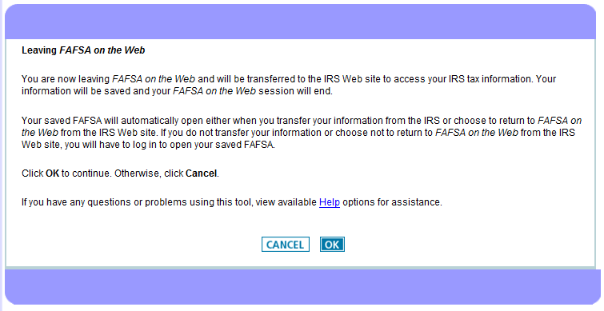
Notes:
Note: The IRS pages are the same for the student and parent. If the parent and/or student are eligible to use the IRS DRT, they will follow the same process outlined in this slide.

Slide 59
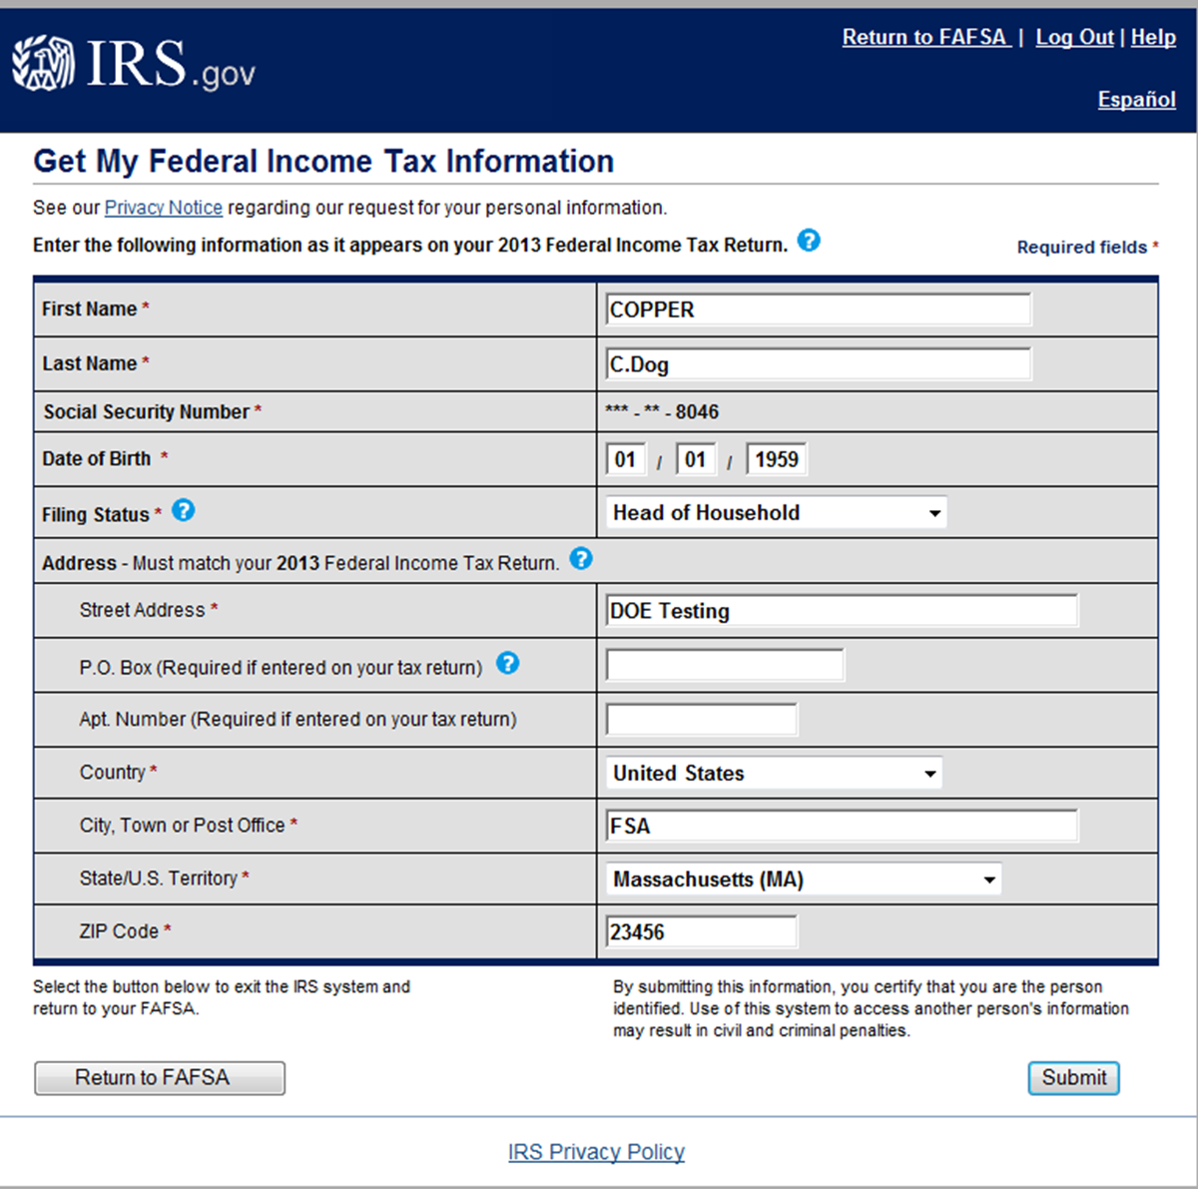
Notes:
Note: The IRS pages are the same for the student and parent. If the parent and/or student are eligible to use the IRS DRT, they will follow the same process outlined in this slide.

Slide 60
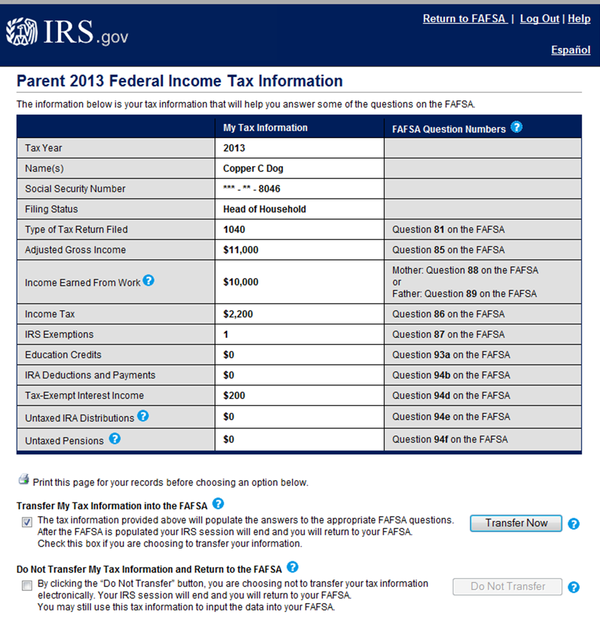
Notes:
Note: If the parent and/or student are eligible to use the IRS DRT, they will follow the same process outlined in this slide. This page is dynamic and the information that displays is variable, depending on whether parent data or student data is displayed. The data is also dynamic; the type of tax form that is filed will determine what type of tax information is displayed.

Slide 61
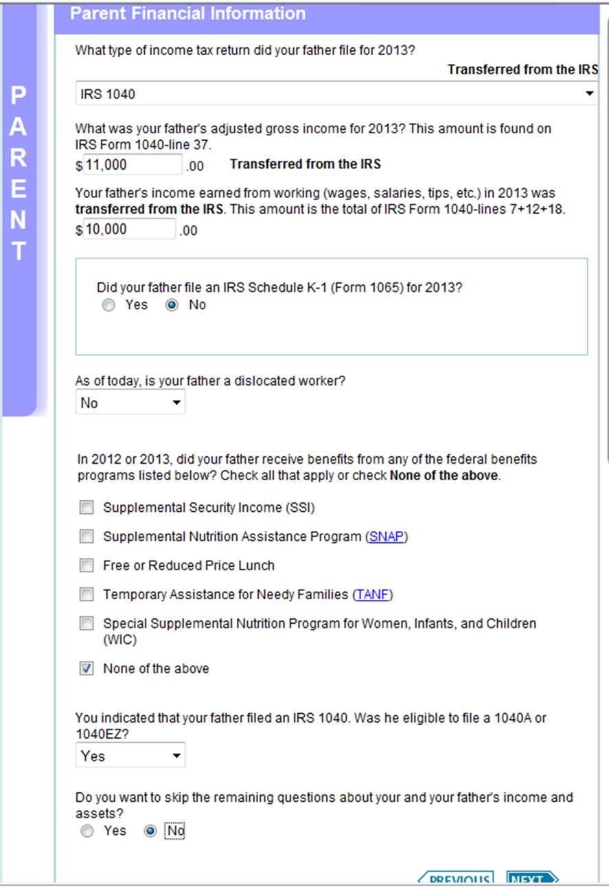
Notes:
Note: This student’s parents are Auto Zero eligible and are from a state that allows the parents to skip questions. The final question on this page “Do you want to skip the remaining questions about your and your parents' (father’s) income and assets?” is displayed to the parents. In this case, the parents indicated that they do not want to skip the remaining financial questions. If they did choose to skip the remaining questions, the student/parents would be taken to the Sign & Submit page.

Slide 62
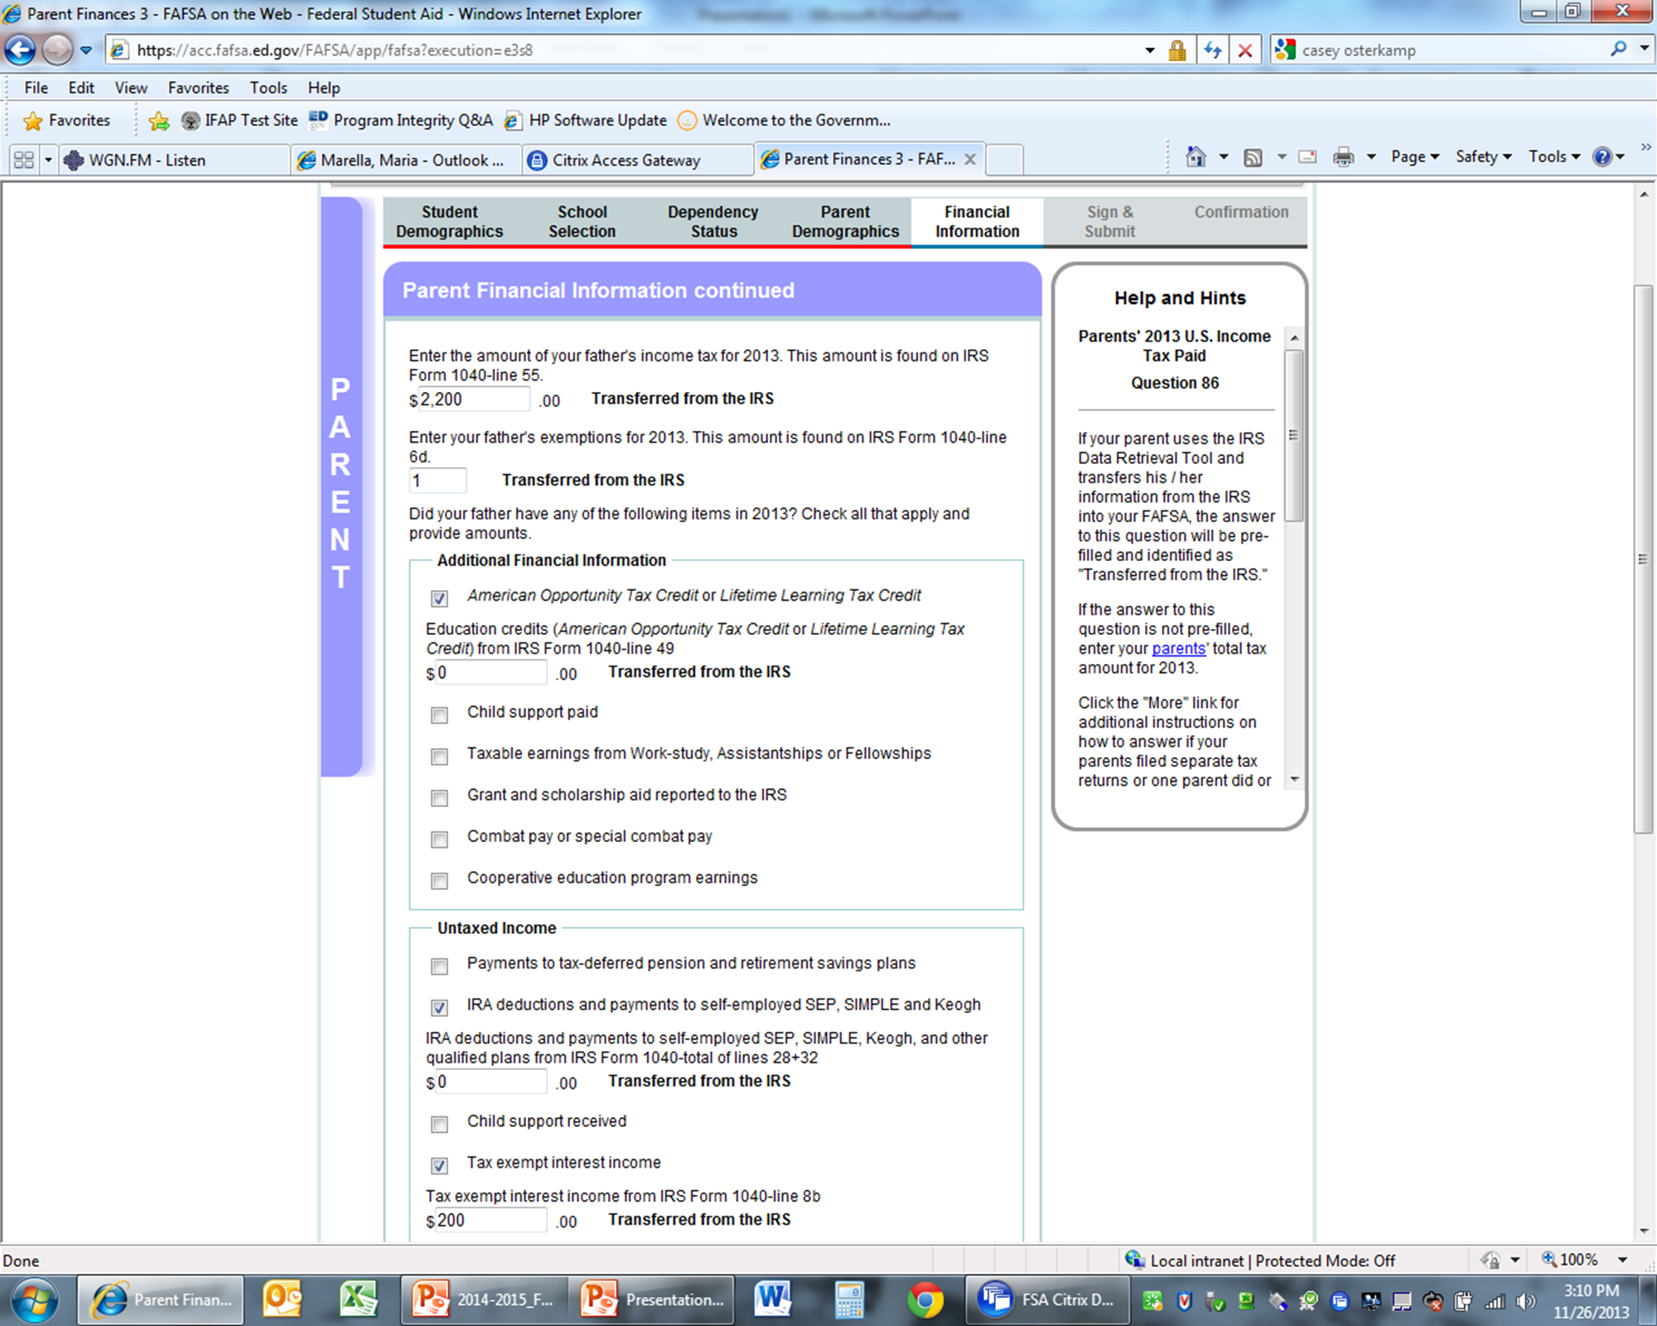
Notes:
This slide displays the top half of the “Parent Finances 3” page. Note the “Transferred from the IRS” labels for the data was transferred from the IRS. The bottom half of the “Parent Finances 3” page is continued on the next slide.

Slide 63
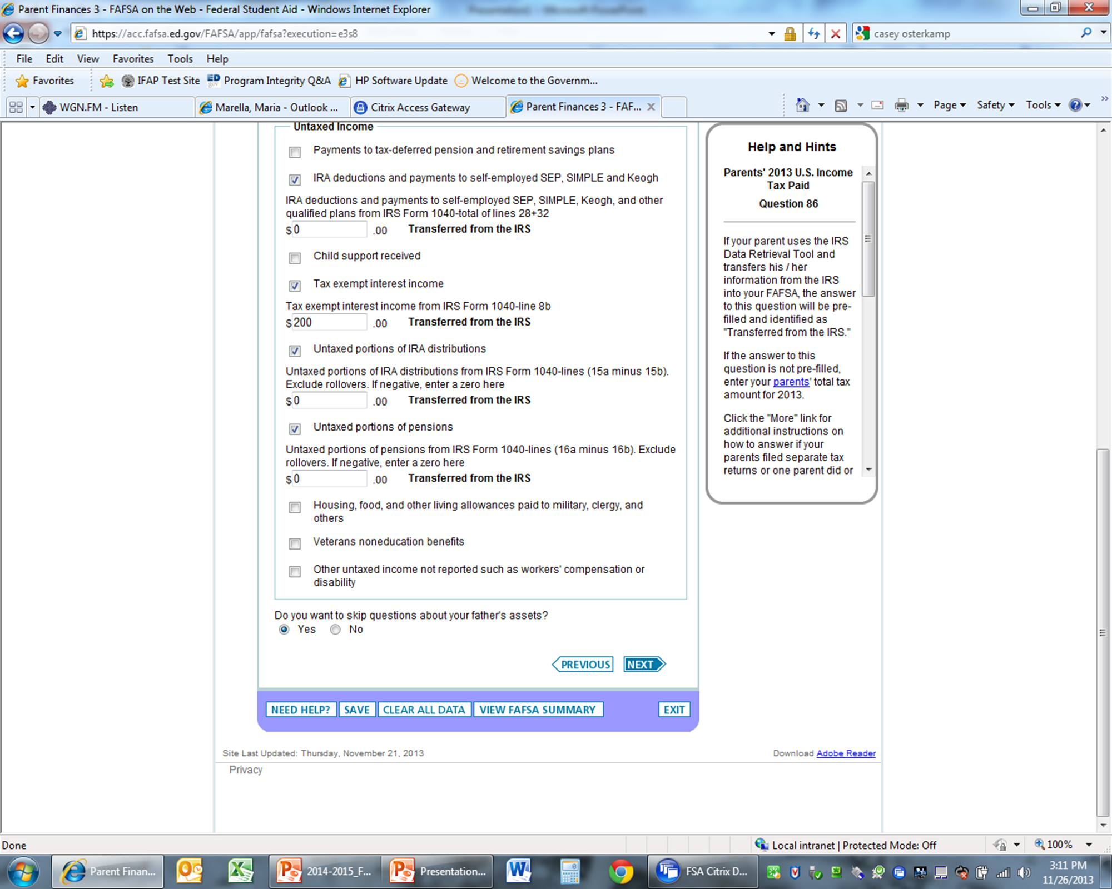
Notes:
This slide displays the bottom half of the “Parent Finances 3” page. Again, note the “Transferred from the IRS” labels for the data was transferred from the IRS.

Slide 64
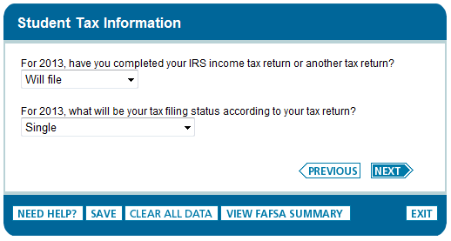
Notes:
Based on the answers to the questions on this page, the system will determine if the user is eligible to use the IRS Data Retrieval Tool. If they are eligible, the system will provide the option to link to the IRS.
Note: The IRS pages are the same for the student and parent. If the parent and/or student are eligible to use the IRS DRT, they will follow the same process outlined in slides 16-18.

Slide 65
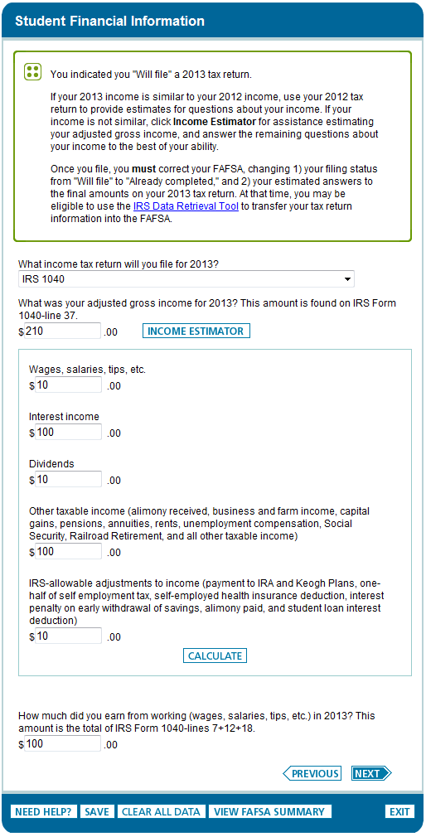
Notes:
This slide shows the messaging that displays when a user indicates they “Will File” their taxes.
In addition, the income estimator is also displayed on this page.

Slide 66
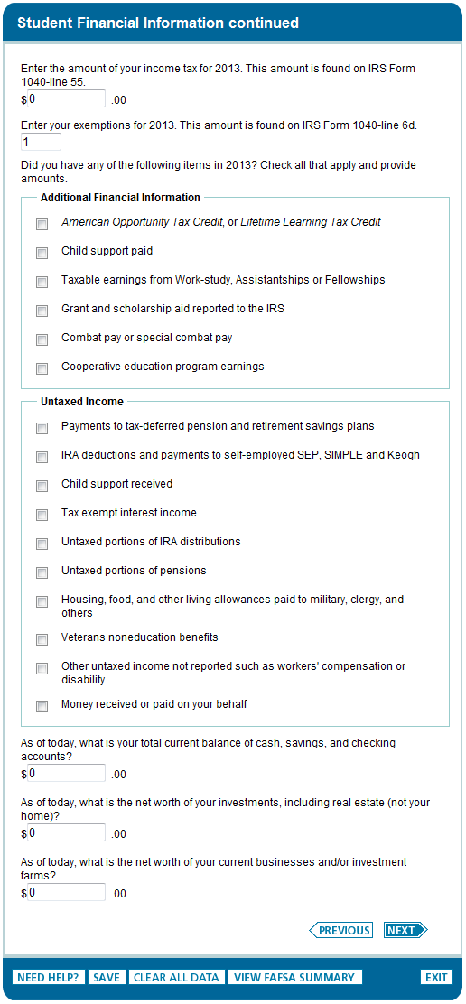

Slide 67
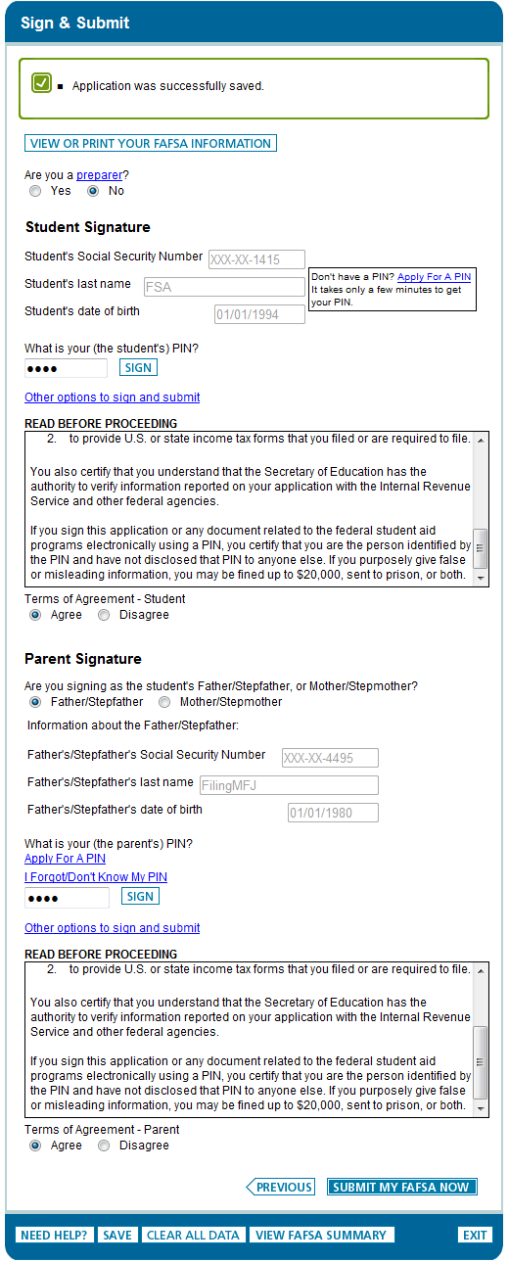

Slide 68
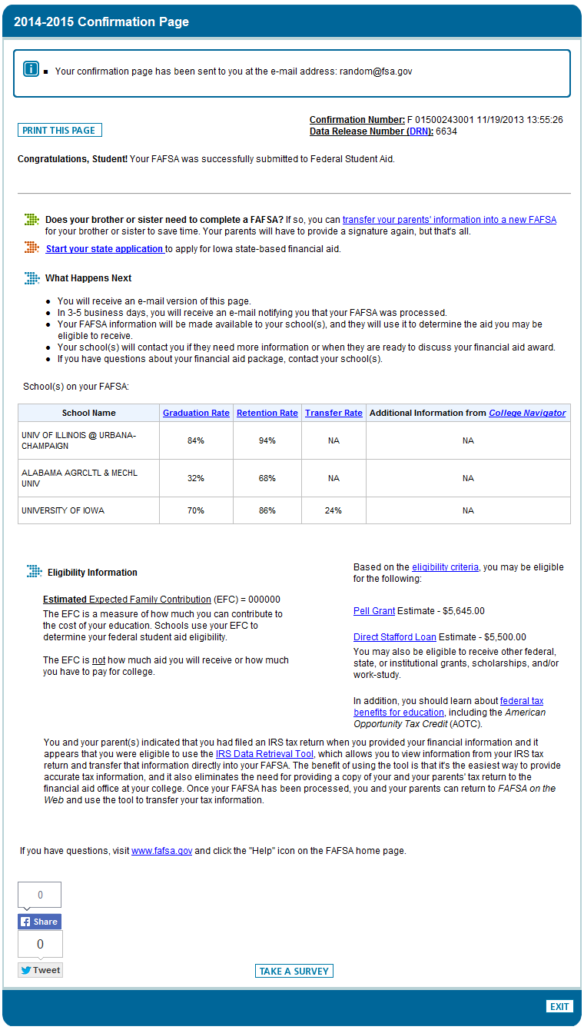
Notes:
The confirmation page includes links to transfer parental data into a new FAFSA for another student.
In addition, some states allow users to transfer FAFSA information into their state’s aid application. The link is included on the confirmation page. The states that allow this transfer are:
New York
New Jersey
Pennsylvania
Vermont
California
Iowa
Mississippi
Minnesota
Indiana

