Slide 1

Overview of DACA & MN Dream Act
Meghan Flores
Manager, State Financial Aid
MN Office of Higher Education
Notes:
Estefanía Navarro Education Program Director Navigate MN is also here to help answer questions.

Slide 2
Why is a person “undocumented”?
Failed U.S. immigration policy
1982 Plyer v Doe- K-12 education guaranteed in order “to prevent a permanent underclass”
Upon graduation from high school, students are abandoned by the education system
Some, but not all states, have responded
Some, but not all colleges and universities have responded
Notes:
WE DON’T USE illegal alien- Merriam Webster definition of illegal is “differing in nature or character to the point of incompatibility”
At least 20 states have a state dream act- all are different

Slide 3

Is DACA the same as the MN Dream Act?

Slide 4
Deferred Action for Childhood Arrivals (DACA)
U.S. immigration policy memorandum
Defer action against undocumented individuals meeting certain criteria
Applicants pay $495 to apply
  Opportunities to offset filing fee
Originally created on June 15, 2012
Consult with immigration attorney before applying for DACA
If approved, granted for two years
Notes:
Failed US Immigration policy has lead to 2 million unauthorized youth living in U.S.
1982 Plyer v Doe

Slide 5
DACA: Qualifications to Apply
Under age 31 as of June 15, 2012
Arrived in U.S. before 16th birthday
Have continuously resided in the U.S. since 06/15/2007
Physically present on 6/15/2012, entered w/o inspection before 6/15/2012 OR fell out of lawful status as of 06/15/2012
Attending school at time of application (or have graduated, earned GED, honorable military discharge)
Not convicted of felony, significant misdemeanor or 3 or more misdemeanors

Slide 6
Deferred Action for
Parents of US Citizens and Permanent Residents – DAPA CURRENTLY BLOCKED
Parent of a U.S. citizen or permanent resident (green card holder), as of November 20, 2014;
Continuously resided in the U.S. since January 1, 2010;
Physically present in the U.S. on November 20, 2014 and at the time of request;
No lawful status as of November 20, 2014
Notes:
Recent injunctions by federal court system in Texas did not end DACA. It stalled the expansion of DACA and prevented DAPA.

Slide 7
Benefits & Limitations
Benefits
Protection from deportation for 2 year period
Work authorization
Social security number
Limitations
Not a path to citizenship
Discretionary case-by-case decision based on DHS enforcement priorities
Driver’s license in some states
Executive order not law and not a “green card” or visa
May request permission to travel abroad
Notes:
Permission to Travel Abroad “Advanced Parole” Additional $575 fee

Slide 8
DACA Statistics
Since program’s inception, 1.3M DACA approved
Cumulative initial DACA = 752,154
Cumulative renewal DACA = 588,151
There are 16,000 DACA eligible youth in MN.
Notes:
Data from UCIS REPORT https://www.uscis.gov/sites/default/files/USCIS/Resources/Reports%20and%20Studies/Immigration%20Forms%20Data/All%20Form%20Types/DACA/daca_performancedata_fy2016_qtr4.pdf
Low denial rate due to prescreening from legal community- 68,240 or about 5%

Slide 9
Prosperity Act (MN Dream Act)
Currently, the Federal Dream Act has not been approved
Amended to Omnibus Higher Education bill
Signed into law on May 23, 2013
Applies to any academic term starting on or after July 1, 2013 at a Minnesota college or university
We are in our 4th cycle
Notes:
Fed Dream Act first introduced in 2001 as bipartisan legislation. 11 different federal versions presented in past 16 years.

Slide 10
Prosperity Act (MN Dream Act)
Eligible for:
In-state tuition rates at Minnesota State and University of MN campuses
State financial aid programs
Privately-funded scholarships administered by Minnesota State and U of M campuses

Slide 11
Prosperity Act (MN Dream Act)
Requirements:
Attend a MN high school for at least 3 years; and
Graduate from a MN high school or earn a GED in MN; and
If male, complied with Selective Service registration requirements; and
Apply for lawful immigration status once federal process exists (does not refer to DACA)

Slide 12
Prosperity Act (MN Dream Act)
Selective Service Requirements
Males 18 to 25 years old born 1960 or later are required to register
  This includes undocumented individuals
If student has social security number via Deferred Action for Childhood Arrivals (DACA) status
  Register for Selective Service online at: www.sss.gov
    Should receive confirmation in 1-2 weeks

Slide 13
Prosperity Act (MN Dream Act)
If student cannot register online:
  download Selective Service registration card from www.ohe.state.mn.us/MNDreamAct
  Mail completed card to OHE along with other documentation needed for MN Dream Act
  OHE will make copy and mail original to Selective Service System on student’s behalf

Slide 14
Prosperity Act (MN Dream Act)
Documentation required to establish eligibility for MN Dream Act
High school transcripts (don’t have to be certified/sealed)
High school diploma or GED (if high school graduation not documented on transcripts)
Proof of Selective Service registration (for males born after 1959)
  Completed SS registration card or
  Proof of registration from Selective Service or
  Confirmation from Selective Service that failure to register was not knowing or willful

Slide 15
In-State Tuition at Minnesota State
& U of M
Students meeting MN Dream Act (or MN residency criteria after receiving DACA status) eligible for in-state tuition rates
Several Minnesota State campuses and U of M Crookston and Morris campuses no longer have non-resident tuition rates
Students will only have to apply for in-state tuition under the MN Dream Act if the campus charges a non-resident tuition rate

Slide 16
Other Ways to be MN Resident
  Student who graduated from MN high school while lawfully* residing in MN and, if currently residing in another state, is physically attending college in MN; OR
  Student who earned GED in MN after lawfully residing in MN for one year; OR
  Dependent student whose parents lawfully resided in MN when application completed; OR
  Student who lawfully resided in MN for 12 consecutive months without being enrolled for 6 or more credits in any term
*Lawfully = Citizen, permanent resident, refugee, VISA, DACA

Slide 17
2016-17 Resident vs. Non-Resident Tuition*
College | Resident | Non-Resident | Savings
U of M – TC | $14,224 | $24,378 | $10,154
U of M – Duluth U of M - Morris | $13,114 $12,846 | $17,460 $16,984 | $ 4,346 $ 4,138
Metro State Univ | $ 7,566 | $14,394 | $ 6,828
MN State Univ, Mankato | $ 7,858 | $18,476 | $10,618
Saint Cloud State Univ | $ 7,910 | $14,763 | $ 7,918
Winona State Univ | $ 9,076 | $14,744 | $ 6,853
Lake Superior College | $ 4,946 | $ 9,320 | $ 4,374
MN West CC&TC | $ 5,641 | $10,736 | $ 5,095
Pine Technical College | $ 5,037 | $ 9,586 | $4,549
*Undergraduate tuition for 30 semester credits

Slide 18
Prosperity Act (MN Dream Act)
  What state financial aid programs are available?

Slide 19
MN State Grant Program
Need-based grant based on student’s federal EFC, price of college and enrollment level
Gift aid; does NOT have to be repaid
Must be used by MN resident at MN college
Eligible until student has attended college for 4 full-time academic years (or equivalent)
Cannot be in default on student loans or delinquent on child support
Must be making satisfactory academic progress in college pursuing certificate, diploma or degree

Slide 20
MN State Grant Program
(2016-2017 Annual Awards for Student With $0 EFC)
U of M/Private | State University | 2-Year Public
Credits
For
Term
15
14
13
12
11
10
9
8
7
6
5
4
3
Annual | Annual
Pell Grant | State
Award | Grant
$5,815 | $5,938
$5,815 | $5,150
$5,815 | $4,375
$5,815 | $3,587
$4,361 | $4,254
$4,361 | $3,478
$4,361 | $2,691
$2,908 | $3,356
$2,908 | $2,580
$2,908 | $1,793
$1,454 | $2,459
$1,454 | $1,684
$1,454 | $896
Annual | Annual
Pell Grant | State
Award | Grant
$5,815 | $2,869
$5,815 | $2,287
$5,815 | $1,714
$5,815 | $1,132
$4,361 | $2,004
$4,361 | $1,431
$4,361 | $849
$2,908 | $1,721
$2,908 | $1,147
$2,908 | $566
$1,454 | $1,438
$1,454 | $865
$1,454 | $283
Annual | State
State | Grant for
Grant | Term
$1,543 | $772
$1,050 | $525
$565 | $283
$0 | $0
$1,033 | $517
$547 | $274
$0 | $0
$1,014 | $507
$528 | $264
$0 | $0
$996 | $498
$510 | $255
$0 | $0
Notes:
In 2015-2016 423 students received a Minnesota State Grant Via the Dream Act. The average annual award was $2,452.

Slide 21
Postsecondary Child Care Grant Program
For low-income students with children in child care while they attend college
Available to MN residents attending MN public colleges and private 4-year degree-granting colleges
Gift aid; does NOT have to be repaid
Eligible until student has attended college for 4 full-time academic years (or equivalent)
Cannot be in default on student loans
Must be making satisfactory academic progress in college

Slide 22
Postsecondary Child Care Grant Program
Maximum award per child for full-time student $2,800
Must fill out paper program application after completing online state financial aid application
  Program application available at college financial aid office
Will be awarded by financial aid office at college
  Financial aid administrator can access student’s application record on OHE system to get total income, household size, household members, EFC

Slide 23
MN State Work Study Program
Must have DACA status, work authorization and social security number
Must also meet MN Dream Act requirements OR have DACA status before meeting state residency requirements
Work study jobs available on or off campus
  Most students work 10-15 hours per week
Must be arranged by college financial aid office
Contact college after submitting online state financial aid application and all supporting documentation
  College can access OHE system to confirm DACA, MN resident status, EFC

Slide 24
Tuition Reciprocity Program
Available to MN residents attending public colleges and universities in:
  North Dakota
  South Dakota
  Wisconsin
  Manitoba
  Iowa Lakes Community College
Won’t have to pay higher non-resident tuition rate
MN residents generally pay the higher of the MN resident tuition rate or the resident tuition charged by the college attended

Slide 25
Tuition Reciprocity Program
If attending in SD, IA, Manitoba and ND, students will be approved on campus
  All students attending in SD, IA, MB
  New high school graduates attending in ND
Otherwise, students should:
  Use new state online financial aid application
  Tuition reciprocity application
Both available on: www.ohe.state.mn.us
State financial aid NOT available in other states (except SELF Loan)
Notes:
All of the programs I have mentioned so far are the exact same programs, terms and conditions as they are for documented MN students. The only thing that is different, is how they apply!

Slide 26
SELF Loan Program
Available to students attending MN colleges or MN residents attending in other states
No immigration requirements for borrower
  Co-signer must be U.S. citizen or permanent resident, live in U.S. and have no adverse credit
Should complete state online financial aid application
Will also require a SELF loan application
  www.selfloan.state.mn.us (online application for DACA students with SSN)
  Pick up paper application at college (students without SSN)
Up to $20,000 per year for 4-year degree programs or graduate students
Up to $7,500 per year for shorter programs

Slide 27
Financial Verification Documents
Will need to submit signed copies of federal income tax return for previous tax year (e.g. 2015 for 2016-2017 & 2017-2018 school year)
  Student (and spouse, if married)
  Student and Parents (if student is dependent for financial aid purposes)
If income was under threshold for filing a tax return, should submit W2s and signed statement indicating not required to file tax return and listing any additional income

Slide 28
Financial Verification Documents
If income was over threshold for filing federal tax return, student/parents must complete and submit a federal tax return
  Can apply for and use ITIN (instead of SSN) to file tax return
  Submit copy of completed form(s) to OHE with other MN Dream Act documentation

Slide 29
2015 Federal Tax Returns Required
Tax Filing Status | Age | Gross Income at Least
Single | Under 65 65 or older | $10,300 $11,850
Married filing jointly | Under 65 (both) 65 or older (one) 65 or older (both) | $20,600 $21,850 $23,100
Married filing separately | Any age | $ 4,000
Head of Household | Under 65 65 or older | $13,250 $14,800
Single and claimed as dependent | Under age 65 | $ 1,050 unearned income $ 6,300 earned income

Slide 30
MN Dream Act State Financial Aid Application
Undocumented students cannot file a Free Application for Federal Student Aid (FAFSA)
  www.ohe.state.mn.us/MNDreamAct
  MN Dream Act State Financial Aid Application
Application has instructions on-line in English and Spanish
Student should reapply for state financial aid every year in college

Slide 31
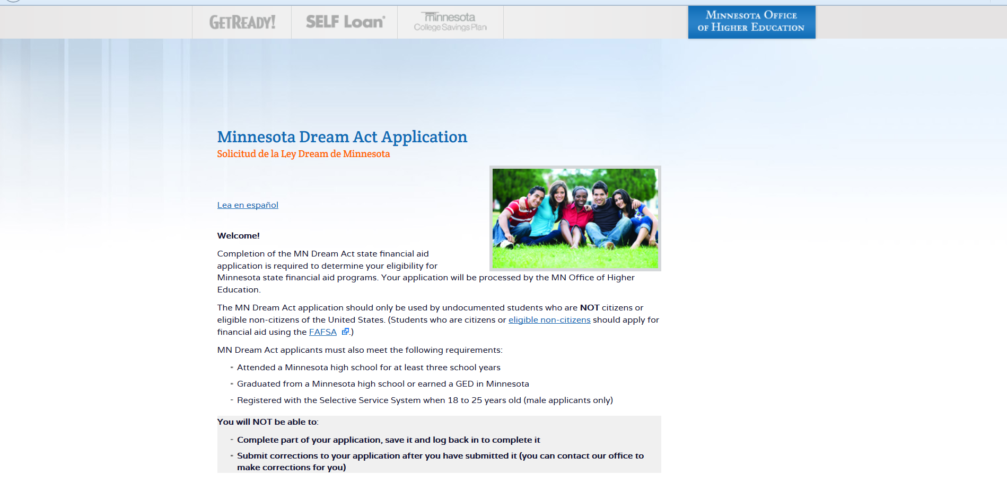
MN Dream Act State
Financial Aid Application
Must complete in one sitting!

Slide 32
MN Dream Act State
Financial Aid Application
Students can call MN Office of Higher Education Grant Unit for assistance
  (651) 642-0567 #2 Toll-free (800) 657-3866
  Can arrange for translation services if student and/or parents don’t speak English

Slide 33
Special Considerations
State Grant does not cover tuition and fees for most students
  Some colleges offer institutional scholarships
    U of M – UPromise
    Private 4-year college scholarships
    Minnesota State – Some award Alliss Grants
  Some colleges try to reserve State Work Study funds for these students
  Some students will need to borrow private student loan or state SELF loan

Slide 34
Special Considerations
Some MN Dream Act students had to withdraw because they couldn’t pay their tuition and fees
  Most schools will arrange payment plan, but even those payments are tough to pay out of pocket for students
Withdrawals put students in position of not being able to reenroll until past due amount paid off

Slide 35
Special Considerations
Many students have pursued college part-time prior to MN Dream Act
Some now have hit the 4-year limit on postsecondary attendance for the State Grant program
Parents may have received incorrect tax advice
  Married couples told to file as head of household when they should apply as married

Slide 36
Special Considerations
Can be challenging to identify undocumented students
MN Dream Act applications are increasing, but word still needs to get out
  2013-2014 = 362
  2014-2015 = 620
  2015-2016 = 700
  2016-2017 = 821 (so far)

Slide 37
Contact Information
www.ohe.state.mn/MNDreamAct
Meghan Flores
Manager, State Financial Aid
MN Office of Higher Education
(651) 355-0567, Option 2 for general questions
(651) 355-0610 for translations and tricky eligibility questions
Meghan.Flores@state.mn.us
Notes:
If you found this session interesting, please attend Estefanía’s presentation on Immigration Reor

