Slide 1
Overview of the MN Dream Act
Jessica Larson
Outreach Coordinator
April 11th, 2014

Slide 2
Is DACA the same as the MN Dream Act?

Slide 3
Deferred Action for Childhood Arrivals (DACA)
U.S. immigration policy memorandum
Defer action against undocumented individuals meeting certain criteria
Applicants pay $450 to apply
In force from June 15, 2012 – June 14, 2014
Provides work authorization and Social Security Number

Slide 4
DACA
Under age 31 as of June 15, 2012
Arrived in U.S. before 16th birthday
Continuously resided in the U.S. for the past 5 years
Physically present in the U.S. on 6/15/2012 and when applying for DACA
Entered U.S. before 6/15/2012 without inspection or lawful status expired
Attending school at time of application (or have graduated, earned GED, honorable military discharge
Not convicted of felony, significant misdemeanor or 3 or more misdemeanors

Slide 5
Prosperity Act (MN Dream Act)
Amended to Omnibus Higher Education bill
Signed into law on May 23, 2013
Applies to any academic term starting on or after July 1, 2013 at a Minnesota college or university

Slide 6
Prosperity Act (MN Dream Act)
Eligible for:
In-state tuition rates at MnSCU and University of MN campuses
State financial aid programs
Privately-funded scholarships administered by MnSCU or U of M campuses

Slide 7
Prosperity Act (MN Dream Act)
Requirements:
Attend a MN high school for at least 3 years
Graduate from a MN high school or earn a GED in MN
If male, complied with Selective Service registration requirements
Apply for lawful immigration status once federal process exists (does not refer to Deferred Action for Childhood Arrivals)

Slide 8
Prosperity Act (MN Dream Act)
Selective Service Requirements
Males 18 to 25 years old born 1960 or later are required to register
This includes undocumented individuals
If student has social security number via Deferred Action for Childhood Arrivals (DACA) status
Register for Selective Service online at: www.sss.gov
Should receive confirmation in 1-2 weeks

Slide 9
Prosperity Act (MN Dream Act)
If student cannot register online:
download Selective Service registration card from www.ohe.state.mn.us/MNDreamAct
Mail completed card to OHE along with other documentation needed for MN Dream Act
OHE will make copy and mail original to Selective Service System on student’s behalf

Slide 10
Prosperity Act (MN Dream Act)
Documentation required to establish eligibility for MN Dream Act
High school transcripts (don’t have to be certified/sealed)
High school diploma or GED (if high school graduation not documented on transcripts)
Proof of Selective Service registration (for males born after 1959)
Completed SS registration card or
Proof of registration from Selective Service or
Confirmation from Selective Service that failure to register was not knowing or willful

Slide 11
In-State Tuition at MnSCU & U of M
Students meeting MN Dream Act (or MN residency criteria after receiving DACA status) eligible for in-state tuition rates
Several MnSCU campuses and U of M Crookston and Morris campuses no longer have non-resident tuition rates
Students will only have to apply for in-state tuition under the MN Dream Act if the campus charges a non-resident tuition rate

Slide 12
2013-14 Resident vs. Non-Resident Tuition*
College | Resident | Non-Resident | Savings
U of M – TC | $12,060 | $18,310 | $6,250
U of M - Duluth | $11,720 | $15,385 | $3,665
Metro State Univ | $ 6,329 | $12,914 | $6,585
MN State Univ, Mankato | $ 6,668 | $14,327 | $7,659
MN State Univ Moorhead | $ 6,898 | $13,791 | $6,893
Saint Cloud State Univ | $ 6,584 | $14,226 | $7,642
Winona State Univ | $ 6,866 | $12,456 | $5,590
Lake Superior College | $ 4,418 | $ 8,835 | $4,417
MN West CC&TC | $ 5,147 | $10,293 | $5,146
Pine Technical College | $ 4,595 | $ 9,190 | $4,595
*Undergraduate tuition for 30 semester credits

Slide 13
Prosperity Act (MN Dream Act)
What state financial aid programs are available?

Slide 14
MN State Grant Program
Need-based grant based on student’s federal EFC, price of college and enrollment level
Gift aid; does NOT have to be repaid
Must be used by MN resident at MN college
Eligible until student has attended college for 4 full-time academic years (or equivalent)
Cannot be in default on student loans or delinquent on child support
Must be making satisfactory academic progress in college pursuing certificate, diploma or degree

Slide 15
MN State Grant Program (2013-2014 Annual Awards for Student With $0 EFC)
U of M/Private | State University | 2-Year Public
Annual | Annual
Pell Grant | State
Award | Grant
$5,645 | $4,805
$5,645 | $4,105
$5,645 | $3,415
$5,645 | $2,715
$4,234 | $3,426
$4,234 | $2,736
$4,234 | $2,036
$2,823 | $2,747
$2,823 | $2,057
$2,823 | $1,357
$1,411 | $2,069
$1,411 | $1,379
$1,411 | $679
Annual | Annual
Pell Grant | State
Award | Grant
$5,645 | $2,145
$5,645 | $1,623
$5,645 | $1,109
$5,645 | $587
$4,234 | $1,476
$4,234 | $962
$4,234 | $440
$2,823 | $1,329
$2,823 | $815
$2,823 | $293
$1,411 | $1,183
$1,411 | $669
$1,411 | $147
Annual | Annual
Pell Grant | State
Award | Grant
$5,645 | $987
$5,645 | $543
$5,645 | $105
$5,645 | $0
$4,234 | $627
$4,234 | $190
$4,234 | $0
$2,823 | $712
$2,823 | $274
$2,823 | $0
$1,411 | $797
$1,411 | $360
$1,411 | $0
Credits
For
Term
15
14
13
12
11
10
9
8
7
6
5
4
3

Slide 16
Postsecondary Child Care Grant Program
For low-income students with children in child care while they attend college
Available to MN residents attending MN public colleges and private 4-year degree-granting colleges
Gift aid; does NOT have to be repaid
Eligible until student has attended college for 4 full-time academic years (or equivalent)
Cannot be in default on student loans
Must be making satisfactory academic progress in college

Slide 17
Postsecondary Child Care Grant Program
Maximum award per child for full-time student $2,800
Must fill out paper program application after completing online state financial aid application
Program application available at college financial aid office
Will be awarded by financial aid office at college
Financial aid administrator can access student’s application record on OHE system to get total income, household size, household members, EFC

Slide 18
MN State Work Study Program
Must have DACA status, work authorization and social security number
Must also meet MN Dream Act requirements OR have DACA status before meeting state residency requirements
Work study jobs available on or off campus
Most students work 10-15 hours per week
Must be arranged by college financial aid office
Contact college after submitting online state financial aid application and all supporting documentation
College can access OHE system to confirm DACA, MN resident status, EFC

Slide 19
Tuition Reciprocity Program
Available to MN residents attending public colleges and universities in:
North Dakota
South Dakota
Wisconsin
Manitoba
Iowa Lakes Community College
Won’t have to pay higher non-resident tuition rate
MN residents generally pay the higher of the MN resident tuition rate or the resident tuition charged by the college attended

Slide 20
Tuition Reciprocity Program
If attending in SD, IA, Manitoba and ND, students will be approved on campus
All students attending in SD, IA, MB
New high school graduates attending in ND
Otherwise, students should:
Use new state online financial aid application
Tuition reciprocity application
Both available on: www.ohe.state.mn.us
State financial aid NOT available in other states (except SELF Loan)

Slide 21
SELF Loan Program
Available to students attending MN colleges or MN residents attending in other states
No immigration requirements for borrower
Co-signer must be U.S. citizen or permanent resident, live in U.S. and have no adverse credit
Should complete state online financial aid application
Will also require a SELF loan application
www.selfloan.org (online application for DACA students with SSN)
Pick up paper application at college (students without SSN)
$10,000 per year for 4-year degree programs or graduate students
$7,500 per year for shorter programs

Slide 22
Financial Verification Documents
Will need to submit signed copies of federal income tax return for previous tax year (e.g. 2013 for 2014-2015 school year)
Student (and spouse, if married)
Student and Parents (if student is dependent for financial aid purposes)
If income was under threshold for filing a tax return, should submit W2s and signed statement indicating not required to file tax return and listing any additional income

Slide 23
Financial Verification Documents
If income was over threshold for filing federal tax return, student/parents must complete and submit a federal tax return
Can apply for and use ITIN (instead of SSN) to file tax return
Submit copy of completed form(s) to OHE with other MN Dream Act documentation

Slide 24
2013 Federal Tax Returns Required
Tax Filing Status | Age | Gross Income at Least
Single | Under 65 65 or older | $10,000 $11,500
Married filing jointly | Under 65 (both) 65 or older (one) 65 or older (both) | $20,000 $21,200 $22,400
Married filing separately | Any age | $ 3,900
Head of Household | Under 65 65 or older | $12,850 $14,350
Single and claimed as dependent | Under age 65 | $ 1,000 unearned income $ 6,100 earned income

Slide 25
MN Dream Act State Financial Aid Application
Undocumented students cannot file a Free Application for Federal Student Aid (FAFSA)
Link and MN-Specific Instructions to online state financial aid application posted on:
www.ohe.state.mn.us/MNDreamAct
MN Dream Act State Financial Aid Application
Application for 2014-2015 school year available in January 2014
Covers July 1, 2014 through June 30, 2015
Student should reapply for state financial aid every year in college

Slide 26
MN Dream Act State Financial Aid Application
For customer service with application, call
(800) 282-1550
Monday through Friday
8:00 a.m to 4:30 p.m.
Students can also call MN Office of Higher Education Grant Unit
(651) 642-0567 #2 Toll-free (800) 657-3866
Can arrange for translation services if student and/or parents don’t speak English

Slide 27
Online State Financial Aid Application

Slide 28
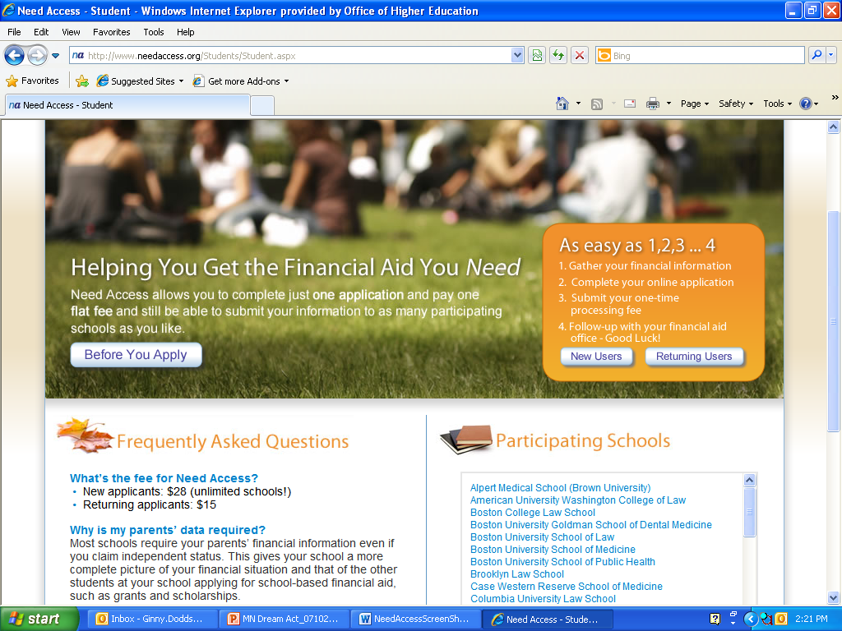
Online State Financial Aid Application

Slide 29
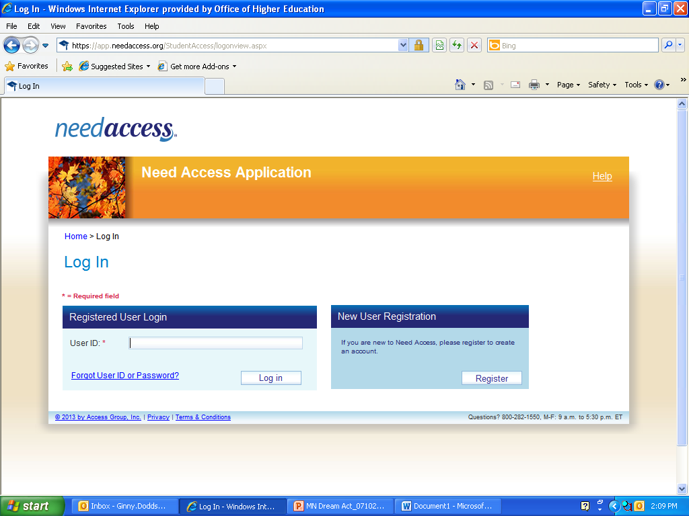
Online State Financial Aid Application

Slide 30
Online State Financial Aid Application
User ID and password will be used to access application

Slide 31
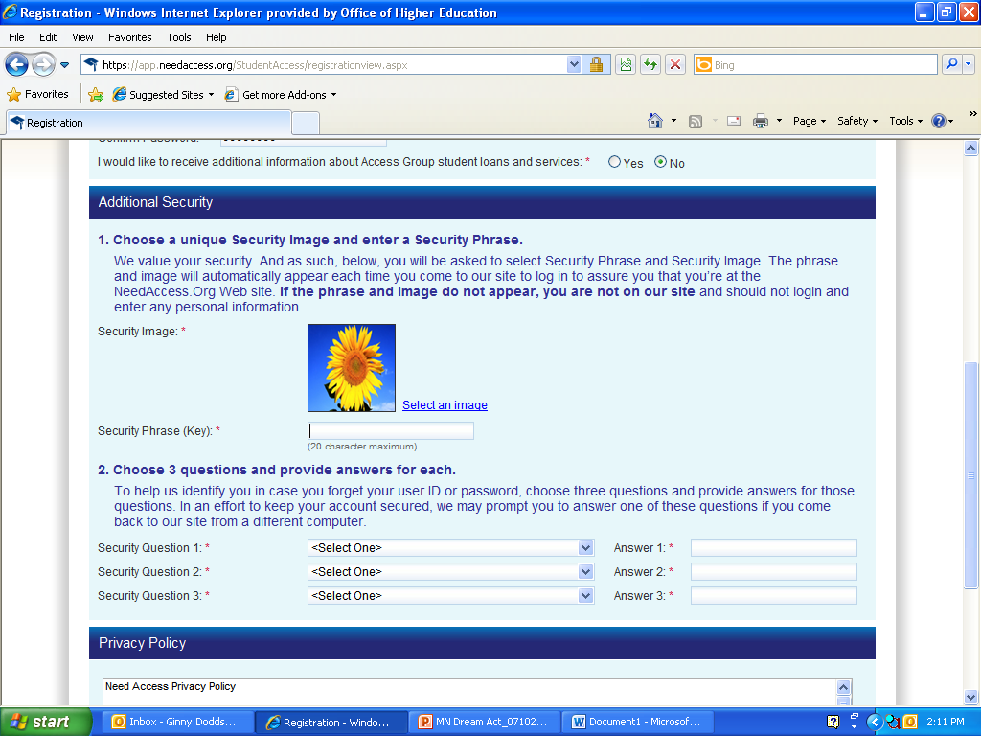
Online State Financial Aid Application
These will later be used to access application.

Slide 32
Online State Financial Aid Application
Student should accept privacy policy

Slide 33
Online State Financial Aid Application
If student doesn’t have SSN, system will assign student 9-digit number to use

Slide 34
Online State Financial Aid Application
Applicant ID used in place of SSN

Slide 35
The Trickiest Section of Application
Scroll down and select ‘MN Dream Act State Financial Aid Application’ instead of a college and click on Add button.
Click Add to bring selection to this side
Select from this side

Slide 36
Contact Information
www.ohe.state.mn/MNDreamAct
Ginny Dodds
Manager, State Financial Aid
MN Office of Higher Education
(651) 355-0610
Ginny.Dodds@state.mn.us

Slide 37
Other Ways to Pay
Scholarships
Community, employers, faith organizations etc.
Talk to teachers, counselors, college etc.
Online @ www.fastweb.com or www.finaid.org
Savings/Family Support
Dual Credit in High School
AP, IB, CIS, PSEO
www.fafsa.gov with a valid SSS number

Slide 38
Other contact info:
Jessica Larson
Outreach Coordinator
651-259-3966
jessica.larson@state.mn.us
Emilia Avalos
Navigate – Advocacy Director
emilia@navigatemn.org

