Slide 1

NAVIGATE MN, CITIZENS LEAGUE & HENNEPIN TECHNICAL COLLEGE Prosperity Act (MN Dream Act)

Slide 2
WELCOME
Nathan Stratton
Dean of Hennepin Technical College

Slide 3
Mn Dream Act
JUVENTINO MEZA
Citizens League & NAVIGATE

Slide 4
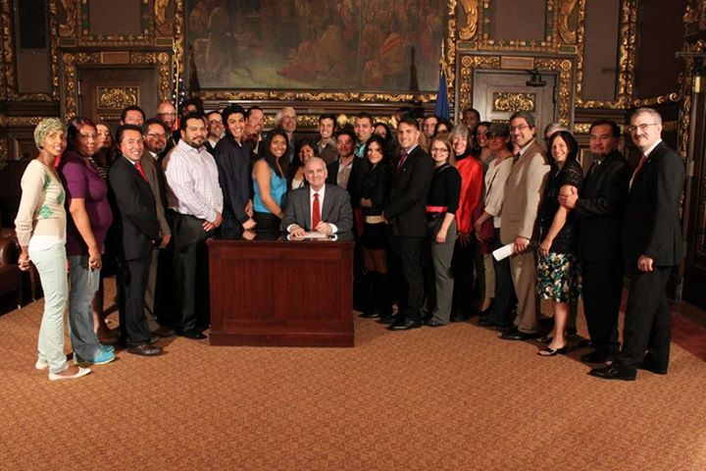
MN Prosperity/Dream Act
Passed by MN State Legislature & signed by Gov. Mark Dayton in May 2013

Slide 5
APPLICATION PROCESS
Ginny Dodds
MN Office of Higher Education

Slide 6
Prosperity Act (MN Dream Act)
Amended to Omnibus Higher Education bill
Signed into law on May 23, 2013
Applies to any academic term starting on or after July 1, 2013 at a Minnesota college or university

Slide 7
Prosperity Act (MN Dream Act)
Eligible for:
In-state tuition rates at MnSCU and University of MN campuses
State financial aid programs
Privately-funded scholarships administered by MnSCU or U of M campuses

Slide 8
Prosperity Act (MN Dream Act)
Requirements:
Attend a MN high school for at least 3 years
Graduate from a MN high school or earn a GED in MN
If male, complied with Selective Service registration requirements
Apply for lawful immigration status once federal process exists (does not refer to Deferred Action for Childhood Arrivals)

Slide 9
Prosperity Act (MN Dream Act)
Attend a MN high school for at least 3 years
Homeschooling in MN is equivalent
Years = academic years
Years do not have to be consecutive as long as they take place at high school
10th – 12th
9th, 11th, 12th

Slide 10
Prosperity Act (MN Dream Act)
Graduate from a MN high school or earn a GED in MN
Homeschooling counts as MN high school

Slide 11
Prosperity Act (MN Dream Act)
Selective Service Requirements
Males 18 to 25 years old born after 1960 are required to register
This includes undocumented immigrants
If student has social security number via Deferred Action for Childhood Arrivals (DACA) status
Register for Selective Service online at: www.sss.gov
Should receive confirmation in 1-2 weeks

Slide 12
Prosperity Act (MN Dream Act)
If student does not have SSN, must mail in registration card
Pick up at any U.S. post office or MN Office of Higher Education
Takes 30-90 days for confirmation to be sent back to student
Avoid delays by completing registration card and mailing to OHE along with other documentation needed for MN Dream Act
OHE will make copy and mail original to Selective Service System on student’s behalf

Slide 13
Prosperity Act (MN Dream Act)
If male student 26 or older never registered, must prove failure to register was not knowing or willful
Download Request for Status Information Letter from www.sss.gov, complete and mail to Selective Service System
If Selective Service System determines student’s failure to register was not knowing or willful, student will be eligible for MN Dream Act
Otherwise, student will not be eligible

Slide 14
Prosperity Act (MN Dream Act)
Apply for lawful immigration status once federal process exists
If no federal process exists prior to start of fall term, MN Dream Act benefits will apply to fall term
If Congress passes immigration reform that includes process for applying for lawful immigration status
May affect MN Dream Act eligibility for future academic terms, years

Slide 15
Prosperity Act (MN Dream Act)
Documentation required to establish eligibility for MN Dream Act
High school transcripts
High school diploma or GED (if high school graduation not documented on transcripts)
Proof of Selective Service registration (for males born after 1960)
Completed SS registration card or
Proof of registration from Selective Service or
Confirmation from Selective Service that failure to register was not knowing or willful

Slide 16
Prosperity Act (MN Dream Act)
MN Dream Act repealed state rules requiring state financial aid recipients to be U.S. citizens or eligible non-citizens
Students will only have to meet ONE of the criteria in the definition of Minnesota resident student in state statute 136A.101, Subd. 8
MN Dream Act provisions are one of the MN resident criteria
Undocumented students who don’t meet MN Dream Act criteria may qualify if they were granted DACA status prior to meeting one of the other state residency criteria

Slide 17
MN Resident Definition
Graduated from MN high school while residing in MN
Earned a GED in MN after residing in MN for 1 year
Dependent applicant’s parents resided in MN when student applied for financial aid
Resided in MN for one year and did not attend college on a half-time basis or more
Refugee who immediately settled in MN
Relocated to MN due to college education being disrupted in area of natural disaster
Stationed on active military duty in MN
Spouse/dependent of veteran who is MN resident
MN Dream Act criteria

Slide 18
Prosperity Act (MN Dream Act)
What state financial aid programs are available?

Slide 19
Independent Student Definition Used for 2013-2014 Financial Aid
Age 24 by December 31, 2013
Married
Graduate or professional student
Has children or other dependents
Orphan, foster care or ward of court at any time since turning 13
Emancipated minor or in legal guardianship
Unaccompanied homeless youth at any time after July 1, 2012
Dependency override

Slide 20
Expected Family Contribution (EFC)
Dependent Student
Parents’ income and assets
Household size
Number of dependents attending college
Student’s income and assets
If income > $6,130
Independent Student
Student’s (and spouse’s) income and assets
Household size
Number in household attending college

Slide 21
MN State Grant Program
Need-based grant based on student’s federal EFC, price of college and enrollment level
Gift aid; does NOT have to be repaid
Must be used by MN resident at MN college
Eligible until student has attended college for 4 full-time academic years (or equivalent)
Cannot be in default on student loans or delinquent on child support
Must be making satisfactory academic progress in college pursuing certificate, diploma or degree

Slide 22
MN State Grant Program
Average Tuition & Mandatory Fees* (30 sem/45 qtr credits)
+ Living and Misc Expense Allowance (LME)** ($7,900)
= State Grant Budget
50% Assigned Student Responsibility
Annual 9-month FM PC (dependent) X .96***
Annual FM EFC X .86 (independent with deps)*** or
Annual FM EFC X .50 (independent w/o deps)***
Pell Grant Award
= State Grant Annual Award (minimum $100)
*subject to tuition & fee caps $13,000 for 4-yr program; $5,808 for 2-yr or less program
**LME $0 for those in correctional facility.
***For MnSCU campuses only, contribution further prorated for enrollment level
(e.g., by 10/15ths or .667 for a student taking 10 credits)

Slide 23
MN State Grant Program
U of M/Private | State University | 2-Year Public
Annual | Annual
Pell Grant | State
Award | Grant
$5,645 | $4,805
$5,645 | $4,105
$5,645 | $3,415
$5,645 | $2,715
$4,234 | $3,426
$4,234 | $2,736
$4,234 | $2,036
$2,823 | $2,747
$2,823 | $2,057
$2,823 | $1,357
$1,411 | $2,069
$1,411 | $1,379
$1,411 | $679
Annual | Annual
Pell Grant | State
Award | Grant
$5,645 | $2,145
$5,645 | $1,623
$5,645 | $1,109
$5,645 | $587
$4,234 | $1,476
$4,234 | $962
$4,234 | $440
$2,823 | $1,329
$2,823 | $815
$2,823 | $293
$1,411 | $1,183
$1,411 | $669
$1,411 | $147
Annual | Annual
Pell Grant | State
Award | Grant
$5,645 | $987
$5,645 | $543
$5,645 | $105
$5,645 | $0
$4,234 | $627
$4,234 | $190
$4,234 | $0
$2,823 | $712
$2,823 | $274
$2,823 | $0
$1,411 | $797
$1,411 | $360
$1,411 | $0
Credits
For
Term
15
14
13
12
11
10
9
8
7
6
5
4
3

Slide 24
Postsecondary Child Care Grant Program
For low-income students with children in child care while they attend college
Available to MN residents attending MN public colleges and private 4-year degree-granting colleges
Gift aid; does NOT have to be repaid
Eligible until student has attended college for 4 full-time academic years (or equivalent)
Cannot be in default on student loans
Must be making satisfactory academic progress in college

Slide 25
Postsecondary Child Care Grant Program
Maximum award per child for full-time student $2,800
Must fill out paper program application after completing online state financial aid application
Program application available at college financial aid office
Will be awarded by financial aid office at college

Slide 26
MN State Work Study Program
Must have DACA status, work authorization and social security number
Must also meet MN Dream Act requirements OR have DACA status before meeting state residency requirements
Work study jobs available on or off campus
Most students work 10-15 hours per week
Must be arranged by college financial aid office
Contact college after submitting online state financial aid application and all supporting documentation

Slide 27
Tuition Reciprocity Program
Available to MN residents attending public colleges and universities in:
North Dakota
South Dakota
Wisconsin
Manitoba
Iowa Lakes Community College
Won’t have to pay higher non-resident tuition rate
MN residents generally pay the higher of the MN resident tuition rate or the resident tuition charged by the college attended

Slide 28
Tuition Reciprocity Program
If attending in SD, IA, Manitoba and ND, students will be approved on campus
All students attending in SD, IA, MB
New high school graduates attending in ND
Otherwise, students should:
Use new state online financial aid application
Tuition reciprocity application
Both available on: www.ohe.state.mn.us
State financial aid NOT available in other states (except SELF Loan)

Slide 29
Midwestern Student Exchange Program (MSEP)
Available to MN residents attending selected public (and some private) colleges and universities in:
Illinois, Indiana, Kansas, Michigan, Missouri and Nebraska
Won’t have to pay higher non-resident tuition rate
MN residents generally pay up to 150% of the resident tuition rate charged by the college
Let college admissions office know you are a MN resident to qualify for the MSEP tuition discount
More info at: www.mhec.org

Slide 30
SELF Loan Program
Available to students attending MN colleges or MN residents attending in other states
No immigration requirements for student borrower
Co-signer must be U.S. citizen or permanent resident, live in U.S. and have no adverse credit
Should complete state online financial aid application
Will also require a SELF loan application
www.selfloan.org (does not require SSN)
$10,000 per year for 4-year degree programs or graduate students
$7,500 per year for shorter programs

Slide 31
SELF Loan Program
Can choose fix rate interest rate (6.9%) or quarterly variable rate (currently 3.3%)
Must make quarterly interest payments while attending college
DOES need to be repaid
After graduating, monthly interest payments for one year, then payments on interest and principal until loan paid in full
CANNOT be consolidated with federal student loans
More information available at: www.selfloan.org

Slide 32
Other State Financial Aid Programs
MN Indian Scholarship Program
MN GI Bill Program
Safety Officers Survivor Grant

Slide 33
Financial Verification Documents
Online state application has already asked for members of household and number in college
Student will need to submit documentation in support of income information provided on the state online financial aid application

Slide 34
Financial Verification Documents
Will need to submit signed copies of 2012 federal income tax return and W2 statements
Student (and spouse, if married)
Student and Parents (if student is dependent for financial aid purposes)
If income was under threshold for filing a tax return, should submit W2s and signed statement indicating not required to file tax return and listing any additional income

Slide 35
Financial Verification Documents
If income was over threshold for filing federal tax return, must complete and submit a federal tax return
Can apply for and use ITIN (instead of SSN) to file tax return
Submit copy of completed form(s) to OHE with other MN Dream Act documentation

Slide 36
2012 Federal Tax Returns Required
Tax Filing Status | Age | Gross Income at Least
Single | Under 65 65 or older | $ 9,750 $11,200
Married filing jointly | Under 65 (both) 65 or older (one) 65 or older (both) | $19,500 $20,650 $21,800
Married filing separately | Any age | $ 3,800
Head of Household | Under 65 65 or older | $12,500 $13,950
Single and claimed as dependent | Under age 65 | $ 950 unearned income $ 5,950 earned income

Slide 37
In-State Tuition at MnSCU & U of M
Students meeting MN Dream Act (or MN residency criteria after receiving DACA status) eligible for in-state tuition rates
Several MnSCU campuses and U of M Crookston and Morris campuses no longer have non-resident tuition rates
Students will only have to apply for in-state tuition under the MN Dream Act if the campus charges a non-resident tuition rate

Slide 38
2013-14 Resident vs. Non-Resident Tuition*
College | Resident | Non-Resident | Savings
U of M – TC | $12,060 | $18,310 | $6,250
U of M - Duluth | $11,720 | $15,385 | $3,665
Metro State Univ | $ 6,329 | $12,914 | $6,585
MN State Univ, Mankato | $ 6,668 | $14,327 | $7,659
MN State Univ Moorhead | $ 6,898 | $13,791 | $6,893
Saint Cloud State Univ | $ 6,584 | $14,226 | $7,642
Winona State Univ | $ 6,866 | $12,456 | $5,590
Lake Superior College | $ 4,418 | $ 8,835 | $4,417
MN West CC&TC | $ 5,147 | $10,293 | $5,146
Pine Technical College | $ 4,595 | $ 9,190 | $4,595
*Undergraduate tuition for 30 semester credits

Slide 39
Online State Financial Aid Application
Undocumented students cannot file a Free Application for Federal Student Aid (FAFSA)
Lack social security numbers
Won’t pass legal immigration status
OHE contracting with Access Group, Inc. to have students use customized state financial aid application
Will contain questions on the FAFSA
Additional customized questions to determine MN Dream Act and state financial aid eligibility
Will be operational in July 2013
Contact OHE if barriers to using online application

Slide 40
Online State Financial Aid Application
Link to online state financial aid application will be posted on:
www.ohe.state.mn.us/MNDreamAct
Two versions of online state application
MN Dream Act – State Financial Aid and U of M In-State Tuition
MN Dream Act – Univ of MN In-State Tuition Only
U of M students who don’t want to apply for state financial aid should use MN Dream Act – In-State Tuition Only application
Otherwise, use application for both state financial aid and in-state tuition rates
This includes both MnSCU and U of M students applying for state financial aid and in-state tuition

Slide 41
Online State Financial Aid Application
U of M will rely on online state application to verify students qualify for in-state tuition rates under MN Dream Act
Uncertain how MnSCU campuses will determine eligibility for in-state tuition under MN Dream Act
Most likely will build into admissions process

Slide 42
Online State Financial Aid Application
PROs
Existing system that will be ready in July 2013
Would have taken much longer for OHE to build own system or use California’s
Easy to use for students without SSNs
Customer support & online instructions
CONs
Not in Spanish like FAFSA on the Web
Students may think they have to pay fee (OHE is paying fees for all undocumented students)
Contains standard questions that are not on FAFSA and won’t be used to determine EFC
OHE will indicate in instructions which questions will not be used (student can enter any response)

Slide 43
Online State Financial Aid Application
For customer service with application, call
(800) 282-1550
Monday through Friday
8:00 a.m to 4:30 p.m.
Students can also call MN Office of Higher Education Grant Unit
(651) 642-0567 #2 Toll-free (800) 657-3866
Can arrange for translation services if student and/or parents don’t speak English

Slide 44
After Using Online State Application
Students will receive email confirming they have used the online application
Email will tell student what documentation is needed for:
MN Dream Act
High school transcripts, diploma, GED
Selective Service registration confirmation
State Financial Aid
College transcripts (if student has attended college for 3 or more academic years)
Tax forms and W2s for verification of financial information

Slide 45
After Applying and Submitting Requested Documentation
Output from state online financial aid application loaded to new system at OHE
Once requested documentation received, MN colleges can access system to certify student is enrolled and meets other eligibility requirements (e.g. SAP, etc.)
OHE system will calculate student’s State Grant and notify student and college(s)
OHE will send funds to college to cover State Grant payments for eligible students

Slide 46
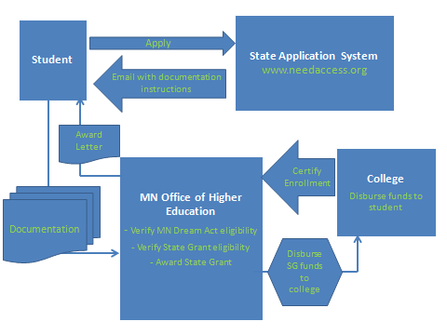
MN Dream Act State Grant System

Slide 47
In the Future…..
If federal DREAM Act passes that extends federal financial aid eligibility to undocumented students, they can use the FAFSA
Until then, MN undocumented students will need to complete the state online financial aid application
OHE will expect MN colleges to modify their systems to handle output from the state online financial aid application for 2014-2015
OHE will verify MN Dream Act eligibility, but colleges will do remaining tasks
State Grant eligibility requirements, verification, award calculation, disbursement

Slide 48
Contact Information
www.ohe.state.mn/MNDreamAct
Ginny Dodds
Manager, State Financial Aid
MN Office of Higher Education
(651) 355-0610
Ginny.Dodds@state.mn.us

Slide 49
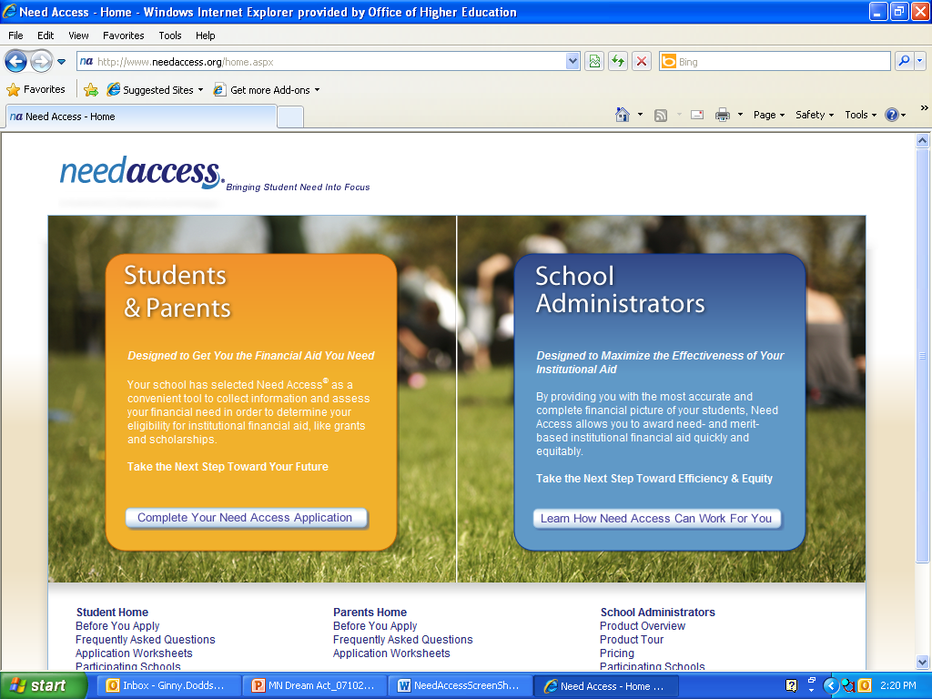
Online State Financial Aid Application

Slide 50
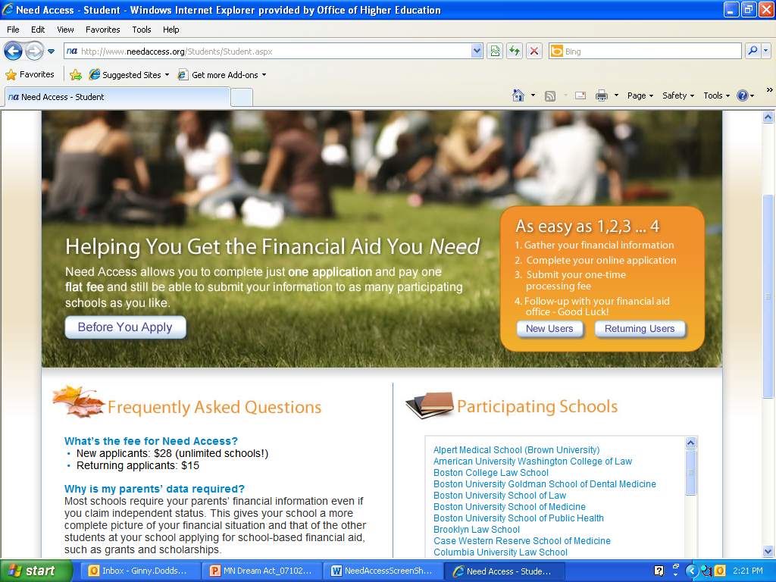
Online State Financial Aid Application

Slide 51
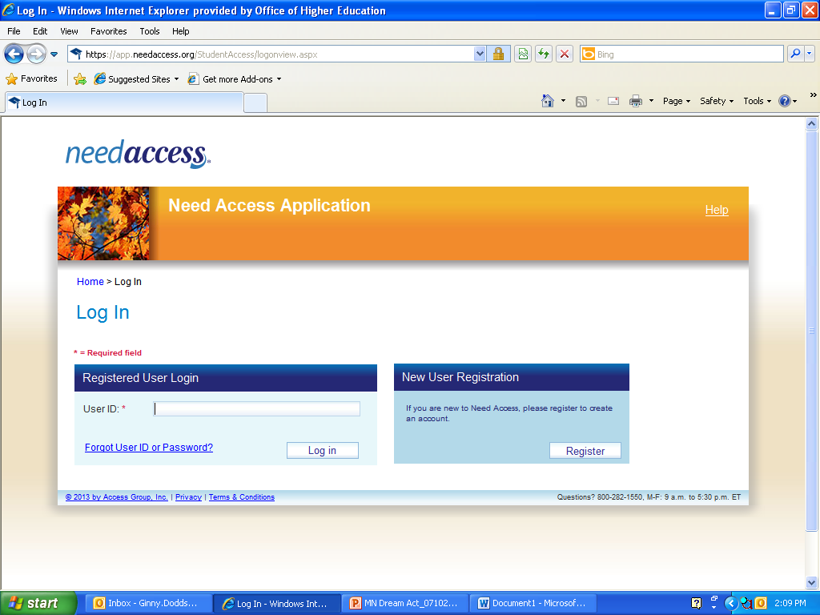
Online State Financial Aid Application

Slide 52
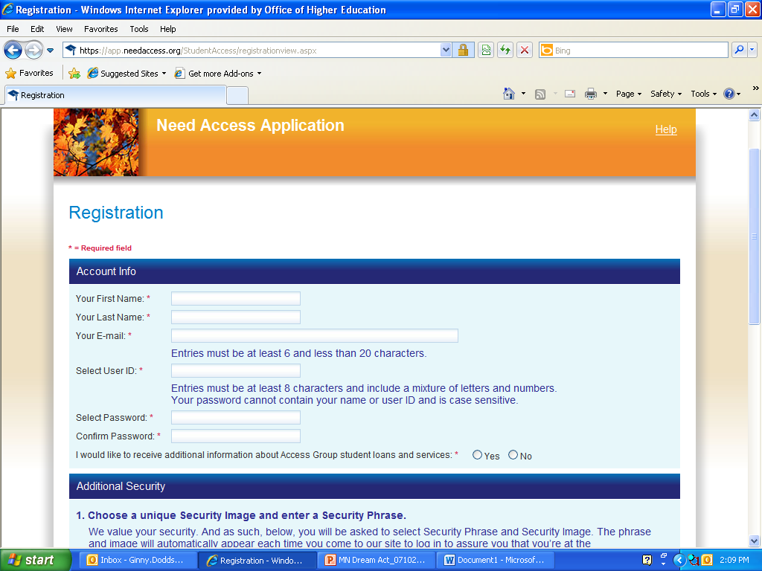
Online State Financial Aid Application
User ID and password will be used to access application

Slide 53
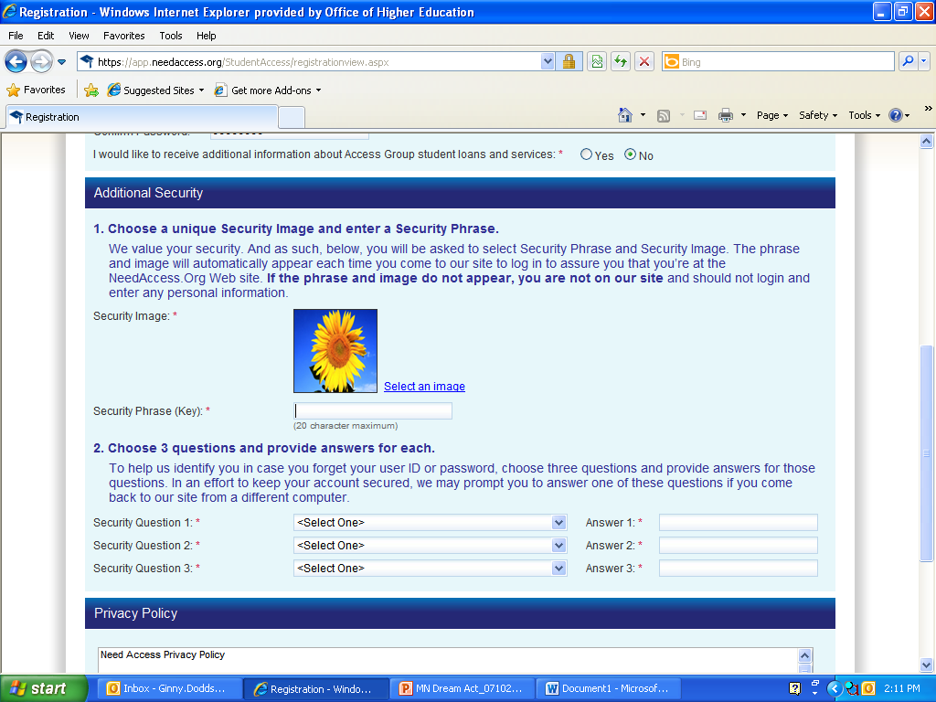
Online State Financial Aid Application
These will later be used to access application.

Slide 54
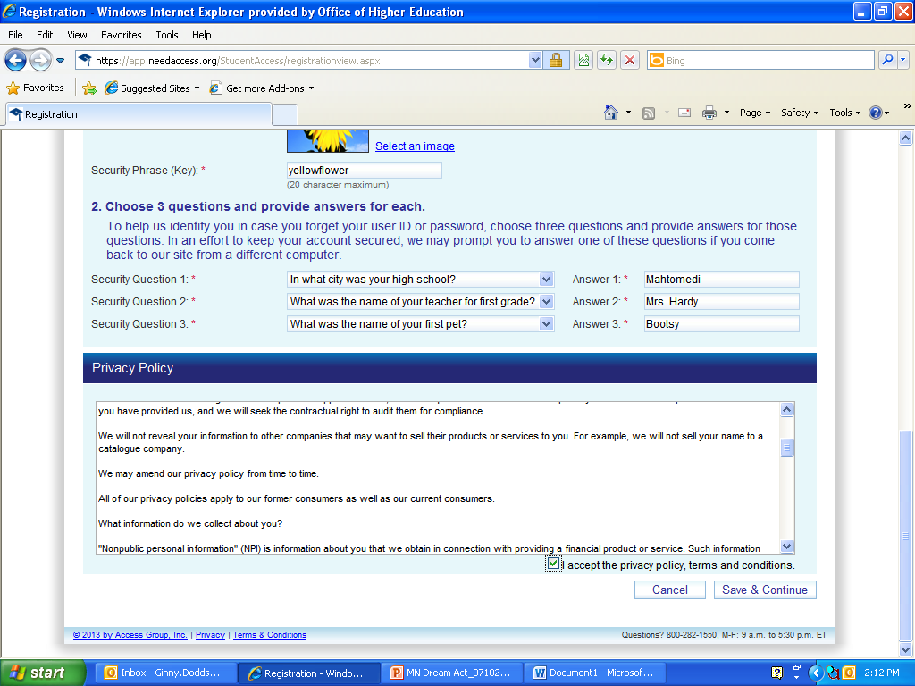
Online State Financial Aid Application
Student should accept privacy policy

Slide 55
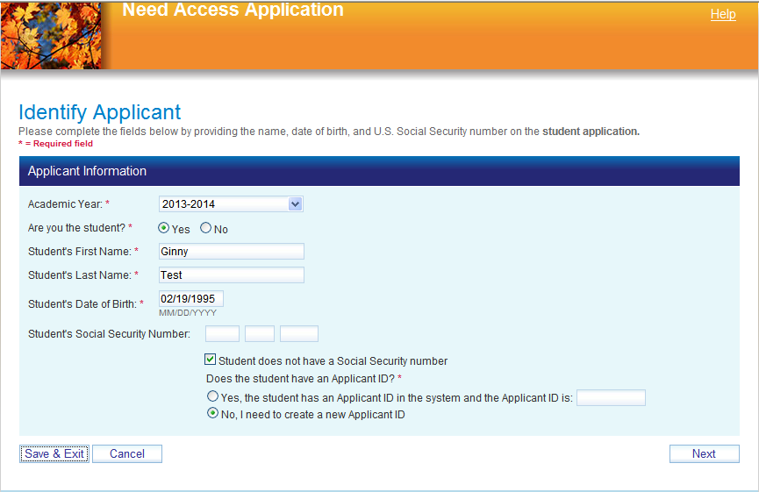
Online State Financial Aid Application
If student doesn’t have SSN, system will assign student 9-digit number to use

Slide 56
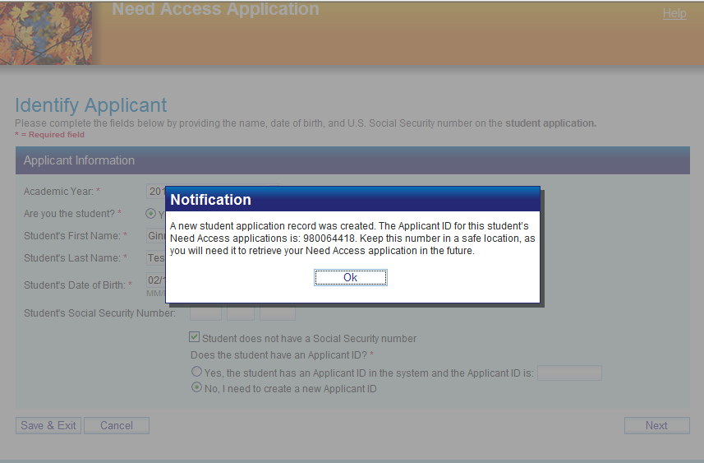
Online State Financial Aid Application
Student ID used in place of SSN

Slide 57
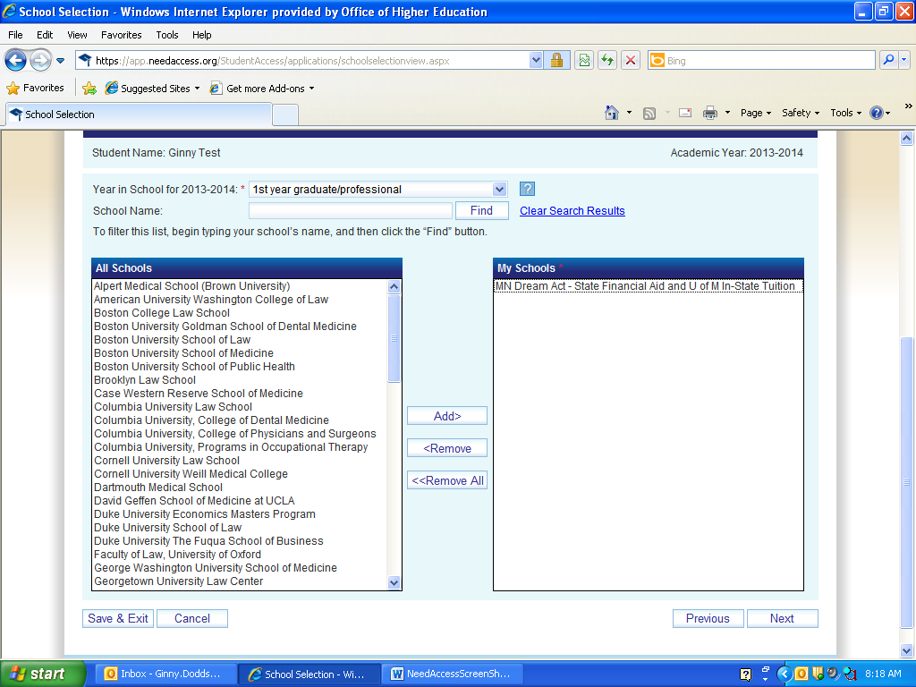
Online State Financial Aid Application
Select ‘MN Dream Act – State Financial Aid and U of M In-State Tuition’ and click on Add button. If U of M student does not want to apply for state financial aid, select ‘MN Dream Act – Univ of MN In-state Tuition Only’ instead.

Slide 58
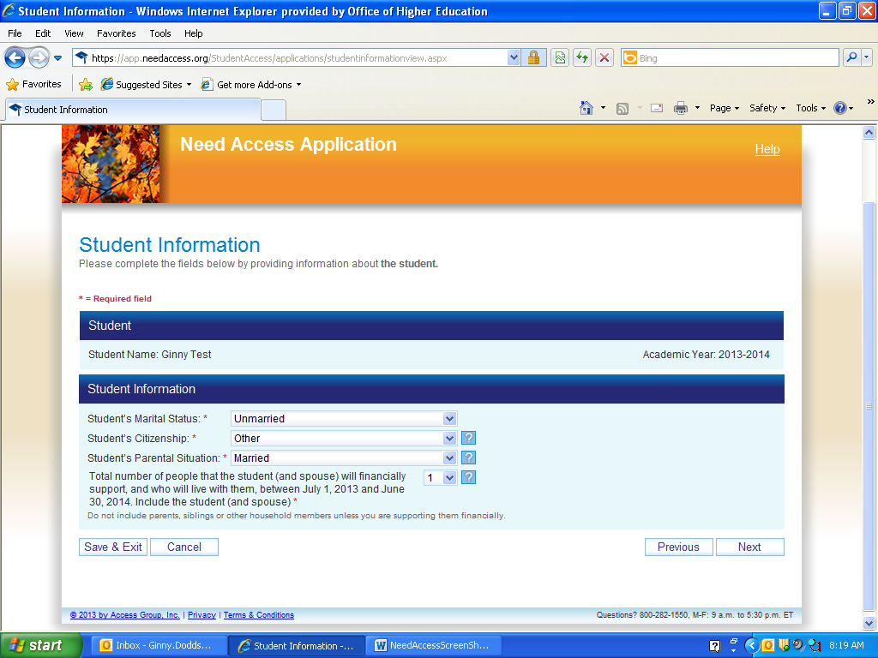
Online State Financial Aid Application
Note questions with * are required
Note ? Box with instructions

Slide 59
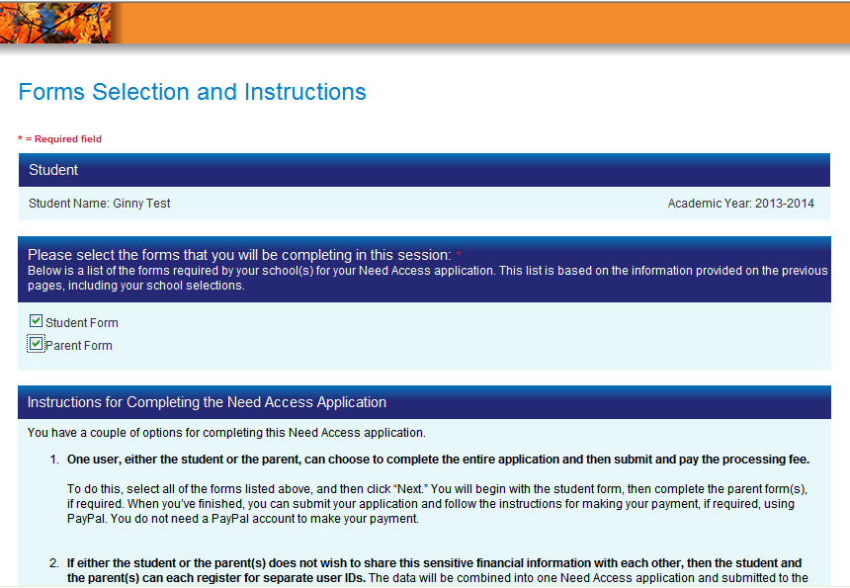
Online State Financial Aid Application

Slide 60
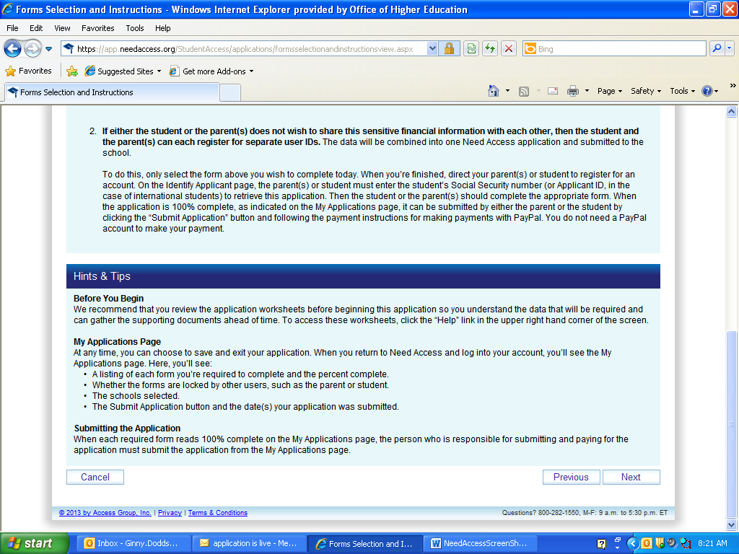
Online State Financial Aid Application

Slide 61
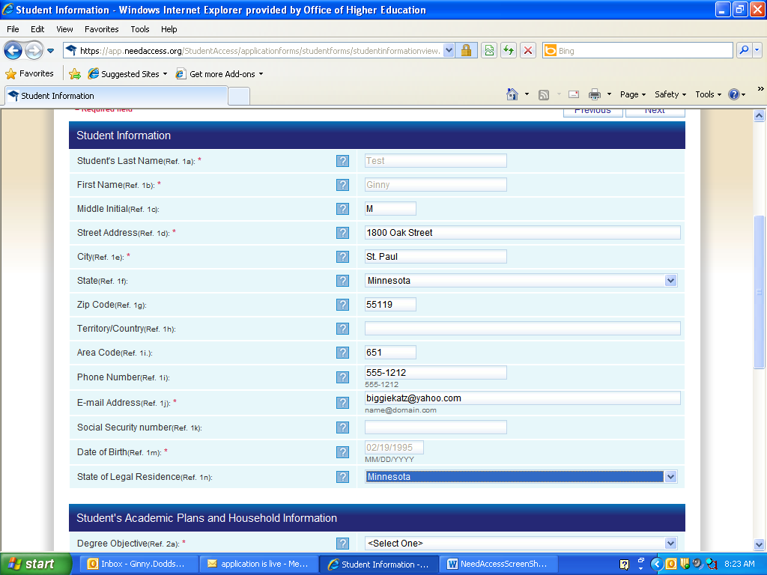
Online State Financial Aid Application
Can leave blank if student doesn’t have SSN

Slide 62
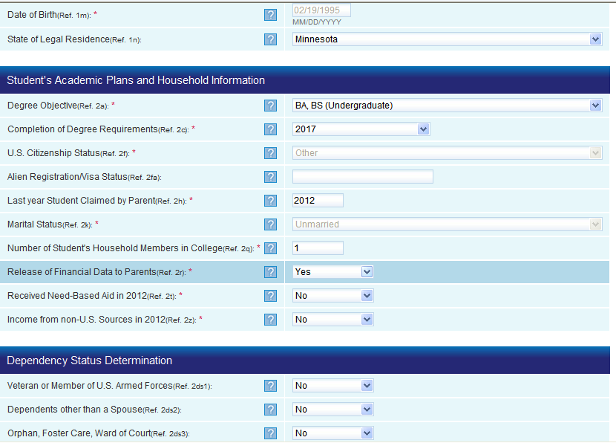
Online State Financial Aid Application = Not Used by MN, but must have some type of response

Slide 63
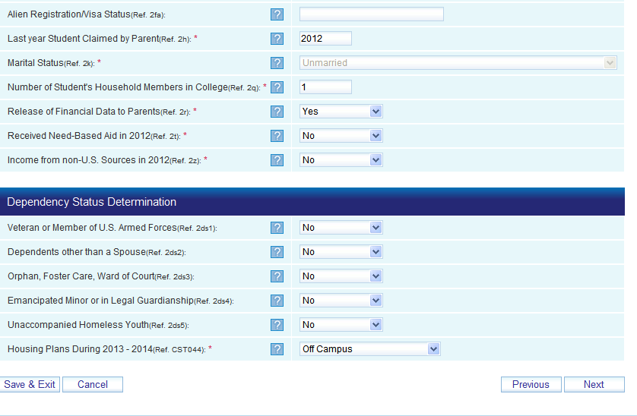
Online State Financial Aid Application

Slide 64
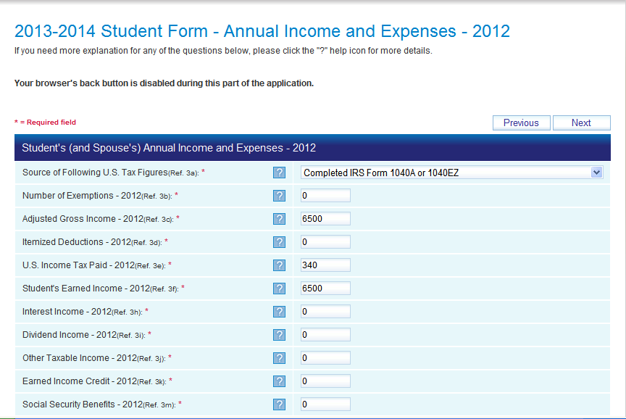
Online State Financial Aid Application

Slide 65
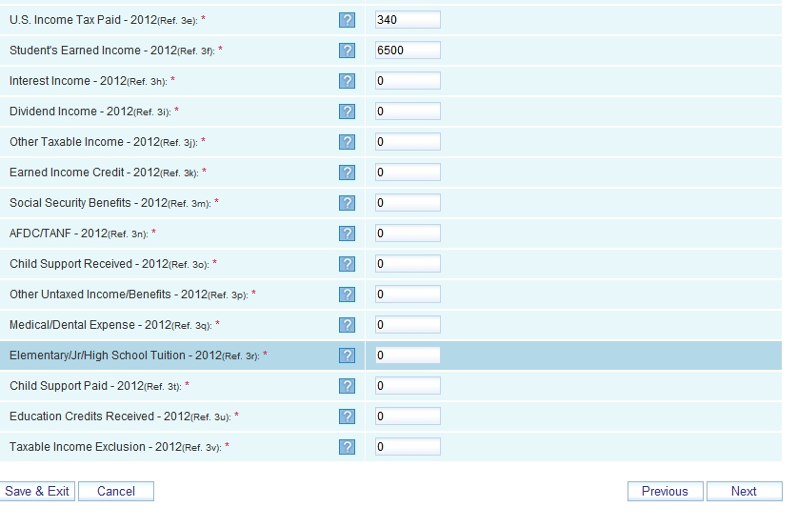
Online State Financial Aid Application

Slide 66
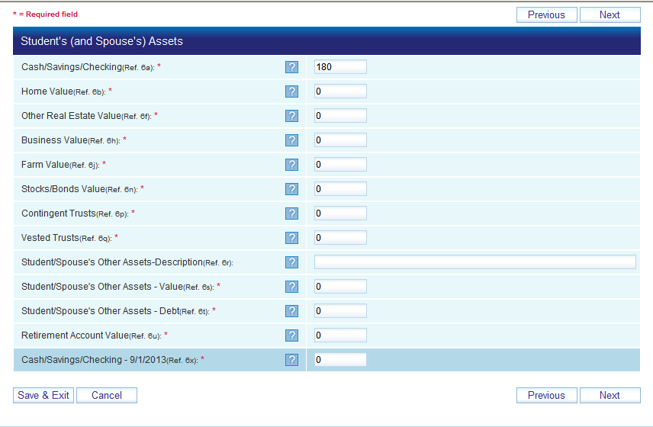
Online State Financial Aid Application

Slide 67
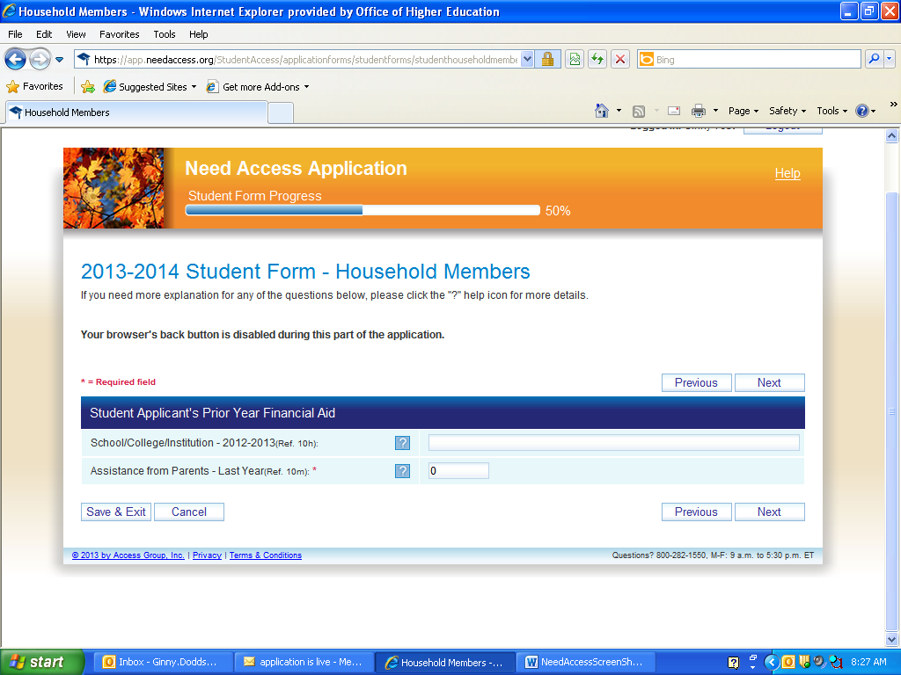
Online State Financial Aid Application

Slide 68
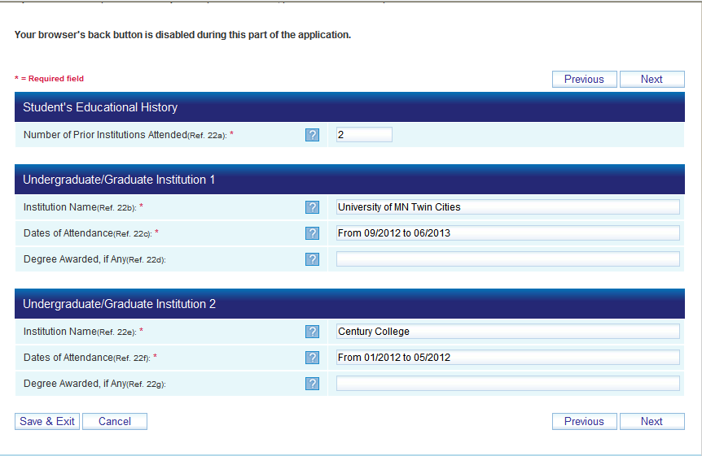
Online State Financial Aid Application

Slide 69
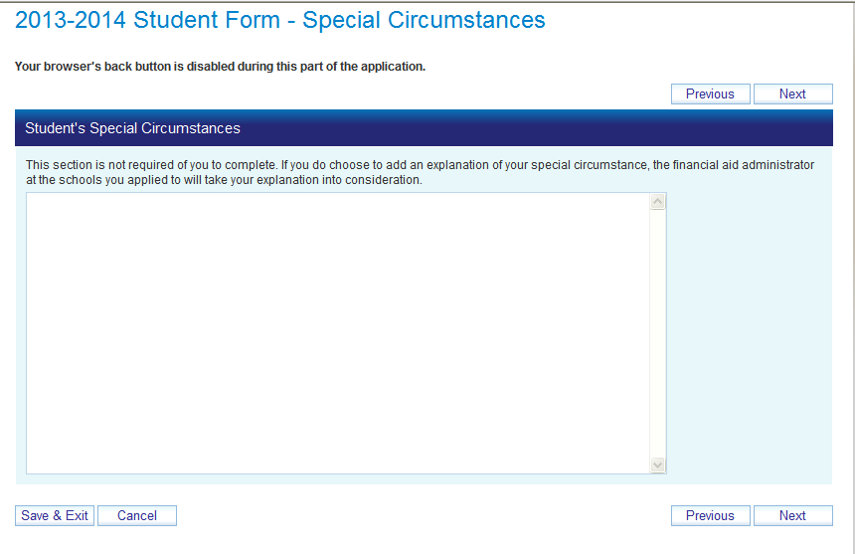
Online State Financial Aid Application

Slide 70
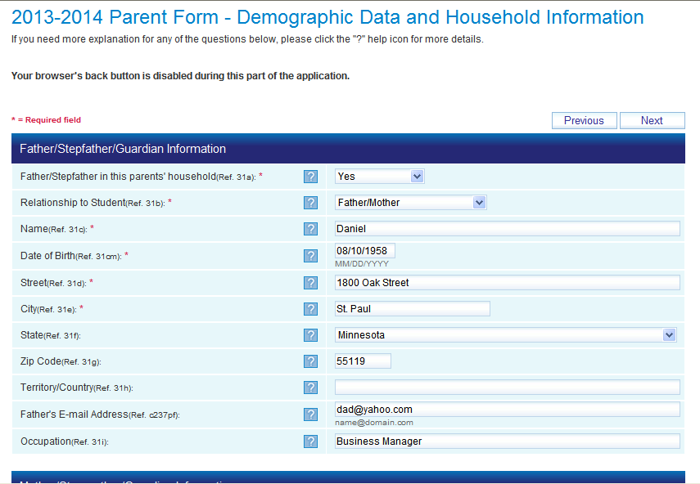
Online State Financial Aid Application

Slide 71
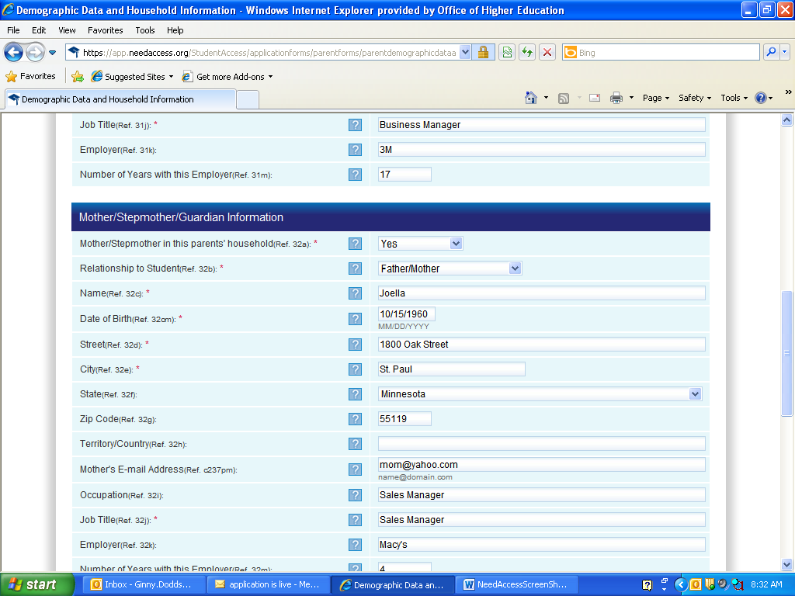
Online State Financial Aid Application

Slide 72
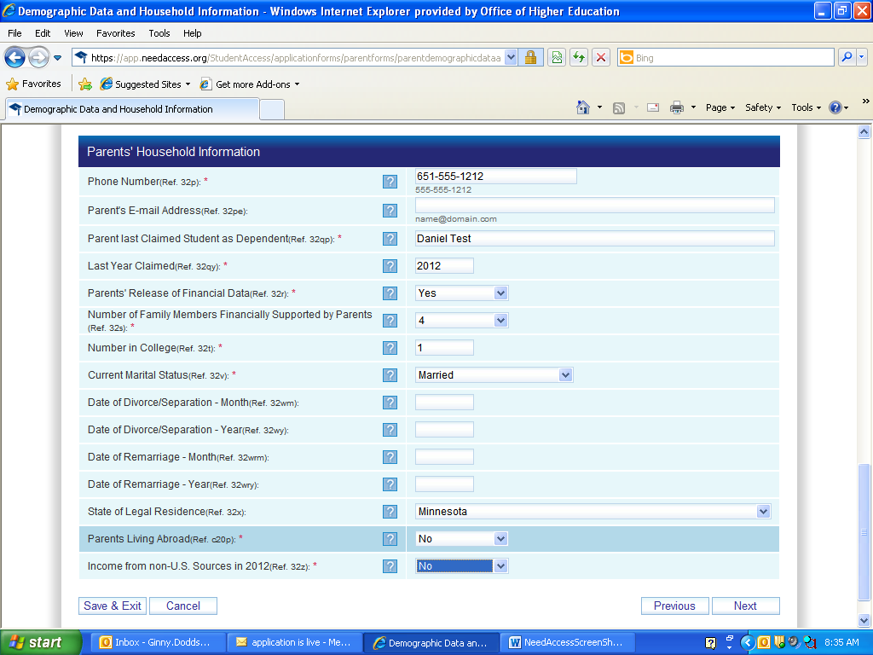
Online State Financial Aid Application

Slide 73
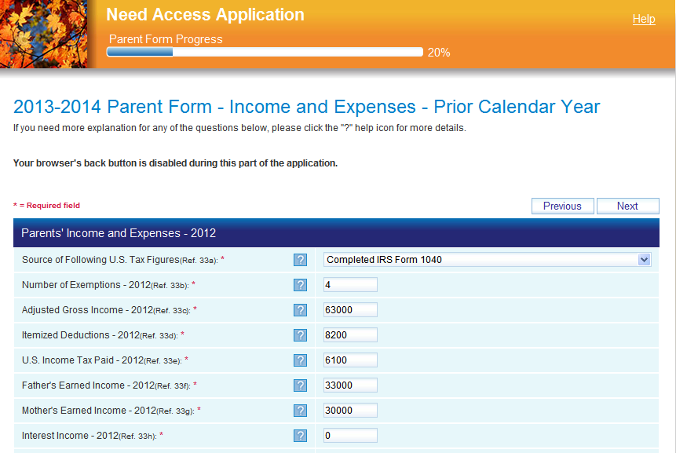
Online State Financial Aid Application

Slide 74
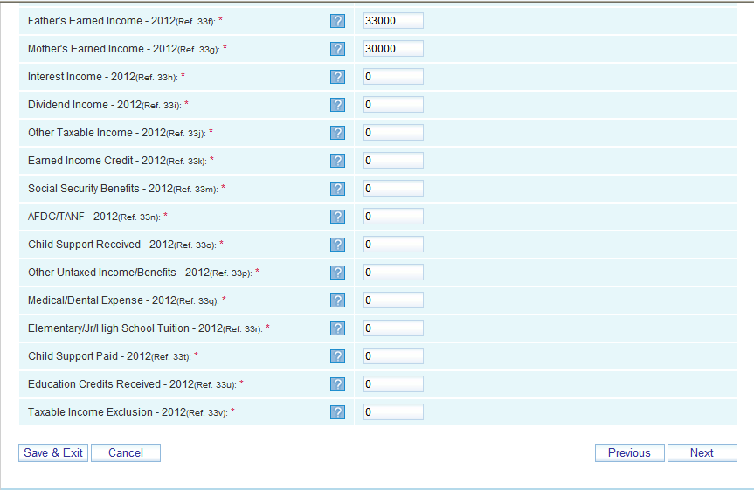
Online State Financial Aid Application

Slide 75
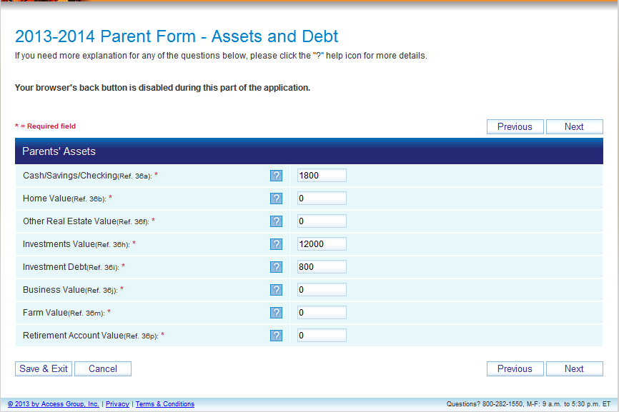
Online State Financial Aid Application

Slide 76
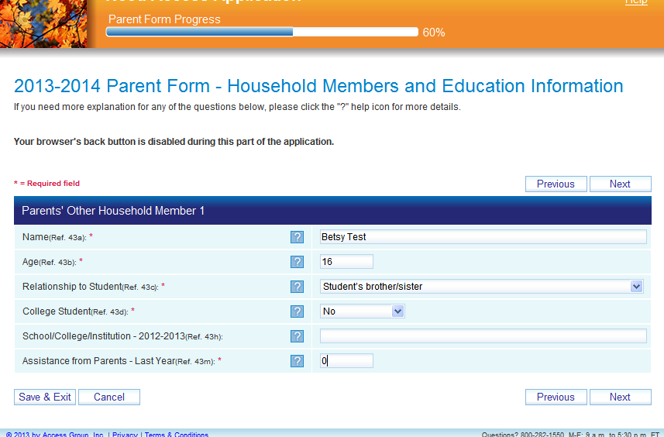
Online State Financial Aid Application

Slide 77
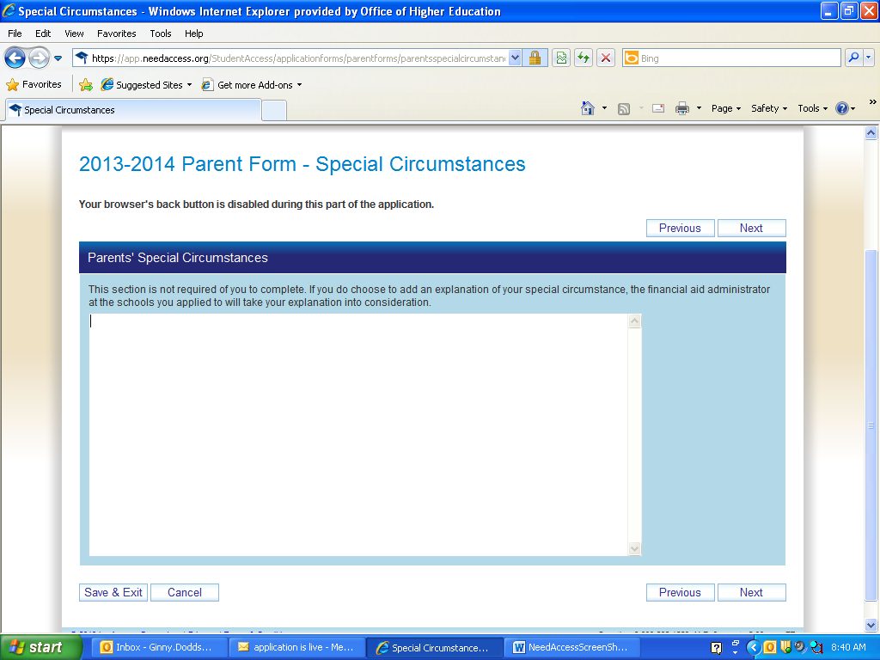
Online State Financial Aid Application

Slide 78
Online State Financial Aid Application
Will be several customized questions related to MN Dream Act and State Grant eligibility criteria
Screens were not available at time of presentation

Slide 79
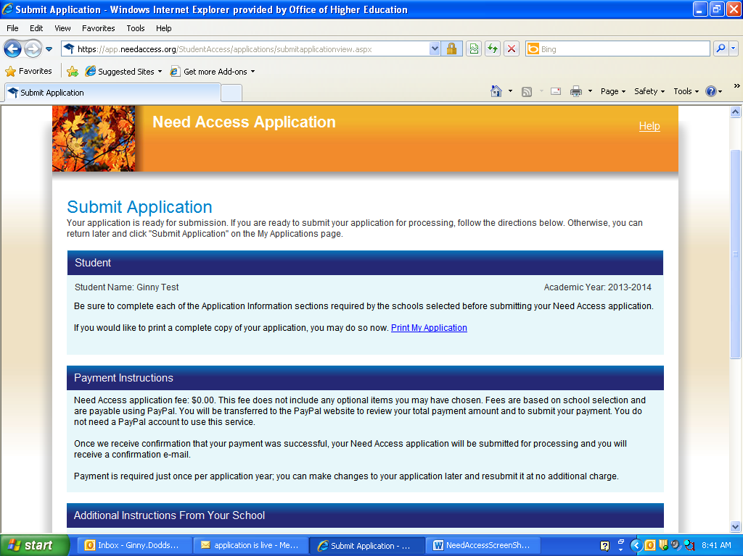
Online State Financial Aid Application
Student can print copy of application (optional)

Slide 80
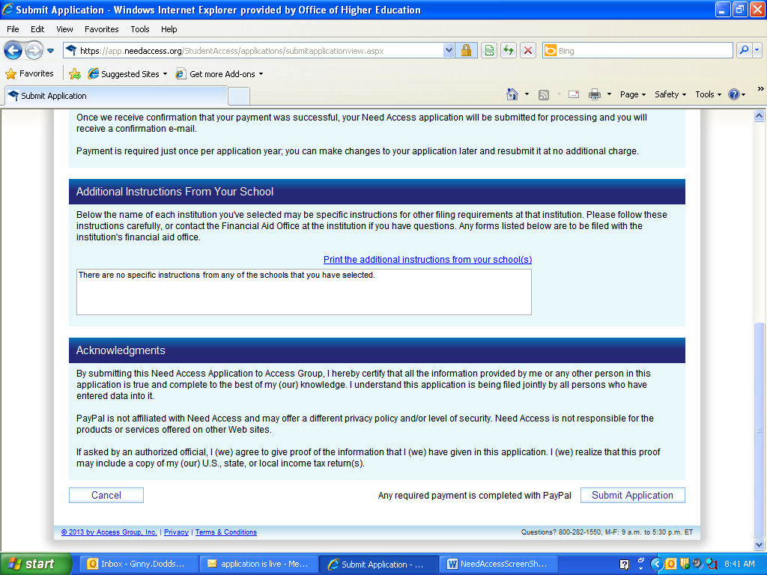
Online State Financial Aid Application
OHE will be adding instructions about what documentation student should send to the Office of Higher Education

Slide 81
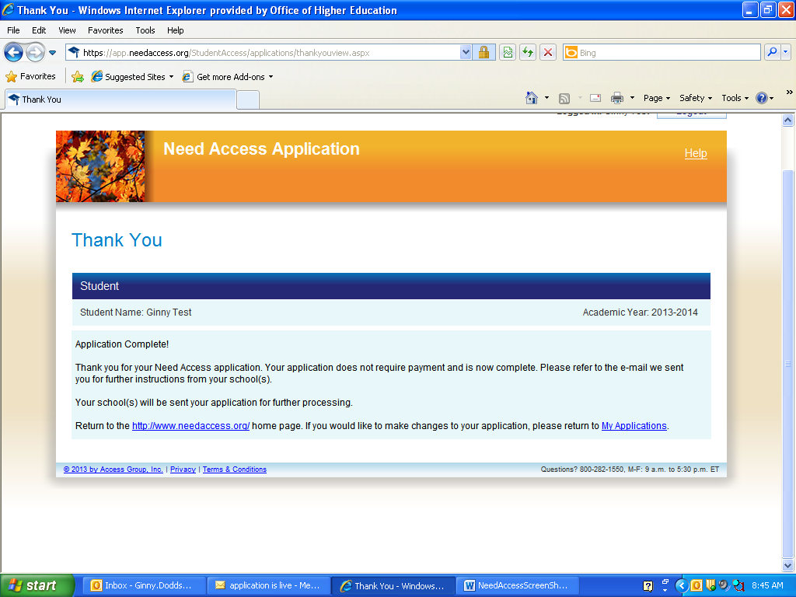
Online State Financial Aid Application
Click here to make changes
Return to home page to log out

Slide 82
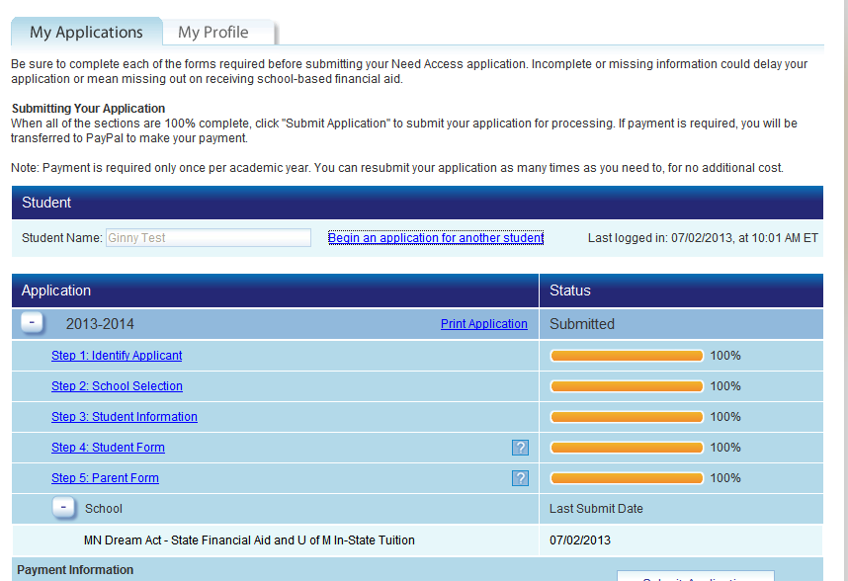
Online State Financial Aid Application
Screen student sees when logging back in to make corrections

Slide 83
IMMIGRATION REFORM
Call your US Representative NOW:
1-866-940-2439
Only republicans can choose to pass an immigration bill – they are meeting TODAY
Use YOUR voice, take action

Slide 84
Questions?
THANK YOU!
www.ohe.state.mn.us/MnDreamAct
WWW.NAVIGATEMN.ORG

