Slide 1


Postsecondary Child Care Grant Training
Firstname Lastname | Job Title
Date

Slide 2
Program Purpose
  2021 Minnesota Statutes 136A.125
  To provide financial assistance to students with financial need pursuing a postsecondary education who require child care assistance for their dependent children.

Slide 3
Child Care Grant Background
The Postsecondary Child Care Grant was first established in Minnesota statute in 1989 with an initial appropriation of $2 million.
Major changes to the Postsecondary Child Care Grant in the past ten years are shown in Table.
Child Care Grant Program Changes
Year | Change
2015 | Can use spouse to fulfill residency requirement
2015 | Income formula uses percentage of federal poverty guideline
2016 | Extends grant to graduate students
2017 | Increase term limit from 8 to 10

Slide 4
Child Care Grant 2021-2022 Eligibility
Eligibility for the Child Care Grants
  Minnesota residents
  Attending an eligible institution
  Enrolled in 1+ undergraduate credits (1+ graduate)
  Students must:
    Complete the FAFSA or Dream Act application
    Complete the Postsecondary Child Care Grant application
    Have an eligible child,
    Maintain satisfactory academic progress,
    Has not received child care grant funds for a period of ten semesters or the equivalent,
    Not be in default on any educational loan,
    Not be receiving MFIP benefits,
    Have child care from a verified provider, and
    Meet financial eligibility guidelines.

Slide 5
Child Care Grant 2021-2022 Eligibility
Eligibility for the Child Care Grants, cont.
  A student is entitled to an additional semester or the equivalent of grant eligibility and will be considered to be in continuing enrollment status upon return if the student withdraws from enrollment.
  For a serious health condition, while under the care of a medical professional, that substantially limits the students ability to complete the term or;
  While providing care that substantially limits the student’s ability to complete the term to the student’s spouse, child, or parent who has a serious health condition.

Slide 6
Child Care Grant 2021-2022 Eligibility
Amount and Length of Grants
  The income of the applicant and spouse; the number in the applicant’s family; and the number of eligible children. Have all been stricken from MN statutes.
  The maximum award to the applicant equals the maximum federal Pell Grant for each eligible child per academic year, except that the campus financial aid officer may apply to the office for approval to increase grants by up to ten percent to compensate for higher market charges for infant care in a community.
  Applicants with expected family contributions at or below the qualifying expected family contribution for the federal Pell Grant, as determined by the commissioner, qualify for the maximum award. Applicants with expected family contributions exceeding that threshold but less than 200 percent of the qualifying expected family contribution receive an amount proportional to their expected family contribution as determined by the commissioner.

Slide 7
Child Care Grant 2021-2022 Eligibility
Amount and Length of Grants, cont.
  The academic year award amount must be disbursed by academic term using the following formula.
  The academic year award amount divided by the number of terms in the academic year, multiplied by applicable enrollment factor.
  1.00 for undergraduate students enrolled in 12 or more semester credits or the equivalent or for graduate students enrolled in six or more semester credits or the equivalent.
  0.75 for undergraduate students enrolled in nine, ten or 11 semester credits or the equivalent or for graduate students enrolled in five semester credits or the equivalent.

Slide 8
Child Care Grant 2021-2022 Eligibility
Amount and Length of Grants, cont.
  0.50 for undergraduate students enrolled in six, seven or eight semester credits or the equivalent or for graduate students enrolled in three or four semester credits or the equivalent.
  0.25 for undergraduate students enrolled in at least one but less than six semester credits or the equivalent or for graduate students enrolled in one or two semester credits or the equivalent.

Slide 9
Example Annual Award Table under the Simplified Formula
Annual Award Amount Per Eligible Child
Undergraduate Student Enrollment Levels | Full-time (12 or more credits per term) | 3Q Time (9-11 credits per term) | Half Time (6-8 credits per term) | Less than Half Time (1-5 credits per term)
Graduate Student Enrollment Levels | Full-time (6 or more credits per term) | 3 Quarter Time (5 credits per term) | Half Time (3-4 credits per term) | 1Quarter Time (1-2 credits per term)
Pell Eligible: EFC $0-$5,846 | $6,500 | $4,875 | $3,250 | $1,625
EFC $5,847-$5,999 | $6,347 | $4,760 | $3,174 | $1,587
EFC $6,000-$6,999 | $5,347 | $4,010 | $2,674 | $1,337
EFC $7,000-$7,999 | $4,347 | $3,260 | $2,174 | $1,087
EFC $8,000-$8,999 | $3,347 | $2,510 | $1,674 | $837
EFC $9,000-$9,999 | $2,347 | $1,760 | $1,174 | $587
EFC $10,000-$10,999 | $1,347 | $1,010 | $674 | $337
EFC $11,000-$11,692 | $655 | $491 | $328 | $164
EFC $11,693+ | $0 | $0 | $0 | $0

Slide 10
Eligible Institutions
  Minnesota public postsecondary institutions.
  Minnesota private baccalaureate degree granting college or university (non-profit or for-profit).
  Minnesota non-profit two-year vocational school granting associate degrees.
  A Minnesota postsecondary institution offering only graduate or professional degrees.
  School must submit annual program participation form, which indicates anticipated funding needs for the coming year.

Slide 11
Allocation Formula
  The school’s initial ESTIMATED allocation of program funds calculated in August for the year is based on the school’s share of the total students with children enrolled in all participating schools per the previous year’s State Grant database and reported on participation request.
  If you have a graduate student population or do not participate in the MN State Grant Program you will need to report the number of students with children at your institution.
  For example, if a school has 1,000 students with children and the total students with children at all schools were 10,000, the school would receive approximately 10% of the appropriation for the program.

Slide 12
Allocation Formula
  September the initial allocation is reduced if the school’s utilization rate for the previous year was less than 100%.
  If the school’s utilization rate for the previous year were 80%, the school’s current year allocation would be reduced by 20%.
  The initial allocation is also capped at the amount of funds requested by the school.
  The initial allocation is disbursed in September approximately 50%, October any additional funds up to 50% and December the remaining 50%.
  Schools with a leading summer term can request an earlier disbursements by contacting Brenda Larter.

Slide 13
Allocation Formula
  The utilization rate for the previous year is determined by subtracting total expenditures from total funds available.
  Total expenditures
  + student awards
  + administrative expense allowance
  = Total Expenditures
  Total funds available
  + Current year initial allocation
  + Current year reallocated funds
  - Funds carried forward/back to another fiscal year
  - Current year funds returned to OHE before March 1
  = Total Funds Available

Slide 14
Reallocation of Funds
  Schools may request additional funds if the initial allocation does not cover anticipated need.
  OHE sends out refund/reallocation forms to schools five times during the school year November, January, March, May & June.
  OHE will reallocate any refunds returned based on school’s share of all schools requesting more funds.
  Minimum reallocation is $100.

Slide 15
Carry Forward/Back
  Schools may carry forward to the next fiscal year or carry back to the previous fiscal year up to 10% of their current year initial allocation.
  Schools can always carry forward.
  Schools cannot carry back funds from the first year of a new biennium to the last year of the previous biennium.
  A biennium is a two-year state budget cycle
  2021-2022 and 2022-2023
  2023-2024 and 2024-2025

Slide 16
Administrative Expense Allowance
  A school may use up to 5% of total student awards expended for Postsecondary Child Care Grant awards during a fiscal year for an administrative expense allowance.
  Schools must be able to verify that the administrative expense allowance was used for the administration of the Postsecondary Child Care Grant Program.

Slide 17
Funds Management
  It is preferable for the school to maintain a separate account for Postsecondary Child Care Grant funds, but they can be combined with other funds if the fund source number is traceable to all activity within the account.
  A manual or electronic record of recipients and corresponding check and account numbers must be maintained in order to track disbursements back through the activity account to the internal requisition form.
  Each school must implement control procedures which prevent funds from one fiscal year from co-mingling with funds from another fiscal year, with the exception of funds which are transferred based on the carry forward, carry back provision.

Slide 18
Excess Funds
  Excess funds are funds that will not be spent on student awards, the administrative expense allowance, or carried forward or back to another fiscal year.
  Excess funds must be returned to OHE when refund/reallocation forms are sent out.
  Excess funds returned after march 1 will result in a utilization rate under 100% which will reduce the initial allocation for the next fiscal year.

Slide 19
Reporting Requirements
  Schools are responsible for reporting total program awards and expenditures to date at the end of each month by the 10th day of each month.
  The web address is: http://www.ohe.state.mn.us/surveys/awards/awards.cfm
  Schools are responsible for collecting data requested by OHE on the End of Year Report.

Slide 20
Reporting Requirements
  End of Year Reports must be submitted to OHE no later than the first working day after August 9th, the 2021-2022 report will be due August 10, 2022.
  Final excess funds must be returned by July 31, 2022. OHE will withhold the school’s allocation for the coming year if the school fails to meet the end of year deadline.
  You must report all data elements for each student review all information reported on the end of year report and double check for accuracy.
  You must make sure this report balances with your Business Office prior to submitting the report to OHE.
  Upon request the school must also report information about students who received awards, students on waiting lists and students who were denied awards.

Slide 21
End of Year Report
  Recipient data:
  Name
  SSN
  Family income
  Family size
  Total hours awarded per week for all children
  Number of children in day care
  Total actual child care cost for award period
  Summer1 Child Care Grant Award Amount
  Summer1 Credits
  Fall Child Care Grant Award Amount
  Fall Credits
  Recipient data Continued:
  Winter Child Care Grant Award Amount
  Winter Credits
  Spring Child Care Grant Award Amount
  Spring Credits
  Summer2 Child Care Grant Award Amount
  Summer2 Credits
  Amount of total award used for on-campus day care
  Amount of total award was increased due to 10% infant care adjustment
  Program level, 1=undergraduate, 2=graduate/professional

Slide 22
Eligible Student
  Meet ONE of the following MN resident criteria:
  Student who graduated from a MN high school while residing in MN and, if currently residing in another state is physically attending college in MN; or
  Student who earned GED in MN after living in MN for one year; or
  Dependent students whose parents resided in MN when FAFSA completed; or
  Student who resided in MN for 12 consecutive months without being enrolled half-time or more in any term. Undergraduates 6 credits, graduate/professional 1 credit; or

Slide 23
Eligible Student
  Residency cont’d.
  Student who resided in MN for 12 consecutive months without being enrolled half-time in any term, does not have to be initial year student lived in MN.
  Residency established this way is lost if student later leaves MN for more than one year (unless for college, military, missionary service and still pay taxes to MN).
  Does not apply to GED recipients; or
  Independent student who originally met residency requirement as a dependent because parents resided in MN when FAFSA completed are grandfathered as an independent student if student continues to live in MN; or

Slide 24
Eligible Student
  Residency cont’d.
  Families not penalized for leaving MN to attend college or serve in military or missionary service if still paying taxes in MN.
  A member, spouse or dependent of the armed forces of the US stationed in MN on active federal military service as defined in MS 190.05, Subd. 5c; or
  A spouse or dependent of a veteran who meets the residency requirement; or
  A person or spouse of who relocated to MN from an area that is declared a presidential disaster area within the preceding 12 months, if the disaster interrupted the person’s postsecondary education; or
  A person defined as a refugee under US code, title 8, section 1101 (a)(42) who upon arrival in the US, moved to MN and has continued to reside in MN.

Slide 25
Eligible Student
  Residency cont’d.
  MN Dream Act is part of state residency statute, requirements are:
  Attended MN high school for at least three academic years.
  Graduated from MN high school or earned MN GED.
  Meet selective service system (SSS) registration requirements:
  Must register with SSS if male 18-25 years old;
  If male 26 or older, must have registered when 18-25;
  Can attempt to get status letter from SSS to show failure to register wasn’t knowing or willful.

Slide 26
Eligible Student
  Residency cont’d.
  The definition of MN resident for the Postsecondary Child Care Grant Program ONLY, was revised to include a student whose spouse is a resident of MN. This would require the school to determine the spouse’s residency status by having the spouse complete OHE’s student eligibility questionnaire (appendix 2 of the State Grant manual). This change was effective for terms starting on or after August 1, 2015.
  The student must not be receiving Tuition Reciprocity benefits from a neighboring state to attend a MN institution.

Slide 27
Eligible Student
  Is enrolled in at least one credit in an undergraduate program or one credit in a graduate/professional program leading to a degree, certificate or diploma.
  A student can receive a Postsecondary Child Care Grant at more than one eligible institution as long as the student is enrolled in a program leading to a credential at one eligible institution.
  Interim term credits should be allocated to adjoining terms as described for the State Grant program.

Slide 28
Eligible Student
  The student must be enrolled in a non-sectarian program or course of study. A “non-sectarian program” means a program of study that is not specifically designed to prepare students to become ministers of religion, to enter some other religious vocation, or to prepare them to teach theological subjects.
  Must be making satisfactory academic progress (SAP) requirements in state law. Which adopts the SAP requirements used for federal financial aid program. The federal requirements referred to in state law defined minimum standards for maintaining SAP, schools are allowed to adopt stricter standards.

Slide 29
Eligible Child
  The student must have a child 12 years of age or younger, or 14 years of age or younger who is disabled as defined in MS 125A.02, and who is or will be receiving care on a regular basis from a licensed or legal non-licensed care giver. If the child is 12 years of age at the start of the term, the child can be considered for an award for the entire term.

Slide 30
Eligible Child
  “Child with a disability” means a child who has a hearing impairment, blindness, visual disability, speech or language impairment, physical disability, other health impairment, mental disability, emotional health impairment, mental disability, emotional/behavioral disorder, specific learning disability, autism, traumatic brain injury, multiple disabilities, or deaf/blind disability who need special education and related services is a child with a disability.
  A licensed physician, an advanced practice nurse, or a licensed psychologist is qualified to make a diagnosis and determination of attention deficit disorder or attention deficit hyperactivity disorder for purposes of identifying a child with a disability.
  A child with a short term or temporary physical or emotional illness or disability is not a child with a disability.

Slide 31
Eligible Child
  The child must meet the requirements for inclusion in the independent student’s household size or dependent student’s parental household size, as specified in applicable Title IV program regulations.
  Foster children are not eligible.

Slide 32
Eligible Child
  It is possible for the child to be included in the household size on both parents’ FAFSA applications. If both students include the child in the household size on the FAFSA application, both can apply for a Postsecondary Child Care Grant.
  If one unmarried student is providing more than half the support for the other student, in addition to providing more than half the support for the child, that student can include both the child and other student/parent in the household size on the FAFSA.

Slide 33
Eligible Child
  The student receiving the support could not include the other student in the household size, but could include the child.
  For 50% support test, the student can include any funds received from someone other than the students parents that flow through to the child. Child’s other parent, Government assistance programs.

Slide 34
Eligible Child
  For example, if a student who lives alone with her child, receives cash from her boyfriend that amounts to more than 50% support for her child, then she would be able to count the child as a dependent in her household size and apply as independent.
  If the boyfriend is the father of the child and a student himself, then he would also be able to count the child in his household size and apply as independent.
  You would award the first student and then have to subtract the award the first student received from the actual child care costs for the other student prior to determining the award amount for the second student.

Slide 35
Eligible Student
  The student must NOT be receiving benefits from the Minnesota Family Investment Program (MFIP).
  This applies even if MFIP child care assistance does not cover school hours.
  A student can get a pro-rated Postsecondary Child Care Grant if the student only received MFIP benefits for a portion of the term.

Slide 36
Eligible Student
  If student is only receiving MFIP benefits for a portion of a term, the student would be eligible for a prorated Postsecondary child Care Grant award for remainder of the term.
  Postsecondary Child Care Grant award does not have to be refunded to the program if the student receives MFIP benefits later in a term, provided the student notified the school within 10 days of the change of status.
  School can opt to adjust the award and bill the student for the overpayments, but in this case it is not required.
  If the student did not notify the school of the change, the student does not meet program eligibility requirements and should not receive future disbursements during the aid year, nor be considered a renewal applicant in future aid years.

Slide 37
Eligible Student
  If the student is excluded from receiving MFIP benefits, but the students children receive MFIP benefits, the student IS eligible for the Postsecondary Child Care Grant.
  Since many students do not know if the assistance they receive is under MFIP, if they indicate on their application that the family is receiving any type of public assistance, the school must collect documentation from the county verifying the student is excluded from receiving MFIP benefits.
  OHE created the “MFIP CCAP Verification Form” for you to use to determine what type of assistance the students is receiving from the county.
  Students who are not on MFIP, but receive other benefits such as General Assistance, MN Care Insurance, Medical Assistance, Food Stamps, or Diversionary Work Program (DWP) ARE eligible for the Postsecondary Child Care Grant.

Slide 38
Eligible Student
  Students receiving DWP are eligible for child care assistance through the DWP, so those benefits would be subtracted from actual child care costs used in the Postsecondary Child Care Grant award calculation. The DWP is a program families are referred to for four months prior to going on MFIP. Therefore, you need to follow-up with these students.

Slide 39
Eligible Student
  The student cannot be in default on any student loan. The student can regain eligibility retroactive to the beginning of the current aid year by producing documentation from the holder of the loan that it has been paid in full or otherwise satisfied.
  A student who has a hold on their State Grant file for being in arrears on child support payments IS eligible to participate in the Postsecondary Child Care Grant Program. According to statute this hold only prevents a student from receiving funds from the MN State Grant Program.
  Has not received child care grant funds for a period of ten semesters or the equivalent.

Slide 40
Eligible Student
  The student must report any changes to data reported on the Postsecondary Child Care Grant application within 10 days of the change taking place.
  The student is notified of this requirement in the student certification section of the application.
  It is left to the discretion of the financial aid administrator to determine whether the student’s failure to report changes was an unintentional oversight or an intentional withholding of information from the school.

Slide 41
Eligible Provider
  A licensed child care provider; or
  A legal non-licensed care giver, is a person who is at least 18 years old and takes care of the children from only one family other than his/her own; or
  Other programs excluded from state licensure, after school program affiliated with school district, all-day kindergarten and pre-school if they charge a fee.

Slide 42
Not An Eligible Provider
  A parent or legal guardian of the student’s child does NOT qualify as an eligible provider.
  Parents, step-parents, legal guardians of the child.
  Any individual if they reside in the same household or occupies the same residence as the student and child.
  There is no requirement that the provider be located in Minnesota.

Slide 43
Provider Verification
  Campuses are required to verify provider information for ALL students. Provider verification is being required to preserve the integrity and future viability of this program to ensure that funds go to eligible students.
  A form letter template was created to send to the provider along with a copy of the provider section page of the student’s completed application. When mailing a copy of the provider section of the application to the provider make sure you only copy the provider page of the application and black out the student’s ID number at the top of the page.
  Providers can verify the information in the provider section via telephone, faxing, emailing, or mailing the information back to the school.
  Be sure to take adequate notes, including the date and time for auditing purposes.

Slide 44
Provider Verification
  You can modify the language on the form template. For example, if you would like all responses via email, you can delete the language and contact information for the other methods.
  Or, if you prefer to enclose a blank provider section form to be completed by the provider (similar to a verification worksheet) as opposed to having the provider verify a copy of a completed application.

Slide 45
Provider Verification
  Schools that choose to disburse Postsecondary Child Care Grant funds directly to the child care provider will also need to verify the provider information prior to disbursing funds.
  Provider verification will be required for each applicant at least once during the aid year prior to disbursing funds. Schools can opt to do provider verification more frequently.
  If there is a change in provider, verification would need to be done for the new provider.

Slide 46
Provider Verification
  To avoid liability for overpayments, a school will want to delay awarding a student until the provider’s information has been verified.
  In cases where a student receives a disbursement prior to provider verification, and provider verification results in changes to the award, the student will be liable for the overpayment to the Postsecondary Child Care Grant Program.
  If the school cannot collect the overpayment from the student, the school must repay the overpayments to the Postsecondary Child Care Grant Program.

Slide 47
Provider Verification
  In cases where verification does take place prior to awarding, but subsequent changes are reported after disbursement that decreases or eliminate the award, the student will be liable for the overpayment.
  The school would not be required to repay the funds from institutional funds if it cannot collect the overpayment from the student.
  These cases can be turned over to OHE to collect after you make diligent effort to collect the overpayment.

Slide 48
Provider Verification
  If in your best judgement, the student and/or provider willfully provided false information on the application, the student’s Postsecondary Child Care Grant should be cancelled and recouped for any term during the aid year for which fraudulent information was provided.
  If the school cannot collect the funds after diligent efforts are made, the school will not be liable.
  In these cases, the student’s liability can be turned over to OHE as an accounts receivable at the end of the year.

Slide 49
Provider Verification
  The school may also want to pursue action against the student according to its own student conduct policies and/or contact the county attorney for the county to initiate a fraud investigation.
  OHE should be notified of all cases referred to the county attorney’s office.
  Financial Aid Administrators are free to require any type of documentation you feel is necessary to verify the accuracy of the student’s application. Including, requiring the student to use a licensed day care facility that can provide documentation on facility stationary.

Slide 50
Prioritizing Applicants/Renewal Applications
  School’s are required to award all renewal applicants prior to awarding first time applicants. School must establish a deadline date by which applications for initial and renewal awards must be received for the initial prioritization of applications.
  After all applicants (renewal and first-time) meeting the initial application deadline have been awarded, the school may then award students whose applications were received after the initial application deadline.
  Prioritization of applications received after the initial deadline date is based on the school’s written award policy.
  At this point there is no requirement that renewals be given priority over first time applicants.
  Most schools have prioritized these applications based on the date received.

Slide 51
Prioritizing Applicants/Renewal Applications
  A “renewal” applicant is a student who:
  Received an award in the immediately preceding academic year, and has had continuing enrollment at the institution since the time the previous year’s award was given.
  “Continuing enrollment” means that a student has not had an interruption in enrollment at the current institution for more than one academic term or 60 days in the preceding academic year, whichever is longer.
  2007 higher education bill contained language excusing enrollment interruption for those who left for active duty military service.

Slide 52
Prioritizing Applicants/Renewal Applications
  A student may miss one academic term and summer term and not lose continuing enrollment status.
  If funds don’t cover all renewal applicants meeting initial application deadline, school must prioritize these applications according to its written award policy.
  If funds don’t cover all eligible applicants, school must maintain waiting list.
  Prioritization of those on the waiting list is based on the school’s written award policy.
  Schools must give priority to renewal applicants meeting initial priority deadline.
  Schools should encourage students to apply and be placed on the waiting list even if no funds are available.
  Waiting list data must be reported to OHE on both the refund/reallocation and the monthly spending reporting forms on the web.

Slide 53
Prioritizing Applicants/Renewal Applications
  The program statute does not allow denial of Postsecondary Child Care awards for future aid years based on suspected fraud during the current aid year. However, schools can add language to your written award policy to address this issue.
  The statute requires renewal recipients who meet the school’s priority deadline to be given first priority during the next aid year. So a renewal applicant who provided fraudulent information the previous aid year must be given priority if student meets the priority deadline the following year.
  For example, the information provided fall term was accurate, but spring term was fraudulent. Since the student was awarded during fall the student would be considered a renewal applicant.

Slide 54
Prioritizing Applicants/Renewal Applications
  However, if the student’s entire award was cancelled during the current aid year due to fraudulent information, the student would not be considered a renewal applicant the following aid year.
  Applicant’s who do not meet the school’s priority deadline can be prioritized according the school’s written award policy.
  Though most schools choose to rank applicants based on date of receipt, a school would have the option of assigning lowest priority to students who provided fraudulent information in a previous aid year.

Slide 55
Student Application Form
  A student must complete section A of the Postsecondary Child Care Grant program application, check and sign the certification section of the application. By signing the student certification, student agrees to:
  Report any changes in application data to school within 10 days.
  Use Postsecondary Child Care Grant to pay child care expenses.
  Allows school and/or OHE to contact provider for verification and understands the application will be on hold pending provider verification.
  Allows information be shared between school, OHE and county child care assistance programs.
  Parents or legal guardian of child is not available to care for child.
  Provide truthful information.
  May be required to return all or a portion of award for withdrawals.

Slide 56
Student Application Form
  Provider must complete section B of the Postsecondary Child Care Grant program application, check and sign the certification section of the application. By signing the provider certification, provider agrees to:
  Provide truthful and correct information.
  Provide additional documentation, including confirming the information provided to Financial Aid administrator and grants permission to OHE or school auditors to review financial records to verify receipt of Postsecondary Child Care funds.
  Unlicensed child care providers only, grants permission to OHE or the school to report the amount of the student’s Postsecondary Child Care Grant to the IRS or MN Department of Revenue as taxable income to the provider, when requested.

Slide 57
Student Application Form
  Understands they cannot charge a Postsecondary Child Care Grant recipient a higher rate for services than rates charged to non-recipients.
  Understands if they give false or misleading information, they may be subject to a fine, prison sentence or both.
  Understands they must immediately report any changes to the information provided to the school including no longer providing child care services to the student’s children.

Slide 58
Student Application Form
  Date stamp everything with the date received.
  Application must be complete prior to awarding the student.
  You must verify household size and total income used in the calculation match what is listed on FAFSA and are consistent across financial aid programs.
  Resolve any conflicting information between the application and any other forms or documentation in the student’s file.
  The school must keep a copy of the application form and any other documentation including notes in the student’s financial aid file.
  An institution may maintain electronic records for the fiscal year file instead of paper copies, as long as the records are available to auditors.

Slide 59
Written Award Policy
  The school must have a written Postsecondary Child Care Grant award policy with the effective date for implementation.
  Prior to drafting this policy, review MN statutes and agency rules to ensure the policy is in accordance with these statutes and rules.
  The policy must be signed and dated by the Director of Financial Aid.

Slide 60
Written Award Policy
  Written award policy for prioritization must include the following:
  The institution’s method of prioritizing Postsecondary Child Care Grant applications.
  The deadline date for receipt of applications in order to be included in the initial prioritization of applications.
  The deadline date for receipt of applications in order to be included in the initial prioritization of applications.
  The deadline date to resubmit an application for continuing a Postsecondary Child Care Grant.
  The standard method of award disbursement to the student or child care provider with the reasons for deviation from this policy documented in a student’s financial aid file.

Slide 61
Written Award Policy
  The method used to create and maintain a waiting list.
  Any other institutional policies used to determine which students receive awards and how retroactive awards are processed.
  The institutions method of prioritizing applications may assign the lowest priority to applicants who previously failed to report changes or provided fraudulent information on the application.
  The above suggestions are made to protect the institution in dealing with applicants to the Postsecondary Child Care Grant program and to provide for the equitable treatment of program applicants.

Slide 62
Award Period
  The school must award the student for the full 9-month academic year, fall through spring terms.
  Can award for fewer terms if:
  Student will only attend partial year.
  Student will run out of eligibility mid year due to previous child care grant terms of receipt.
  Awarding later in academic year, you do have the option to award retroactively to past terms if funds are available.
  Remaining funds won’t cover full year.

Slide 63
Award Period
  The institution is responsible for calculation of each student’s Postsecondary Child Care award. The calculation must be documented for each child for each term.
  Although the initial award calculated for the nine-month academic year based on assumed actual costs and enrollment status, the award must be revised at the onset of each term to reflect actual costs and enrollment status for that term.

Slide 64
Award Period
  Like State Grant school can award a student for up to three full-time semesters or four full-time quarters.
  The award for the extra term is calculated in the same manner as for any other term.
  A student could actually get awarded for both summer terms plus fall through spring terms provided, both summer terms were crossover terms. The sum of all term awards did not exceed 150% semester system or 133% quarter system of the annual maximum award for the student’s EFC and enrollment level.

Slide 65
Award Calculation
  OHE has an award calculation spreadsheet and maximum award chart along with additional program forms are available on the OHE website.
  www.ohe.state.mn.us
  Financial Aid Administrator Resources.
  Forms for Financial Aid Administrators.
  Postsecondary Child Care Grant Program.
  The maximum award amount per eligible child, per year currently in statute is $6,500.

Slide 66
Example Annual Award Table under the Simplified Formula
Annual Award Amount Per Eligible Child
Undergraduate Student Enrollment Levels | Full-time (12 or more credits per term) | 3Q Time (9-11 credits per term) | Half Time (6-8 credits per term) | Less than Half Time (1-5 credits per term)
Graduate Student Enrollment Levels | Full-time (6 or more credits per term) | 3 Quarter Time (5 credits per term) | Half Time (3-4 credits per term) | 1Quarter Time (1-2 credits per term)
Pell Eligible: EFC $0-$6,206 | $6,500 | $4,875 | $3,250 | $1,625
EFC $6,207-$6,999 | $6,347 | $4,760 | $3,174 | $1,587
EFC $7,000-$7,999 | $5,347 | $4,010 | $2,674 | $1,337
EFC $8,000-$8,999 | $4,347 | $3,260 | $2,174 | $1,087
EFC $9,000-$9,999 | $3,347 | $2,510 | $1,674 | $837
EFC $10,000-$10,999 | $2,347 | $1,760 | $1,174 | $587
EFC $11,000-$11,999 | $1,347 | $1,010 | $674 | $337
EFC $12,000-$12,412 | $655 | $491 | $328 | $164
EFC $12,413 - + | $0 | $0 | $0 | $0

Slide 67
Award Calculation
  The total Postsecondary Child Care Grant awarded to the student each term is the sum of Postsecondary Child Care Grant awards for each of the student’s eligible children.
  The term award for each eligible child is the lesser of:
  The student’s actual, reported child care costs for that child during the term; or
  The maximum annual award per eligible child on the Postsecondary Child Care Grant table divided by two for semester, or three for quarter, and adjusted for enrollment status.

Slide 68
Actual Child Care Costs
  Actual child care costs are reported by the provider on the application form.
  Schools can require receipts to verify actual costs reported by the provider.
  School can reference average provider rates collected by Department of Human Services.
  Providers cannot charge Postsecondary Child Care Grant recipients a higher costs than non-recipients.
  The maximum rate payable to a provider is $5.00 per hour for home care or $10 per hour for center care up to a maximum of 40 hours per week.
  Hours per week can include school hours, study time, work time, etc. we do not differentiate between school and work hours.

Slide 69
Actual Child Care Costs
  School can include costs for child care during breaks or portion of term when student not enrolled.
  However, you cannot include costs for weeks when student is not receiving child care.
  School must subtract any other child care assistance the student or spouse receives. Basic Sliding Fee, Early Childhood scholarship, Transition Year, employer child care assistance, other parent receiving discounted rate, child care scholarship, Postsecondary Child Care Grant received by spouse, or any other assistance programs.
  If the day care rate is one cost for 17 weeks in the term and another cost for one “holiday” week. Use the 17 week cost for the 18 weeks in the term.
  If the rate charged is a different rate at various times throughout the term you should use an average rate for the calculation worksheet.

Slide 70
Actual Child Care Costs
  School must also subtract court-ordered child care assistance paid to the provider by the other parent if it is not considered child support already included in the student’s income on the FAFSA.
  Other sources of child care assistance should be reported by the provider in Section B of the application and by the student.

Slide 71
Infant Care Adjustment
  The amount shown on the Maximum Award Chart can be inflated by 10% to compensate for higher infant care costs.
  The institution must request permission from OHE to make this adjustment on its annual program participation form.
  Student must document higher infant care costs by having provider complete the Request for Infant Care Adjustment Form.
  “Infant” is defined by the provider up to a maximum age of 18 months.

Slide 72
Infant Care Adjustment
  If the child care provider is providing day care for only the student’s infant, the 10% adjustment would not be made because there is no means of documenting the provider charges higher costs for infant care.
  The student could appeal this decision to the financial aid administrator who could then make a 10% adjustment to the amount on the maximum award table if the provider’s infant care rate is above the average market rate in the provider’s county (see DHS Maximum Provider Rates).
  The minimum award is $50 per semester or $33 per quarter.

Slide 73
Award Adjustments
  Award may change due to changes or corrections to household size or total income on the FAFSA, actual child care costs, MFIP status, enrollment status, provider information or other factors affecting award.
  All changes affecting the award must be dated, documented and maintained in the student’s file.
  If a change results in an increase in the student’s award, the school must increase the award if funds are available. This includes a student adding credits after the original award has been disbursed.

Slide 74
Award Adjustments
  If a change other than drop in enrollment level results in a reduction of Postsecondary Child Care Grant award, the school must either:
  Reduce the student’s awards for the subsequent terms of the aid year to compensate for the overpayment; or
  Bill the student for the overpayment and return the funds to the school’s Postsecondary Child Care Grant account on campus.
  If student drops/withdraws credits or withdraws from school after the disbursement of the original award, the school must:
  Recalculate the award if the student did not attend classes; or
  Complete the OHE Refund Calculation Worksheet.

Slide 75
Award Adjustments
  You may choose an award adjustment end date that coincides with the end of the drop/add period or any other date during the term, including the last day of the term.
  Whichever end date is selected for award adjustments, it must be used for all applicable state financial aid programs.

Slide 76
Disbursement
  The school can disburse the award to either the student or provider.
  The award must be disbursed on a term basis, unless the school chooses to disburse more frequently.
  Funds cannot be disbursed to the student or provider until the student is registered for classes for a term.
  If the student fails to begin the enrollment period, the school must refund the entire Postsecondary Child Care Grant award.
  The student’s award must be based on the student’s enrollment level as of the date of disbursement.

Slide 77
Disbursement
  The school can use any of the following methods to disburse the Postsecondary Child Care Grant award:
  By institutional check directly to the student or provider; or
  By institutional check mailed to the student or provider; or
  By crediting the student’s account, or
  To the student via electronic funds transfer (EFT).

Slide 78
Disbursement
  School should request picture ID if disbursing funds directly to student.
  If mailing a check to the student or provider, the institution must document the student’s or provider’s name, amount and types of charges paid by transaction, source and amount of any other financial aid funds included in the payment, number of the check and the date the check was mailed.
  OHE will not replace lost or forged checks.
  The institution must document the student’s name, amount and type of charges paid by each transaction to the student’s account the source and amount of financial aid funds applied.

Slide 79
Disbursement
  The institution must document the disbursement of funds to each student.
  The disbursement date for funds disbursed to the student prior to beginning of the term will be the first day of required class attendance.
  The disbursement date for funds disbursed to the student during the enrollment period will be the date the funds were credited to the student’s account or applied to tuition charges or the date of the check or EFT or the date the student or provider is handed the check.
  The school must obtain written authorization from the student to disburse Postsecondary Child Care funds by EFT or to hold excess funds in the student’s account.

Slide 80
Disbursement
  The school may NOT require the student to provide written authorization and must allow the student to rescind authorization ay any time.
  Authorization is valid for the award year and can be renewed upon written notice to the student informing the student of the provisions of the authorization and the right to rescind authorization.
  Such notices should indicate how interest accumulates on the student’s account and whether interest will be paid to the school or student.

Slide 81
Late Disbursement
  A school may make a late or retroactive payment to the student provided the student did not withdraw from school or drop below half-time status during the term in question.
  Payment must be based on the student’s enrollment level as of the date of disbursement.
  Credits for courses from which the student withdrew should not be counted towards enrollment level.
  Credits with a grade of “F” or “N” should be counted as credits earned.
  A retroactive payment for a term already completed can be made even if the student is no longer enrolled at the school, provided the student still meets the other program eligibility requirements.
  A retroactive payment must be made from funds for the same fiscal year in which the term took place.

Slide 82
Refunds
  If a student does not attend any classes for a term the entire Postsecondary Child Care Grant award must be refunded.
  If a student drops/withdraws credits for a class the student never attended, the school must determine if an award adjustment is needed by comparing the student’s actual costs for the term to the amount on the Maximum Award Chart prorated for the revised enrollment level.
  If a student attends classes and then drops/withdraws credits or withdraws from school, the school must refund a proportional share of any remaining refund of institutional charges after the institution’s share of any required Title IV refund is subtracted.
  Schools can use the OHE Refund Calculation Worksheet on OHE’s Forms for Multiple Programs web page.
  Proportional share is based on the Postsecondary Child Care Grant’s share of the total non-title IV financial aid package.

Slide 83
Refunds
  Courses that a student withdrew, failed but never attended, failed but stopped attending prior to finals or the equivalent for a course cannot be included in the student’s enrollment level. All other grades, including “F”, “NC” and “I”, or it’s equivalent should be counted when determining the student’s enrollment level.
  All refunds must be returned to the school’s Postsecondary Child Care Grant account and documented in the school’s fiscal records.
  If the school has already closed-out the year, (end of year report has been submitted) additional refunds need to be returned directly to OHE with the OHE Refund Return Form.

Slide 84
Award Notification Denial/Termination
  The school must provide each recipient with an award notice which includes the amount of the award for each term and the names of the recipient’s children.
  School must deny or terminate the student’s award if the student does not meet the program eligibility requirements.
  The denial or termination notice must be in writing and state the reason the award is being denied or terminated and inform the student of the right to appeal the adverse action and the procedure for doing so.
  The provider should also be notified that the student’s award was denied or terminated.

Slide 85
Denial/Termination
  Valid reasons for denial or termination include but are not limited to:
  Failure to provide required information or documentation.
  Failure to report status changes.
  Misrepresentation of child care costs.
  Extended absences without an approved leave of absence.
  Failure to meet any of the program eligibility requirements.
  Payments must be suspended pending the outcome of any appeal.

Slide 86
Denial/Termination
  The institution must allow the student to meet with financial aid administrator to discuss the termination and to provide documentation as to why the termination should not occur.
  Students must follow the school’s appeal process established to handle complaints about financial aid program decisions.
  If the student is not satisfied with the results of the appeal, the student may ask the school to forward the results to OHE for review.
  OHE reviews the case to determine if the school made its decision in accordance with applicable program statutes and rules and informs the student and school of the decision which is considered final.

Slide 87
State Audit Requirements
  OHE staff will periodically perform an audit. Historical records and documentation must be kept on file for three years after the last day of the fiscal year or until all audit exceptions for the period have been resolved.
  The school must have written documentation that verifies the student meets all of the requirements of the program.
  Written award policy for prioritization.
  All items must be date stamped.

Slide 88
State Audit Documentation
  The school must have written documentation to show:
  An auditable trail from the application, through the account, to the disbursement of Postsecondary Child Care Grant funds to the student or child care provider.
  The calculation of applicable refund amount for students who withdraw or reduce enrollment status.
  That funds were used in the fiscal year in which they were allocated, with the exception of carry forward-back provision.

Slide 89
State Audit Documentation
  Each student’s award calculation, including supporting income documentation and any recalculations.
  Documentation of the required provider verification and/or federal verification.
  Copy of the Postsecondary Child Care Grant end of year report and applicable supplements.
  Definition of satisfactory academic progress based on federal aid program regulations and MS 136A.101, subd. 10.

Slide 90
Child Care Terms of Receipt
Postsecondary Child Care Grant end of year reports only collected annual child care award amount.
OHE loaded 2004-2021 end of year reports into the database. 2021-2022 end of year reports will be added to the database soon.
OHE compared data with the MN State Grant and OHE’s Research Department student enrollment database to obtain enrollment information.
OHE research staff sent data requests to the U of M system, MNState Central and each of the private participating institutions requesting term data information.

Slide 91
Child Care Terms of Receipt
Total students in database 24,088.
Total students who have at least one year of units missing 1,132.
Total undergraduate students past max units is 2.
Total graduate students past max units is 0.
Total undergraduate students who reached warning units set at 106 units is 9.
Total graduate students who reached warning units is 6.

Slide 92
Child Care Terms of Receipt
Majority of students still missing information as of October 13, 2022 are students from 2004-2006 aid year.
  End of year reports went back to 2004. However, research records and the data requests sent only went back to 2006.
About 1,228 students from 2022 records. FY22 does contain term data information.
OHE is holding both students and institutions harmless for an award given to a student who had missing term data information.
  Yes, the OHE auditors have been informed.

Slide 93
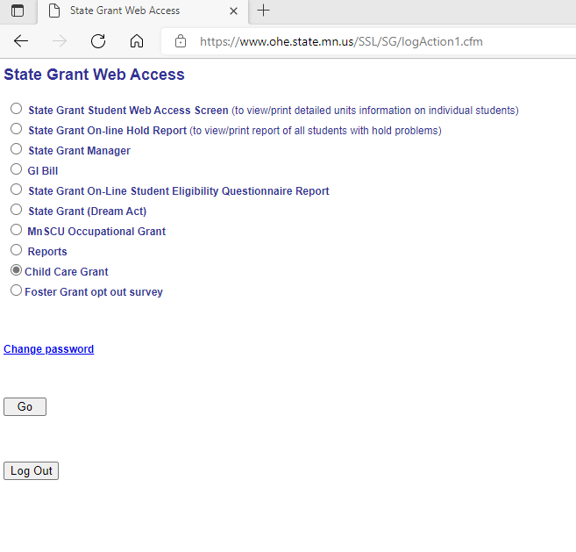
Child Care Terms of Receipt
  To access the Postsecondary Child Care Grant Terms of Receipt Database you will need to log into the State Grant Web Access using your email and the password assigned to you for access to the Child Care terms of receipt database.
  https://www.ohe.state.mn.us/SSL/SG/index.cfm

Slide 94
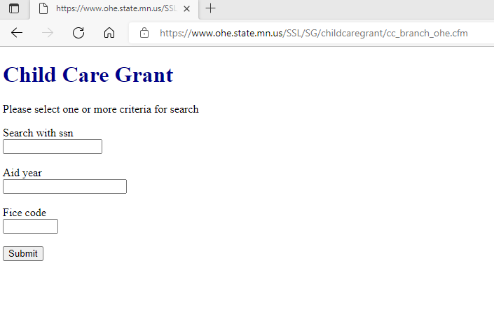
Child Care Terms of Receipt

Slide 95
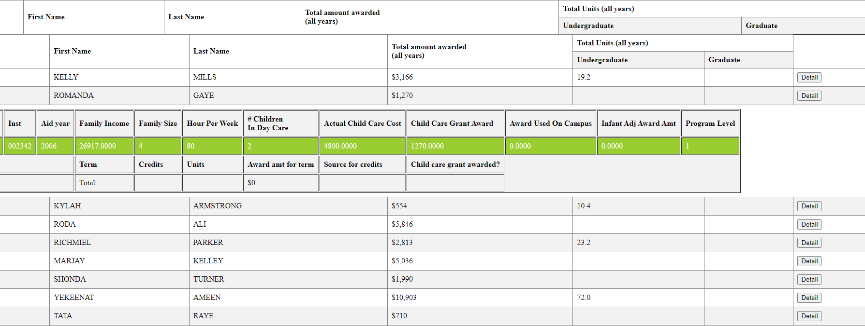
Child Care Terms of Receipt

Slide 96
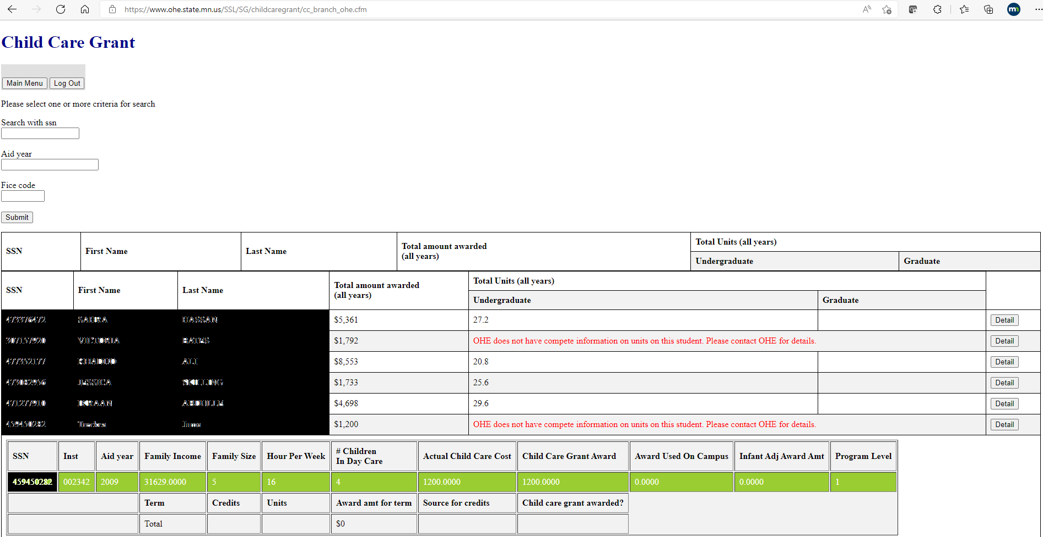
Child Care Terms of Receipt

Slide 97
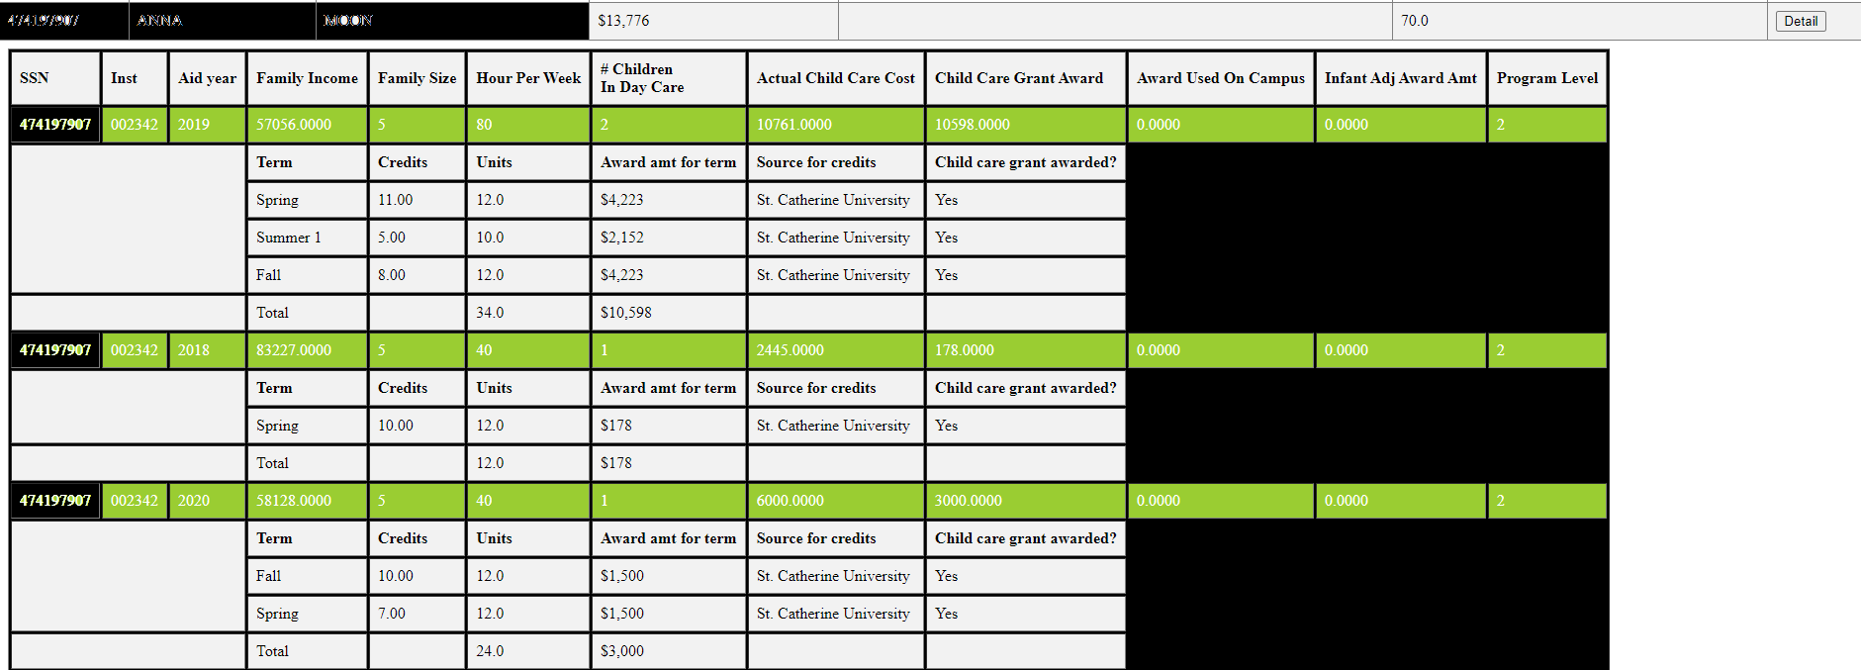
Child Care Terms of Receipt

Slide 98
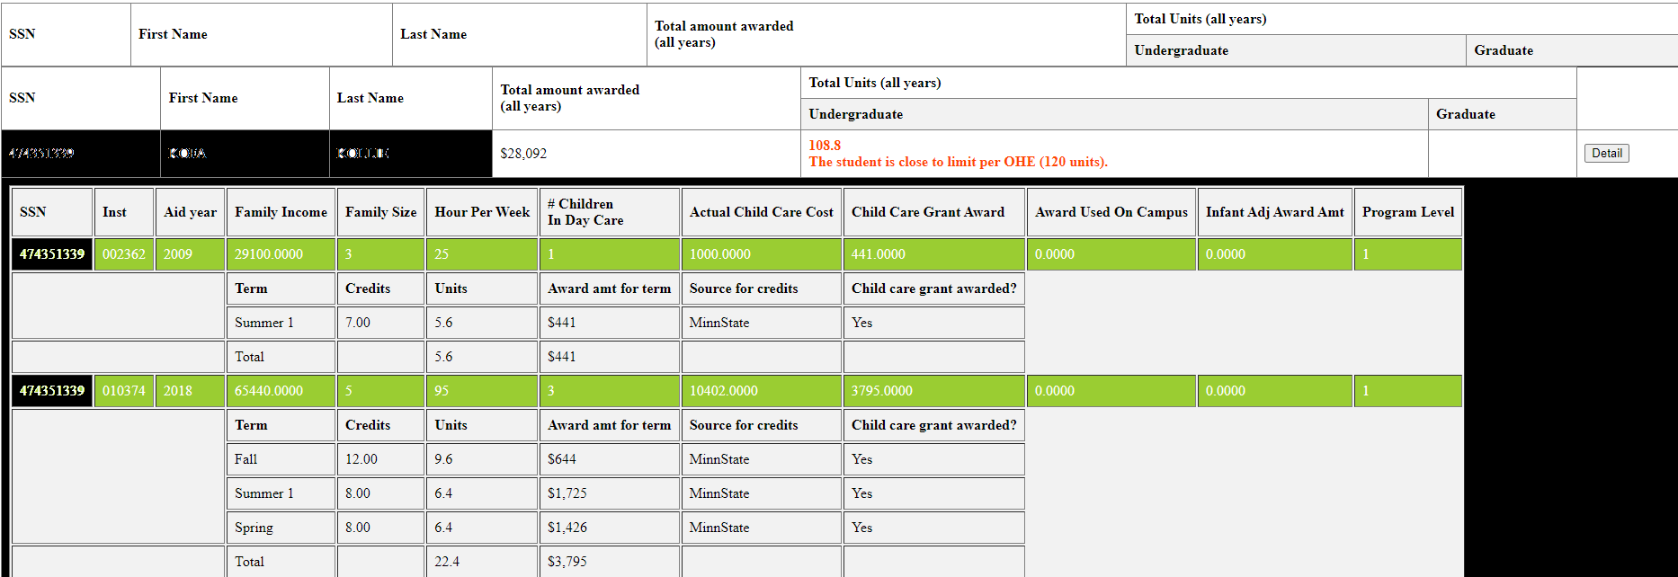
Child Care Terms of Receipt

Slide 99
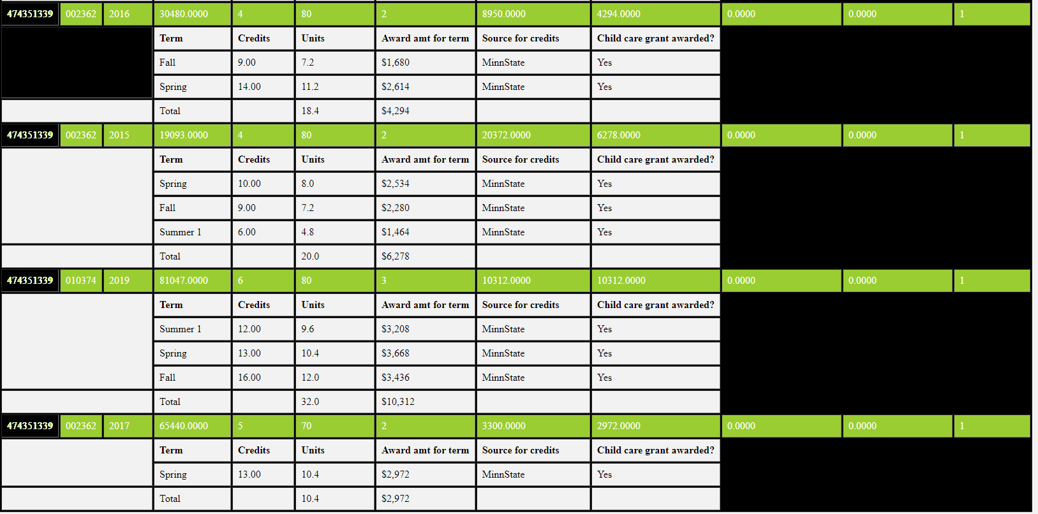
Child Care Terms of Receipt

Slide 100
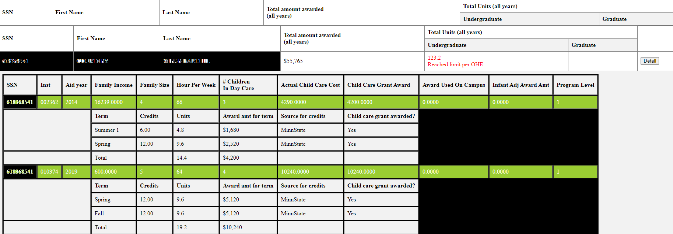
Child Care Terms of Receipt

Slide 101
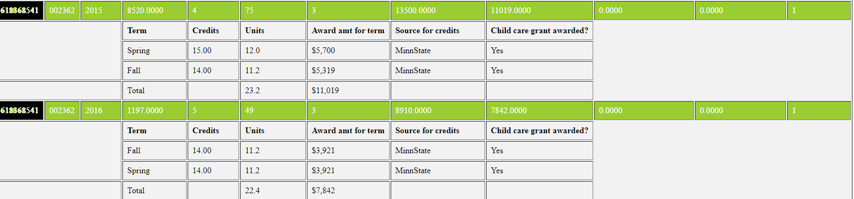
Child Care Terms of Receipt

Slide 102
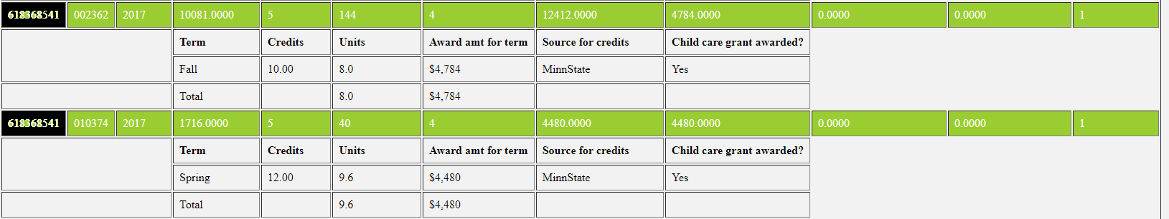
Child Care Terms of Receipt

Slide 103
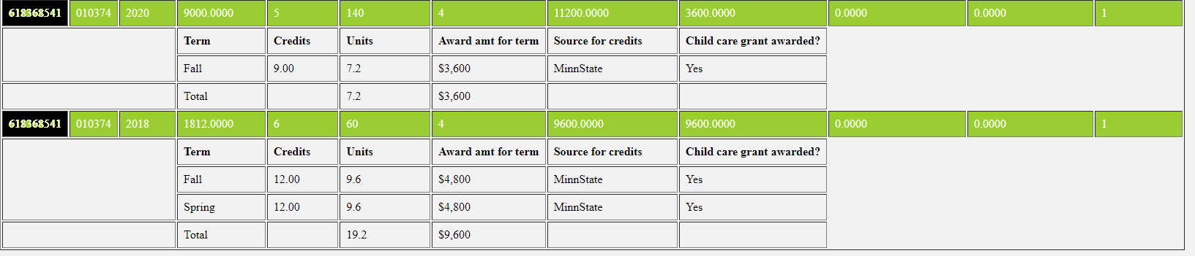
Child Care Terms of Receipt

Slide 104
Thank you!
Brenda Larter
Brenda.larter@state.mn.us
651-355-0612

