Slide 1
State Grant Training for Financial Aid Administrators
Presented by Meghan Flores
November 19, 2019

Slide 2

Application Process

Slide 3
Application Process
Submit Free Application for Federal Financial Aid (FAFSA) to the Central Processing Center (CPS)
Available October 1st each year
FAFSA on the WEB (FOTW) at www.fafsa.gov
FAFSA on the WEB requires a valid federal school code
Download paper FAFSA
Complete MyFAFSA from MyStudentAid Mobile App
2019-2020 FAFSA (July 1, 2019 – June 30, 2020)
2020-2021 FAFSA (July 1, 2020-June 30, 2021)

Slide 4
Application Assistance
Application and Verification Guide (AVG) of the Federal Student Aid (FSA) Handbook
Download at: www.ifap.ed.gov
FSA Coach at: www.ifap.ed.gov
Call federal financial aid hotline at (800) 433-3243 or get help on-line at: www.fafsa.gov
Call State Grant Unit at (651) 642-0567 #2 or (800) 657-3866 #1

Slide 5

MN Dream Act Application Process
Undocumented students meeting criteria in MN Dream Act cannot use FAFSA
OHE annually creates a MN Dream Act Application for these students
Modeled after FAFSA on the Web
Generally available 10/1
Questions are in English and Spanish
Must be completed in one sitting
Uses Prior Year (PPY)
Does not use FSA ID- not a federal app
100% verification w/ 1040s
www.ohe.state.mn.us/MNDreamAct

Slide 6
State Grant Application Deadline
Original FAFSA/MN Dream Act Application must be received by the federal application Central Processing Center (CPS)/OHE no later than the 30th day of the term
e.g., September 30th for term starting September 1
The FAFSA receipt date appears as Application Receipt Date on the Institutional Student Information Record (ISIR) and Student Aid Report (SAR).
Deadline applies only to ORIGINAL application
No deadline for corrections
Missing deadline for one term won’t affect subsequent terms (if deadline met for those terms)

Slide 7
Application Deadlines
The Office of Higher Education (OHE) will reject term payment submitted by school if student didn’t meet application deadline
OHE collects term start dates from schools on annual SG Budget Questionnaire
OHE uses application receipt date on ISIR
If school combines “mini-terms” into one term, term start date is first day of first “mini-term”
State auditors will review term start dates, application receipt dates during audits

Slide 8
Application Deadlines
For clock hour schools and schools with multiple start dates for term, FAFSA application receipt date (or MN Dream Act application submission date) must be within 30 days of date student’s term or payment period starts
OHE will be unable to verify
Schools must monitor on campus

Slide 9
Application Deadlines
Application deadline also applies to MN Dream Act financial aid application
“Orig Application Receipt Date” on MN Dream Act Database
Must be received by 30th day of term
Applies to application itself and not supporting documentation (100% verification for MN Dream Act applicants)

Slide 10
Application FAFSA Output
School must use ISIR/SAR to screen for State Grant eligibility
If school not on Title IV programs, school must use student’s paper SAR
If student provided email address on FAFSA, student given link to SAR which can be printed
Student should be sure to add federal system email address to email address book
Otherwise, student SAR mailed
SAR is NOT the same as FAFSA on the Web summary screen print
Should say Student Aid Report
OHE does eligibility screening centrally for MN Dream Act applicants

Slide 11
Application State Questionnaire
School must have student complete State Grant Student Eligibility Questionnaire to collect additional information not on FAFSA
School may use form designed by OHE (Appendix 2 of manual) or incorporate questions into institutional form(s)
This form collected by school and NOT submitted with FAFSA
Not required for MN Dream Act applicants, since questions built into the application itself
Form must only be completed when student first starts
School responsible for resolving any conflicting information thereafter
Effective 2013-2014, schools have choice of using FOTW state interface for this purpose

Slide 12
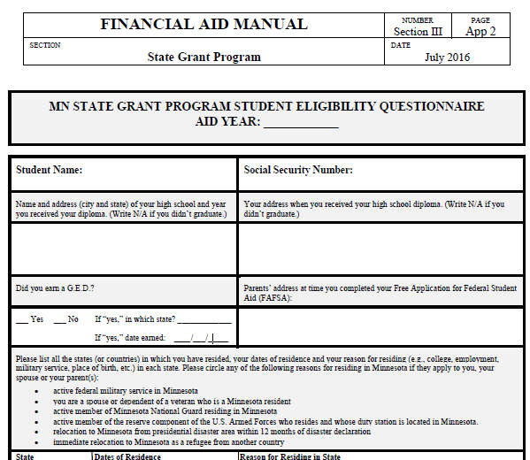
Grant Student Eligibility Questionnaire- App 2

Slide 13
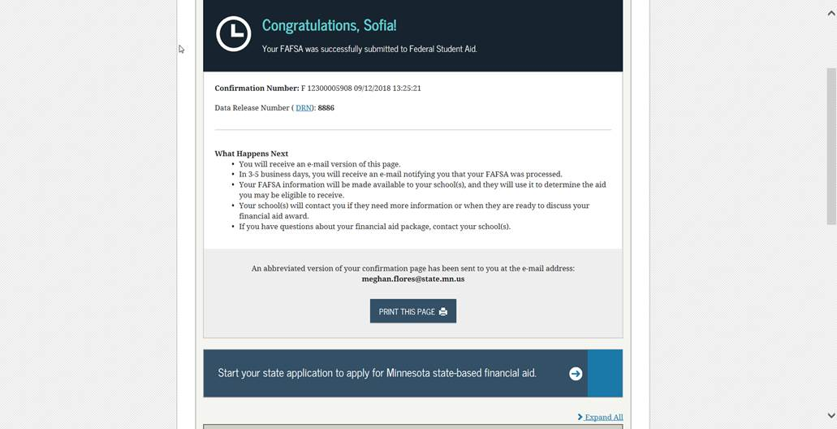

MN Online Student Eligibility Questionnaire
Student must click on MN link on FOTW confirmation page to be redirected to the OHE online questionnaire website.

Slide 14
MN On-Line Student Eligibility Questionnaire
When MN resident student submits the original FOTW, confirmation page will show link/message to access state financial aid application
Student must list MN as state of legal residence on FOTW to see link on FOTW confirmation page
Student will receive message on screen about interface when entering ‘MN’ for state of legal residence
Must be student’s original FOTW, not correction
67% of MN students presented the link completed it using FOTW state interface
OHE will have secure web site for students to access if they miss the FOTW link (another 31% complete it this way)

Slide 15
MN On-Line Student Eligibility Questionnaire
OHE loads ISIR records each night
Will cross reference on-line questionnaire database to determine if student has successfully completed questionnaire
Will push out email to student with unique link to on-line questionnaire if:
Student not screened out (see App 24 SG manual); AND
No on-line questionnaire on file OR
Incomplete questionnaire on file
Will push out existing on-line questionnaire to any new colleges listed on ISIR

Slide 16
MN On-Line Student Eligibility Questionnaire
If student loses email with unique link to on-line state questionnaire, student can log-in with SSN, name and DOB (as they are on FAFSA) at this site:
https://www.ohe.state.mn.us/ssl/fafsa_quest/index.cfm
Can only access if:
OHE has loaded student’s ISIR record
Takes 5 days from original FOTW submission
Student has not already successfully completed a questionnaire

Slide 17
Participating Schools- View Results
Via State Grant Web Access – select State Grant On-Line Student Eligibility Questionnaire Report
Select Aid year
Adjust date range you want to view
Can view individual student or all students at your school
Residency status will be confirmed or unconfirmed

Slide 18
Disclosure Statement
Private schools not participating in the Federal Pell Grant program must have students read and sign a disclosure statement
Informs student s/he won’t be eligible for Federal Pell Grant at that particular school
Form is Appendix 23 of State Grant manual

Slide 19

Program Eligibility Requirements

Slide 20
Eligibility Screening
School is responsible for verifying students meet all State Grant program eligibility requirements
School financially liable for disbursements to ineligible students

Slide 21
U.S. Citizen or Eligible Non-Citizen
For terms starting after July 1, 2013:
No longer a requirement for students to be a U.S. citizen or eligible non-citizen
However, students must be lawfully present to meet one of the state residency criteria (except MN Dream Act)
“Lawfully present” means:
Citizen or eligible non-citizen
Undocumented students granted Deferred Action for Childhood Arrivals (DACA), TPS, VISA holders, Political Asylum pending

Slide 22
Minnesota Resident M.S.136A.101, Subd. 8
Meet ONE of the following criteria:
Student who graduated from MN high school while residing in MN (must be physically attending college in MN if residing in another state*); OR
Student who earned GED in MN after residing in MN for one year; OR
Dependent student whose parents resided in MN when FAFSA completed; OR
Student who resided in MN for 12 consecutive months without being enrolled for 6 or more credits in any term
*Restriction on distance education applies ONLY if graduating from a MN high school is the ONLY way a student can establish MN residency

Slide 23
Continued- Minnesota Resident M.S.136A.101, Subd. 8
A member (or spouse or dependent of) of the armed forces of the U.S. stationed in MN on active federal military service as defined in MS 190.05, Subd. 5c; or
A spouse or dependent of a veteran who meets the residency requirement; or
A person (or spouse of) who relocated to MN from an area that is declared a presidential disaster area within the preceding 12 months, if the disaster interrupted the person’s postsecondary education; or
A person defined as a refugee under US Code, Title 8, section 1101 (a)(42) who upon arrival in the US, moved to MN and has continued to reside in MN; or

Slide 24
Continued- Minnesota Resident M.S.136A.101, Subd. 8
Effective August 1, 2015, the following individuals are also considered MN residents:
An active member (or spouse or dependent of) of the state’s National Guard who resides in MN
An active member (or a spouse or dependent of) of the reserve component of the U.S. armed forces whose duty station is located in Minnesota and who resides in Minnesota
Template letter for verifying active membership in MN National Guard or Reserves (Appendix 26)

Slide 25

Minnesota Resident MN Dream Act M.S. 135A.043
A person eligible for resident tuition rates under 135A.043 AKA the MN Dream Act
Requirements:
Attend a MN high school for at least 3 years
Graduate from a MN high school or earn a GED in MN
If male, complied with Selective Service registration requirements
Apply for lawful immigration status if a federal process becomes available (does not refer to Deferred Action for Childhood Arrivals/DACA)
This requirement not yet enforced, since federal process does not yet exist

Slide 26

Minnesota Resident Agency Policy
Student who resided in MN for 12 consecutive months without being enrolled for 6 or more credits in any term
Does not have to be initial year student lived in MN
Residency established this was is lost if student later leaves MN for more than 1 year (unless for college, military, missionary service and still file taxes in MN)
Does not apply to GED recipients

Slide 27
Minnesota Resident Agency Rules
Independent student who originally met residency requirement as dependent because parents resided in MN when FAFSA completed grandfathered once independent if continues to live in MN (4830.0100 Subp. 10E)
Families not penalized for leaving MN to attend college or serve in military or missionary service if still paying taxes in MN (4830.0400 Subp. 2a.)

Slide 28
MN Residents?
Graduated from MN high school, lives in Eau Claire, WI and drives to classes at Century College in MN. Yes- if was distance education & only way to meet residency requirement was graduating from MN HS, than no.
Graduated from MN high school, lives in MN, taking only distance education classes from MN college. Yes- living in MN, so mode of delivery doesn’t matter
First moved to MN on June 1, 2011. Attended U of M full-time from January 23, 2012 to December 31, 2012. Moved from MN on November 1, 2013, to work in another state. Returned to MN on June 14, 2015 and attended U of M full-time during 14-15 aid year. Is this student a resident for 15-16? No
Dependent student first moved to MN after high school graduation in Colorado. Parents divorced. Mother stayed in CO, but father moved to MN. Mother’s income provided on FAFSA. No

Slide 29
Additional Requirements
Student must be 17 years old OR a H.S. graduate/GED recipient
No state ability-to-benefit requirement
Cannot award State Grant to student in high school
Student cannot receive MN State Grant AND receive tuition reciprocity benefits from neighboring state
Affects only public colleges in MN
Will be more beneficial for student to turn down reciprocity if attending MN campus that no longer charges non-resident rates

Slide 30
Enrollment in Eligible School
Must be enrolled for 3 or more credits/6 clock hours per week @ a clock hour school
In program leading to diploma, certificate or degree
Minimum program length is 8 weeks long and 300 clock hours or 12 credits
No requirement that student be accepted in program at each MN school, just one eligible MN school

Slide 31
Satisfactory Academic Progress
Same as Title IV satisfactory academic progress policy
Qualitative Component
GPA requirements
Quantitative Component
Timely completion of program
On-line tutorial at:
http://fsatraining.info/course/view.php?id=31

Slide 32
Satisfactory Academic Progress
GPA component
Identical to Title IV GPA requirements
Prior to end of 2nd academic year, student must meet school’s GPA requirements
Like Title IV policy, student must have GPA of 2.0 or academic standing consistent with school’s graduation requirements at end of 2nd academic year and thereafter
This means GPA can be below 2.0 if school’s graduation requirements have a lower GPA standard
“Academic year” means school’s definition of academic year for federal financial aid programs
Typically, two semesters or three quarters

Slide 33
Satisfactory Academic Progress
Timely Completion Component
State SAP policy is identical to Title IV policy for timely completion
School must define maximum time frame for program completion
At minimum, cannot exceed 150% of published program length
For example, 6 academic years to complete 4 year program
(4 X 1.5 = 6)
School can have stricter policy than 150%

Slide 34
Satisfactory Academic Progress
Timely Completion Component
To determine percentage of courses student must complete to meet timely completion component, divide program length by 150% of program length
Example: 4 years divided 6 years = 67%
Clock hour schools should set policy based on scheduled hours completed within a given timeframe

Slide 35
Satisfactory Academic Progress
Check Points/Increments
Program must be divided into equal evaluation periods or increments
Increment cannot be longer than half the program or one 9-month academic year
Clock-hour schools may use federal payment periods to check SAP

Slide 36
Satisfactory Academic Progress
Warning vs. Probationary Period
If school checks SAP each term:
Students not making SAP can be placed on financial aid warning and receive financial aid for one term
If still not making SAP, lose aid eligibility unless they successfully appeal (professional judgment due to special circumstance) and are placed on probation
If school checks SAP each academic year:
Student can only be placed on probation and receive financial aid if based on professional judgment appeal for special circumstances
Must recheck at end of next term

Slide 37
Undergraduate Program
Student must be in undergraduate program and not have bachelor’s degree
Bachelor’s degrees earned at foreign schools still count as bachelor’s degrees
Student can take graduate level classes as long as student enrolled in undergraduate program

Slide 38
Amount of Post-Secondary Education
Student ineligible once enrolled for the equivalent of 8 full-time semesters of postsecondary education
OHE State Grant database/rosters only track units of State Grant paid
Schools must request and review academic transcripts for students who indicated at least 3 or more years of postsecondary education on the State Grant Student Eligibility Questionnaire
Includes attendance at current campus
NSLDS student loan history on SAR/ISIR is another possible resource of previous attendance

Slide 39
Reviewing Academic Transcripts
Separate transcript from each school -does not need to be official transcript
Written statement from student reconstructing history when transcript can’t be obtained due to school closure, destruction of records, civil war, etc.
Can’t use if school holding transcript due to unpaid bill
However, FERPA and MN Data Practices Act allow student to inspect education records
Voluntary waiver of SG & CCG form if can not obtain transcript (Appendix 25)
School can make good faith effort to assign units when transcript lacks information needed to make accurate determination
Course work not separated by term, no start or end date, no credits shown for any course work
If course shows grade of ‘W’ with no attempted credits, use assumed value of 4 credits (unless all other classes show otherwise)

Slide 40
Reviewing Academic Transcripts
ALL course work counts EXCEPT:
Term during which student withdrew for active military service after December 31, 2002
Term during which student withdrew for major medical illness while under the care of a medical professional
Courses taken during high school under the Post-Secondary Enrollment Options (PSEO);
CLEP/AP course work (tests out of class w/o attending);
‘FN’ grade at MNState campus (failed - never attended)
Programs under 8 weeks in duration (or under 300 clock hours- Nursing Assistant);
Course work not offered by a post-secondary school (e.g., Red Cross training, military training) even if a college later grants college credit for the training;
Course work or training assigned –CEUs (continuing education units);
Courses the student audited;
Course work at Minnesota schools not participating in the State Grant Program and from which no course work transferred to the current school. Historical list of State Grant schools on OHE web site http://www.ohe.state.mn.us/mPg.cfm?pageID=1406

Slide 41
Reviewing Academic Transcripts
Be sure to include:
Unaccredited or non-transferable course work
Course work completed outside the U.S. or in other states,
Course work taken at a post-secondary school during military service (as opposed to military training)
Courses with grades of “F,” “NC,” “W,” “I”, “FW” (unless student withdrew for active military service after 12/31/2002 or major medical illness)
Remedial course work credit equivalencies
Independent study courses
Course work taken during a term for which the student was not eligible for a State Grant (e.g., missed application deadline, not eligible at student’s enrollment level, etc.)
Use Appendix 7 of State Grant Manual or Transcript Review Spreadsheet to review transcripts and record units [hand out copy of spreadsheet and sample case]

Slide 42
Units of Postsecondary Education (Units Shown for Full-Time Enrollment)
Quarter System |  |  | Units per Acad Year | Semester System
8 | 8 | 8 | = 24 = | 12 | 12
8 | 8 | 8 | = 24 = | 12 | 12
8 | 8 | 8 | = 24 = | 12 | 12
8 | 8 | 8 | = 24 = | 12 | 12
Cutoff if current college is on quarter system = 94.4 |  |  | 96 units = 8 FT semesters | Cutoff if current college is on semester system = 93.6
Student ineligible if units EXCEED cutoff. If units are at or under the cutoff, student can continue to be paid State Grant for any enrollment level until units cutoff is exceeded.

Slide 43
Units are Based on Term Enrollment Level (Full-Time Definition Changed from 12 to 15 Credits July 1, 1992)
Pre-July 1, 1992 Course Work QTR SEM 12+ credits 8 12 9-11 credits 6 9 6-8 credits 4 6 1-5 credits bank* bank* *total credits in each bank divided by 12 to determine the number of full-time quarters or semesters Example: 18 Qtr credits / 12 = 1.5 FT quarters 1.5 X 8 units = 12 units | Post-July 1, 1992 Course Work QTR SEM 15+ credits 8 12 14 credits 7.5 11.2 13 credits 6.9 10.4 12 credits 6.4 9.6 11 credits 5.9 8.8 10 credits 5.3 8.0 9 credits 4.8 7.2 8 credits 4.3 6.4 7 credits 3.7 5.6 6 credits 3.2 4.8 5 credits 2.7 4.0 4 credits 2.1 3.2 3 credits 1.6 2.4 2 credits 1.1 1.6 1 credit .5 .8

Slide 44
Transcript Review Tool

Slide 45
Reviewing Clock Hour Transcripts
To determine the amount of post-secondary education at a progressive clock hour school (other than your school):
Divide total number of clock hours in program by number of weeks in program to get average hours per week
Determine enrollment level based on average hours per week
Divide number of weeks in program by 12 to get approximate number of quarters in program
Determine units of post-secondary education by multiplying the number of quarters in program by the units for enrollment status
Assume continuous enrollment without breaks unless the transcript states otherwise (approved Leave of Absence (LOA))
If total clock hours do not appear on a cosmetology transcript, assume these total hours: Cosmetology = 1,550 hours, Barbering = 1,500 hours, Esthetician = 600 hours, and Nail Tech = 350 hours

Slide 46
Enrollment Status at Clock Hour School

Slide 47
Reviewing Clock Hour Transcripts
Example:
Period of Enrollment was 9/1/89 to 8/26/90 = 51 weeks
Total Hours Completed = 1550
Average Hours Per Week = 1550/51 = 30
Assumed Enrollment Status = full-time
Number of Quarters in Period = 51/12 = 4.25
Number of PSE Units = 4.25 x 8 units = 34 units
Enter the info above in the transcript review tool

Slide 48
Federal Student Loan Default
Students in default of federal loan not eligible for State Grant
When FAFSA processed, interface run with NSLDS database
Students in default have indicator on SAR or ISIR
Students regain eligibility by:
paying off loan
making 9 on-time monthly payments, or
making 3 on-time monthly payments prior to consolidation
Regaining eligibility extended retroactively to current aid year for State Grant

Slide 49
Default on SELF Loan
Student not eligible if defaulted on SELF loan
Does NOT affect eligibility for federal aid
If loan not in collections, eligibility regained by paying off loan or making 4 to 6 monthly payments
Eligibility retroactively extended to beginning of current aid year
If loan is in collections, must fully repay to regain eligibility
Regular interface run between SELF and State Grant databases at OHE
OHE notifies schools via State Grant on-line hold report, which can be viewed via SG Web Access

Slide 50
Child Support Hold
Student not eligible if 30+ days in arrears on child support obligation
Student regains eligibility by paying off past due amount or complying with monthly payment plan approved by caseworker
Eligibility retroactively extended to beginning of current aid year
Weekly interface run between Department of Human Services (DHS) and State Grant database at OHE
OHE notifies schools of holds on State Grant on-line hold report, which can be viewed via SG Web Access
Students should be referred to county

Slide 51
Eligibility Notification
Student loses eligibility as of month/year student placed on hold (regardless of when school notified)
School liable for overpayment if school paid AFTER receiving notification student on hold
OHE notifies school with On-Line Hold Report and SG Web Access Screen

Slide 52
Eligibility Screening Tools
FAFSA output – ISIR or SAR
SG Student Eligibility Questionnaire (Appendix 24)
Documentation at school (transcripts, admissions forms, etc.)
SG Web Access Screen (Appendix 4)
SG On-Line Hold Report (Appendix 3)
Appendix 6 of manual has a full list of all State Grant eligibility requirements in a chart format

Slide 53
State Grant On-line Hold Report
State Grant Web access screen
Each school participating in the State Grant program is assigned a username and password to gain access to the State Grant web access screen
This screen will allow schools to access student hold data, prior to making State Grant disbursements
Holds include:
Child support holds
SELF default
LPAR units—only paid units

Slide 54
Eligibility Screening
State Grant On-Line Hold Report
OHE downloads ISIRs each night
Data written to school’s on-line hold report each night if:
Student has new hold/warning or released hold; and
School listed on ISIR or DDS record previously submitted by school
School notified via email if data added/revised
School can print comprehensive report or alter date range to select only new/revised records
Does not include MN Dream Act applicants

Slide 55
Eligibility Screening
Hold data displayed on report:
Child support arrears
SELF loan default
Units of State Grant PAID through current year
Previous State Grant Overpayment (rare)
Continuously monitor the hold reports- students can have a hold, have it removed and go back on hold within the same aid year
Instructions and on-line tutorial available at:
http://www.ohe.state.mn.us/mPg.cfm?pageID=346

Slide 56
SG Student Web Access Screen
Student screen can be used to determine:
Holds (child support arrears, SELF default, federal loan default, State Grant overpayment)
Units of State Grant payments (just payments, not attendance)
Awards and payments for current year
School must be listed as college on student’s current ISIR in order for school to access State Grant database

Slide 57
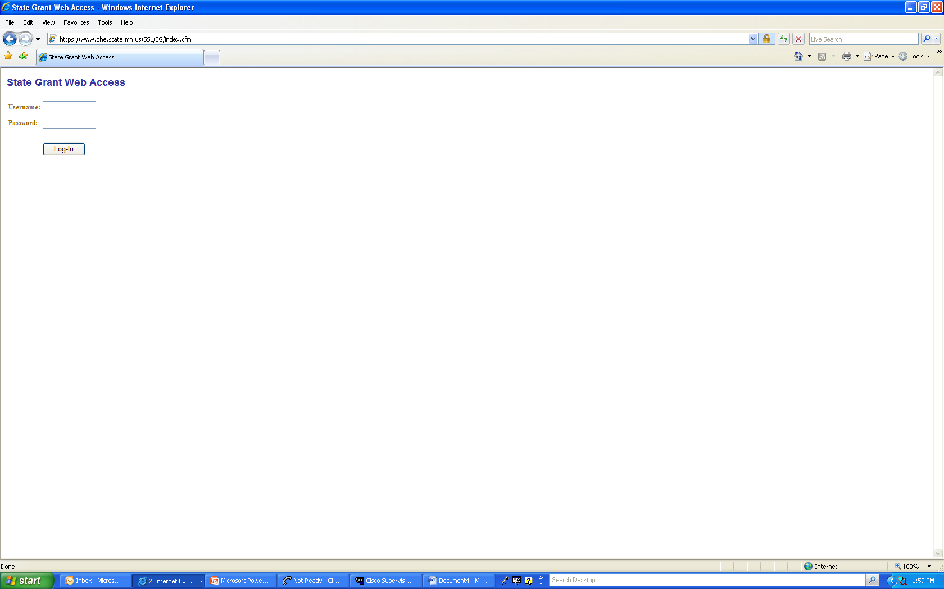
SG Web Access Screen
Username is school’s FAFSA code. Password is set by school. (Call OHE Grant Unit for assistance.)
https://www.ohe.state.mn.us/SSL/SG/index.cfm

Slide 58
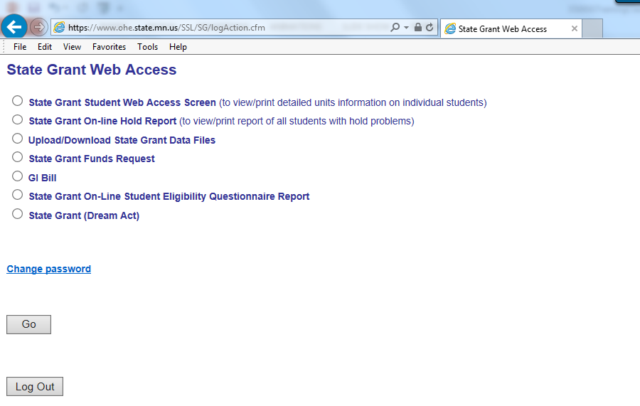
SG Student Web Access Screen
https://www.ohe.state.mn.us/SSL/SG/index.cfm

Slide 59
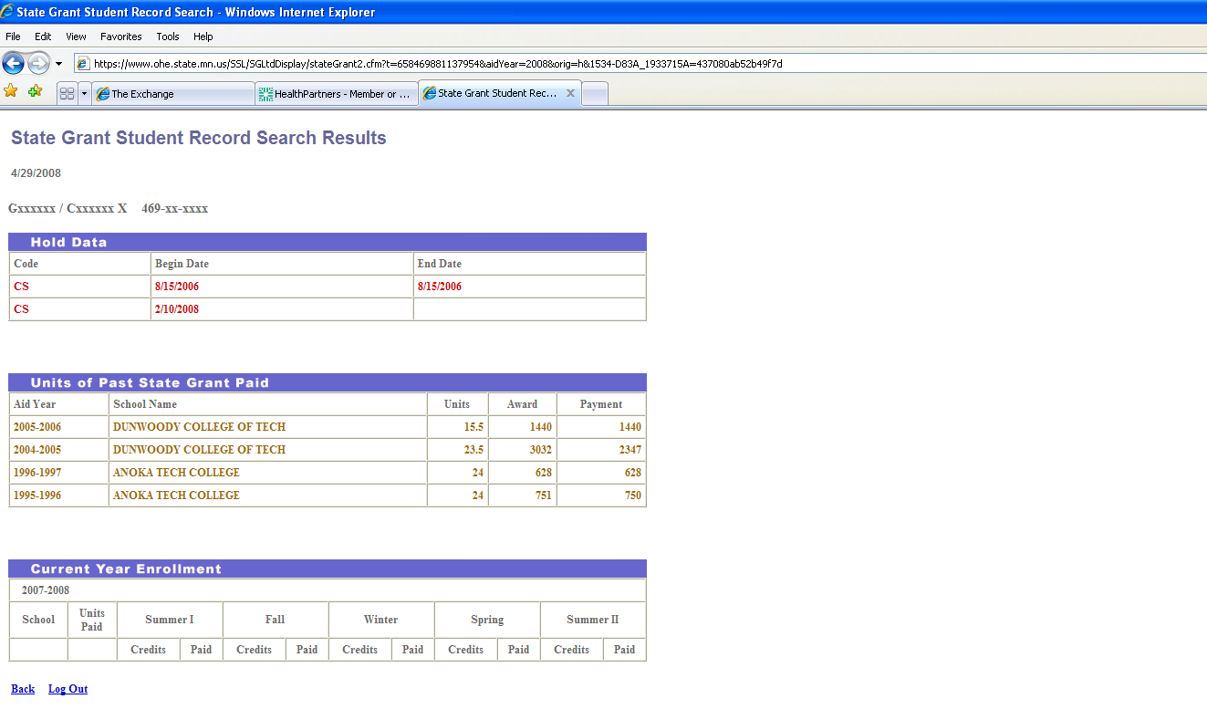
SG Student Web Access Screen
https://www.ohe.state.mn.us/SSL/SG/index.cfm

Slide 60
State Grant On-Line Hold Report
https://www.ohe.state.mn.us/SSL/SG/index.cfm

Slide 61
State Grant On-Line Hold Report
Tutorial available at: www.ohe.state.mn.us
(Minnesota State Grant Program Administration Page)
SSN | help | Student | help | help | help | help | help | help | help | help | help | help | help | help | help
 |  |  |  |  |  |  |  |  | Child | Child
 |  |  |  |  | SELF | SELF |  |  | Support | Support | Child
 |  |  | DDS/ |  | hold | hold | SELF | Child | hold | hold | Support
 | Aid |  | ISIR | SELF | start | end | Notification | Support | start | end | Notification |  | Units | Units | Last
 | Year |  | rank | hold | date | date | date | hold | date | date | date | Units | > 72 date | < 72 date | Transaction
617-xx-xxxx | 2007 | Axxxxxxx | DDS |  |  |  |  |  |  |  |  | 73.6 | 9/15/2006 |  | 9/15/2006
553-xx-xxxx | 2008 | Axxxxxxx | 12 |  |  |  |  |  |  |  |  | 72.8 | 4/19/2007 |  | 4/19/2007
553-xx-xxxx | 2007 | Axxxxxxx | DDS |  |  |  |  |  |  |  |  | 72.8 | 8/31/2006 |  | 8/31/2006
476-xx-xxxx | 2008 | Axxxxxxx | 15 |  |  |  |  |  |  |  |  | 96.0 | 9/5/2007 |  | 9/5/2007
476-xx-xxxx | 2007 | Axxxxxxx | 12 |  |  |  |  |  |  |  |  | 96.0 | 9/21/2006 |  | 9/21/2006
469-xx-xxxx | 2008 | Axxxxxxx | 13 |  |  |  |  |  |  |  |  | 101.6 | 8/7/2007 | 6/6/2007 | 8/7/2007
472-xx-xxxx | 2007 | Axxxxxxx | 12 |  |  |  |  |  |  |  |  | 78.4 | 6/1/2007 |  | 6/1/2007
615-xx-xxxx | 2008 | Axxxxxxx | 11 |  |  |  |  | Y | Feb 2008 |  | 2/10/2008 |  |  |  | 2/10/2008
504-xx-xxxx | 2008 | Axxxxxxx | 14 |  |  |  |  |  |  |  |  | 75.2 | 1/25/2008 | 1/24/2008 | 1/25/2008
475-xx-xxxx | 2008 | Axxxxxxx | 13 |  |  |  |  |  |  |  |  | 80.0 | 2/6/2008 |  | 2/6/2008
225-xx-xxxx | 2007 | Axxxxxxx | 12 |  |  |  |  |  |  |  |  | 92.0 | 9/22/2006 |  | 9/22/2006
228-xx-xxxx | 2008 | Axxxxxxx | 11 |  |  |  |  | Y | Aug 2005 |  | 4/19/2007 |  |  |  | 4/19/2007
228-xx-xxxx | 2007 | Axxxxxxx | 11 |  |  |  |  | Y | Aug 2005 |  | 7/9/2006 |  |  |  | 7/9/2006
640-xx-xxxx | 2007 | Axxxxxxx | DDS |  |  |  |  |  |  |  |  | 76.8 | 6/14/2007 |  | 6/14/2007
225-xx-xxxx | 2007 | Axxxxxxx | 13 |  |  |  |  | Y | Sep 2007 | 2/27/2007 | 9/12/2007 |  |  |  | 9/12/2007
472-xx-xxxx | 2007 | Axxxxxxx | 11 |  |  |  |  |  |  |  |  | 88.8 | 12/28/2006 |  | 12/28/2006
469-xx-xxxx | 2008 | Axxxxxxx | 12 |  |  |  |  |  |  |  |  | 96.0 | 4/19/2007 |  | 4/19/2007
469-xx-xxxx | 2007 | Axxxxxxx | DDS |  |  |  |  |  |  |  |  | 73.6 | 1/31/2007 |  | 1/31/2007
339-xx-xxxx | 2007 | Axxxxxxx | 11 |  |  |  |  |  |  |  |  | 83.7 | 6/27/2006 |  | 6/27/2006
619-xx-xxxx | 2008 | Axxxxxxx | DDS |  |  |  |  | Y | Jan 2004 |  | 8/14/2007 |  |  |  | 8/14/2007
636-xx-xxxx | 2007 | Axxxxxxx | 12 |  |  |  |  |  |  |  |  | 82.4 | 1/11/2007 |  | 1/11/2007
610-xx-xxxx | 2007 | Axxxxxxx | 31 |  |  |  |  |  | May 2006 | 3/20/2007 | 6/3/2006 |  |  |  | 3/20/2007
474-xx-xxxx | 2007 | Axxxxxxx | 13 |  |  |  |  |  |  |  |  | 100.8 | 7/6/2006 |  | 7/6/2006
474-xx-xxxx | 2007 | Axxxxxxx | 11 | Y | Feb 2006 |  | 7/26/2006 |  |  |  |  |  |  |  | 7/26/2006
647-xx-xxxx | 2007 | Axxxxxxx | DDS | Y | Jan 2005 |  | 8/6/2006 |  |  |  |  |  |  |  | 8/6/2006
648-xx-xxxx | 2008 | Axxxxxxx | DDS |  |  |  |  |  |  |  |  | 76.8 | 1/29/2008 |  | 1/29/2008
497-xx-xxxx | 2007 | Axxxxxxx | 11 |  |  |  |  |  | Sep 2003 | 9/12/2006 | 7/23/2006 |  |  |  | 9/12/2006
471-xx-xxxx | 2007 | Axxxxxxx | DDS |  | Jun 2006 | 9/7/2006 | 6/8/2006 |  |  |  |  |  |  |  | 9/7/2006
439-xx-xxxx | 2008 | Axxxxxxx | DDS |  |  |  |  |  |  |  |  | 75.2 | 9/6/2007 |  | 9/6/2007
469-xx-xxxx | 2007 | Axxxxxxx | 11 |  |  |  |  |  |  |  |  | 84.3 | 11/28/2006 |  | 11/28/2006

Slide 62

Verification

Slide 63
Verification
Must verify certain items reported on FAFSA if selected for verification
Text of student’s SAR will indicate if application was selected for verification, as will Verification Flag = Y shown under ‘For Financial Aid Office Use Only’
SAR will also have asterisk following the EFC if selected for verification
ISIR record will indicate if the application was selected for verification
OHE will perform verification for ALL MN Dream Act state financial aid applicants (100% verification)

Slide 64
Verification
School must use federal guidelines and forms for verification (even if not participating in federal aid programs)
http://ifap.ed.gov/fsahandbook/attachments/1516AVGCh4.pdf
School liable for any overpayments if verification not performed
School also responsible for resolving any conflicting information on student’s financial aid application and other documentation collected by the school, EVEN IF the student is not selected for verification
Must resolve ‘C’ codes following EFC on ISIR/SAR
Indicates there are problems the student or school must resolve

Slide 65
Professional Judgement

Slide 66
Professional Judgment
Schools must use Title IV guidelines for professional judgment
Federal Student Aid Handbook ‘Application and Verification Guide’ is a resource
Adjustments must be based on unusual circumstances that can be adequately documented, preferably by someone outside the family
Adjustments must be done on a case-by-case basis and not applied to a broad class of students

Slide 67
Professional Judgement
Common examples include:
Significant change in income from past tax year based on unemployment, underemployment, death, divorce, military service or natural disaster
Unusually high medical expenses
Nursing home expenses
Elementary or secondary school tuition
Significant college costs for dependent student’s parent attending college
Dependency override
Family should contact financial aid administrator to discuss unusual circumstances

Slide 68
Professional Judgement
Dependency override allows dependent student to apply as independent
Examples: Left parental household due to abuse, inability to locate parents
Dependency override should not be done merely because:
Parents unwilling to complete FAFSA
Student lives independently of parents after graduating from high school
Aid administrators can use professional judgment to adjust the cost of attendance used for state campus-based programs, such as State Work Study, but NOT State Grant budget

Slide 69
Professional Judgment
Aid administrators cannot use professional judgment to override a State Grant Program eligibility requirement (e.g., application deadline, residency, citizenship, etc.).
Can adjust financial data elements to end up with different EFC but cannot make bottom-line change to EFC
OHE will perform professional judgment adjustments for undocumented students completing MN state financial aid application

Slide 70



Break Time

Slide 71

State Grant Enrollment Levels

Slide 72
State Grant Enrollment Levels
Average % of Full-Time
Credits Clock Hours Enrollment State Grant
Per Term Per Week Level Budget Used
15+ 30+ Level 15 100%
14 28-29 Level 14 93.3%
13 26-27 Level 13 86.7%
12 24-25 Level 12 80.0%
11 22-23 Level 11 73.3%
10 20-21 Level 10 66.7%
9 18-19 Level 9 60.0%
8 16-17 Level 8 53.3%
7 14-15 Level 7 46.7%
6 12-13 Level 6 40.0%
5 10-11 Level 5 33.3%
4 8-9 Level 4 26.7%
3 6-7 Level 3 20.0%

Slide 73

State Grant Award

Slide 74
State Grant Award Notice
School must calculate the student’s State Grant award on campus and notify student
OHE performs this function for MN Dream Act applicants; however, schools should incorporate the award into their campus financial aid award letter as well.
Award notice should indicate that State Grant will vary based on enrollment level
Shared Responsibility formula is used to calculate award
Shared Responsibility formula is described in text of State Grant Manual and Appendices 8 and 9

Slide 75
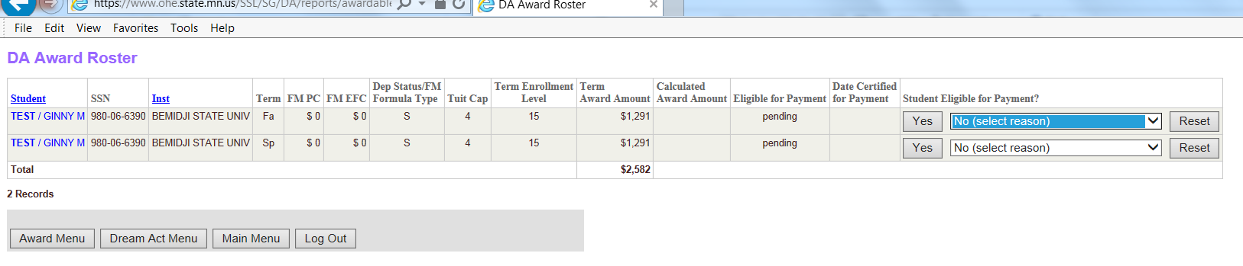
MN Dream Act State Grant Award Roster Screen

Slide 76
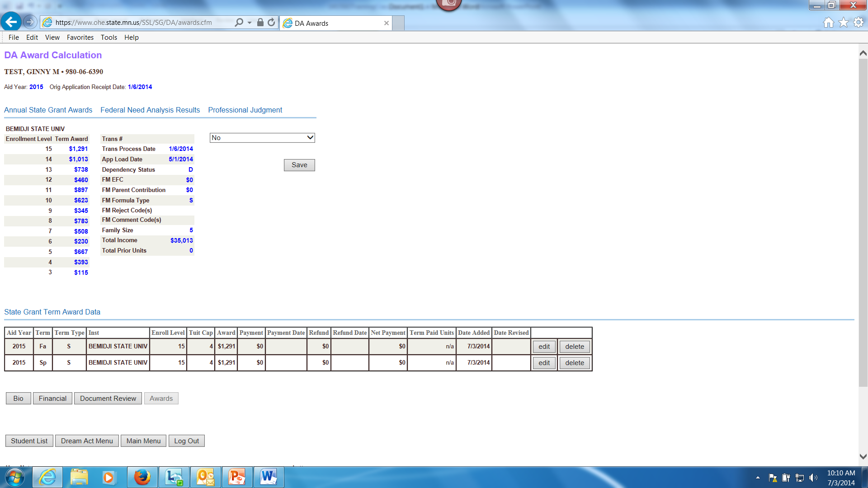
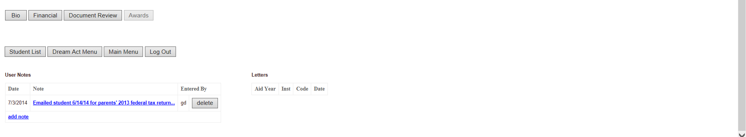
MN Dream Act State Grant Student Award Screen

Slide 77
Design for Shared Responsibility 2019-2020 Annual Award Calculation
Average Tuition & Mandatory Fees* (30 sem/45 qtr credits)
+ Living and Misc Expense Allowance (LME)** ($9,930)
= State Grant Budget
50% Assigned Student Responsibility
Annual 9-month FM PC (dependent) X .82
Annual FM EFC X .74 (independent with deps) or
Annual FM EFC X .38 (independent w/o deps)
Pell Grant Award***
= State Grant Annual Award (minimum $100)
*Subject to tuition & fee caps: $15,142 for 4-yr program; $5,963 for 2-yr or less program
**LME $0 for those in correctional facility
***From 2019-2020 Federal Pell Grant Disbursement Schedule. Amount based
on student’s EFC. Amount subtracted even if student not actually receiving Pell.

Slide 78
Award for Non-Standard Term
“Non-standard” term means semester less than 15 weeks or quarter less than 10 weeks
Award for non-standard term is same as award for standard term
No adjustments required for shorter term length

Slide 79
Award for Full Fiscal Year
Student may receive State Grant for up to 4 full-time quarters or 3 full-time semesters during a fiscal year
This translates into 60 quarter credits or 45 semester credits in a fiscal year
Term with 15 or more credits only counts as 15 credits
If student transfers to another school, the new school must limit payment to stay within these credit limits

Slide 80
Fiscal Year Award Limitation for Transfer Student
Example of Transfer Student
Student completes 17 semester credits at School A
Student transfers to School B, which is on the quarter system
School B must translate 15 semester credits to 22.5 quarter credits (15 X 1.5)
(17 credits only counted as 15)
School B can only award the student for the remaining 37.5 quarter credits of eligibility for the aid year

Slide 81
Award for 4th Quarter or 3rd Semester
State Grant award for student’s 4th quarter or 3rd semester within fiscal year is calculated in the same manner as for other terms
Pell Grant student would be eligible to receive for 4th quarter or 3rd semester is subtracted in the State Grant award calculation
Beginning with summer 2018, “year round” Pell. Students can receive up to 150% of their scheduled Pell award each year.

Slide 82
Attending Multiple Schools
Student can receive separate State Grants at multiple MN schools during the same term based on the cost and credits at each school attended
Can’t receive payment for more than 15 credits per term
School that reports payment that exceeds 15 credits will have payment rejected by OHE
School must recalculate payment for enrollment level of remaining credits. Example:
School A pays for 12 credits and has payment accepted
School B pays for 6 credits and has payment rejected
School B must recalculate State Grant to Level 3 instead of Level 6

Slide 83
Attending Multiple Schools
When calculating awards at separate schools for the same term:
Each school must use the average tuition and mandatory fees, appropriate tuition and fee maximum, and LME for the student’s enrollment level at that school
Example of the award calculation for a student attending two schools for the same term can be found as Example 7 in Appendix 9 of State Grant manual

Slide 84
Combining Credits at ‘Home School’
One eligible MN school may act as the ‘home school’ and base student’s award on the costs for combined credits at both schools
A consortium agreement is not required as long as both schools are eligible MN schools
However, home school must monitor student’s enrollment at other school to determine if student withdraws or is making satisfactory progress

Slide 85
Combining Credits at ‘Home School’
“Home school” must add the average tuition and fees charged at both schools for up to 15 credits per term
Home school can use its own tuition and fees if the other school is within the same system (MNState, U of M, Private 4-year, Private 2-year)
The lesser of the tuition and fees or the applicable tuition and fee maximum for the student’s degree program must be used in the award calculation
LME used in State Grant award calculation cannot exceed the full-time LME for 15 credits
Example award calculation can be found as Example 8 in Appendix 9 of the State Grant manual
Multiple school award calculation spreadsheet available at: www.ohe.state.mn.us

Slide 86
Attending Multiple Schools
A student cannot receive a State Grant at an ineligible school unless the school has a consortium agreement with an eligible MN school and the student is accepted into a degree, certificate or diploma program at the eligible MN school
The eligible MN school must act as the ‘home school’ and award the State Grant

Slide 87
Crossover Term Award Overlaps fiscal years (starts before and ends after July 1st)
Award may be funded from either aid year
Decision on which aid year’s FAFSA to use can differ on student-by-student basis
Must match aid year selected for Federal Pell Grant
Considerations:
Which year’s FAFSA might yield the highest State Grant award?
Has the student met the application deadline for both years?
Has the student already been awarded for 3 FT semesters or 4 FT quarters for the current aid year?
Laws, regs and policies for aid year selected apply

Slide 88

Disbursement

Slide 89
Initial Funds Advances
Initial DDS batch for the year is set to TEST at OHE and must be individually reviewed before putting into PRODUCTION
Plan accordingly for peak processing time; it can take 5-10 business days to review and push first batch into production
Be sure to closeout previous aid year

Slide 90
Initial Funds Advances
State Grant funds advanced to schools via paper check or EFT transaction
Initial advance for first term is based on total amount of first term awards in school’s DDS batch for the current year
Only 90% of the initial advance will be disbursed to school
School can request additional funds later, if necessary
Advance held by OHE if school not in compliance with close out deadline for prior year

Slide 91
Subsequent Funds Advances
Request funds using the State Grant Funds Request Option on SG Web Access Screen:
https://www.ohe.state.mn.us/SSL/SG/index.cfm
OHE can limit advances to amount of total awards for term in most recent DDS batch
Schools cannot receive funds more than 14 days before term start date
Advances held if school missed close out deadline for prior year or not meeting monthly reporting requirements

Slide 92
State Grant Funds Request
Select funds request from main menu and hit ‘Go’

Slide 93
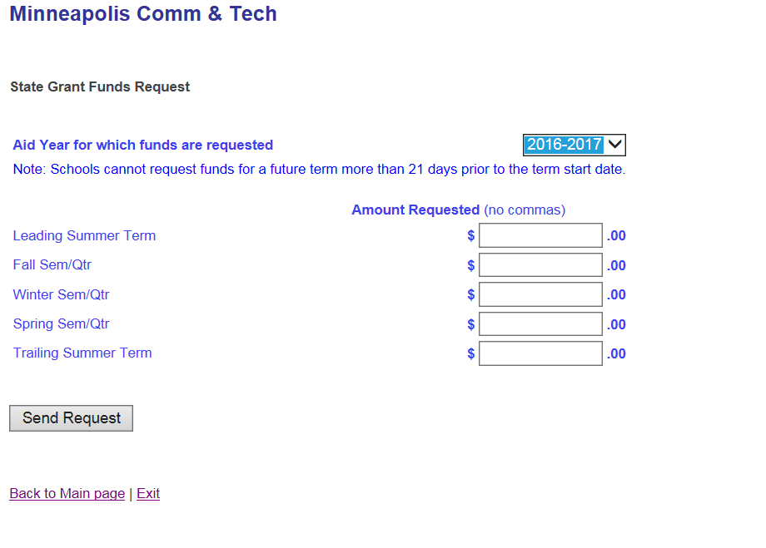
State Grant Funds Request
Make sure to select correct aid year and indicate if final batch (final batch indicator not present until summer)
Enter amount needed for each term and then click ‘Send Request.’ Do not enter cents.

Slide 94
How Funds Disbursed
State Grant funds must be maintained in separate account or in a manner that allows auditors to adequately track funds
Interest earnings must be used to offset State Grant administrative costs
Schools can disburse State Grant funds to students using any of the following methods:
by check directly to the student
by check mailed to the student
applying funds to the student’s account
transferring funds via EFT

Slide 95
MN Dream Act State Grant Funds
OHE will send separate State Grant funds via EFT for MN Dream Act recipients
OHE will email school when funds are sent
These recipients not included in DDS batches or DDS funds advances
Accompanying payment roster can be generated by school on MN Dream Act system
School can return refunds at end of term using OHE Refund Return Form

Slide 96
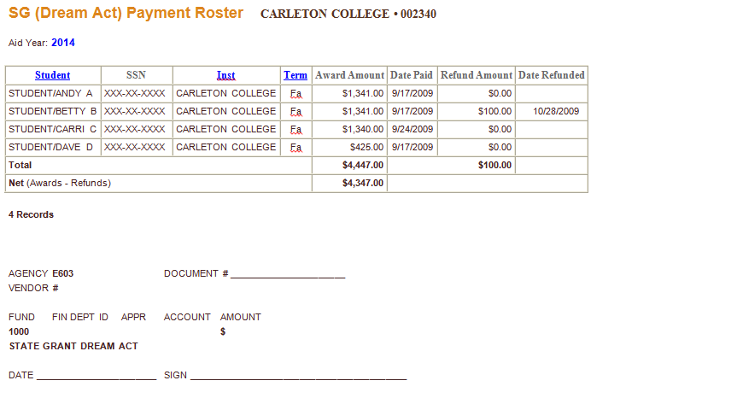
MN Dream Act State Grant Funds

Slide 97
When Funds are Disbursed
School may not disburse funds to a student until the student is registered for a term
Disbursement date is considered to be the first day of the term
If student does not attend, funds must be returned
If school posts State Grant payment with own funds prior to beginning of fiscal year
Liable for any overpayments related to changes in eligibility requirements, enrollment level, etc.

Slide 98
Disbursement Date
If funds disbursed after term starts, disbursement date is:
date funds are applied to student’s account or applied to tuition charges; or
for funds mailed to student or transferred via EFT, date of check or EFT transaction,
for funds disbursed directly to student via check, date student picks up the check
State Grant payment must always be based on student’s enrollment status AS OF THE DATE OF DISBURSEMENT

Slide 99
Late or Retroactive Disbursement
Can pay late in term or retroactively for completed term (even if student not currently enrolled) if student:
met the application deadline for the term in question
currently meets all other program eligibility requirements
Payment must be based on student’s enrollment status for term as of the date of disbursement
Classes with passing grades or grades of “F,” “NC,” or “I” CAN be included when determining enrollment status as of the end of the term
Classes with grades of “W,” “FW” or “FN” CANNOT be counted

Slide 100
Student Authorization
School must obtain written authorization from student allowing school to disburse State Grant funds via EFT or to hold excess funds on student’s account
School cannot require student to authorize these activities
Authorization is provided for one academic year and can be used for future years if school notifies student and offers opportunity to rescind authorization

Slide 101
Student Authorization
Unless otherwise authorized by student, any excess state financial aid funds on student’s account beyond institutional charges must be disbursed to student within 14 days of the later of:
the date the balance occurs; or
the first day of classes for the term/period; or
the date the student rescinds authorization
This includes State Grant payments posted with institutional funds
School must document all disbursements for auditing purposes (for further instructions, see “Method of Disbursement to Students” in the State Grant manual)

Slide 102

Award Recalculation and Refunds

Slide 103
Award Recalculation
State Grant must always be recalculated if student drops/withdraws from credits without having attended
For example, recalculate Level 15 award to Level 12 if student drops 3 credit class without attending
For example, Level 12 State Grant disbursed for two combined summer sessions of 6 credits each recalculated to Level 6 if student doesn’t attend second summer session

Slide 104
Award Recalculation
Withdrawals backdated to beginning of term treated as if student never attended
Entire State Grant must be refunded if student drops/withdraws from all classes without attending

Slide 105
Withdrawing/Adding Credits After Beginning Attendance (First effective 2013-2014 aid year)
No state award adjustments required after student has begun attendance in all classes
School can have written policy to adjust awards through a certain date
E.g. end of drop/add period, end of term, etc.
School can have different policy for different programs
E.g. day school vs weekend college
Policy must be used for all state financial aid programs requiring adjustments
Adjustment end date does NOT have to match end date used for Federal Pell Grant program

Slide 106
Withdrawing/Adding Credits After Beginning Attendance
If school has policy opting for award adjustments, they must be done regardless of whether award increases or decreases if they occur before adjustment end date
Action | Result | Adjustment
Add credit(s) | Increases award | Disburse additional State Grant funds to student
Add credit(s) | Decreases award | No adjustment of State Grant award unless Pell Grant actually increased
Withdraw credit(s) | Increases award | No adjustment of State Grant award unless Pell Grant actually decreased
Withdraw credit(s) | Decreases award | Perform partial withdrawal refund for State Grant using OHE Refund Calculation Worksheet

Slide 107
Partial Withdrawal Resulting in Decreased State Grant Award
If student withdraws from attended class after State Grant disbursement:
School must complete appropriate OHE Refund Calculation Worksheet (Appendix 13 of State Grant Manual or spreadsheet)
The lesser of the amount of the refund of institutional charges or the difference between the original and revised State Grant is refunded
School not required to complete OHE Refund Calculation Worksheet/Spreadsheet if no refund of institutional charges
School must at least review case and make notation in student’s file

Slide 108
Withdrawing/Adding Credits After Beginning Attendance
When first awarding/disbursing funds AFTER the adjustment end date, award must be based on enrollment level as of the date of disbursement
No further adjustments after that point
If student has withdrawn class removed from transcript, treat as if student was never enrolled and perform award recalculation
School can have a policy to add credits after state award adjustment end date if:
Credits would have normally been added during drop/add period and failure to originally add credits was beyond student’s control; or
Interim credits were registered after fall term award adjustment end date and will be allocated to fall term

Slide 109
Award Adjustments
If a student first withdraws from and then adds credits after beginning attendance and before award adjustment end date:
First do partial withdrawal refund for withdrawn class
Compare revised award for new net enrollment level (don’t include Ws) with previous disbursement retained by student
If new award is less than what was retained from original disbursement, there is not an overpayment
If new award is higher than what was retained from original disbursement, disburse additional funds to student
Consult Appendices 26 and 27 in State Grant manual for more detailed instructions

Slide 110
Refund for Total Withdrawal
If student totally withdraws from school after attending classes, school must complete the appropriate OHE Refund Calculation Worksheet or Spreadsheet
Not required if no refund of institutional charges, but school must review and make notation in student’s file
Different worksheet/spreadsheet based on how school charges (upfront for entire program or by term)
Line A: Amount of cash or financial aid applied to original institutional charges (capped at the amount of original institutional charges)
Line B: Subtract amount of original institutional charges school is allowed to retain according to its refund policy
Line C: Gross refund (if zero or negative, STOP! )
Line D: Subtract institutional share of any required refund due to Title IV programs
Line E: Net refund (distributed proportionally among non-Title IV aid programs except State Work Study)

Slide 111
Refund for Total Withdrawal
If school charges for entire program at onset of program:
Line A represents all financial aid and cash received to date for the entire program
This includes funds disbursed to the student for living costs UNLESS they exceed the amount of total program charges
School charges $15,000 for cosmetology program at onset of program
Program normally takes 5 payment periods to complete
School disburses excess financial aid to student each payment period as though school charged by the payment period (e.g., $3,000 charges associated with each period)
All funds received by school to date for program are included on Line A up to $15,000

Slide 112
Award Adjustments
In some cases, both an award recalculation and withdrawal refund calculation must be performed
Example: Student is paid a State Grant for 12 credits at the beginning of summer semester (6 credits per summer session). Student withdraws during first summer session and does not enroll for second summer session.
First recalculate Level 12 State Grant to Level 6 because student never attended classes in second summer session
Perform withdrawal refund calculation for Level 6 State Grant

Slide 113
State Grant Refunds
For main State Grant activity, schools do not return individual student refunds to the OHE throughout school year
Refunds deposited into the school’s State Grant fund on campus
Excess funds returned to OHE in lump sum at end of year
For MN Dream Act State Grant recipients, schools perform award adjustments and/or refunds
Individual student refund amounts returned with payment roster at end of term

Slide 114

Reporting Requirements

Slide 115
Reporting Requirements
Schools are required by law to report State Grant data to OHE on monthly basis throughout the school year
The data record submitted for each student is described under the DDS Record Format (Appendix 12 of State Grant Manual)
Upload files to OHE using SG Web Access Screen at:
https://www.ohe.state.mn.us/SSL/SG/index.cfm
Schools using an automated FTP process can continue to FTP files to OHE
OHE uses DDS record submitted by school to recalculate need analysis and awards (not ISIR)

Slide 116
Reporting Requirements
Schools should only report data for students who:
have completed their financial aid applications,
have a SAR/ISIR that is not rejected,
plan to enroll at the school for the school year being processed,
meet all of the State Grant Program eligibility requirements, and
have been through the State Grant formula to determine whether they are a recipient or no-need applicant
are not MN Dream Act recipients

Slide 117
DDS Record
Most data on DDS record comes from school’s ISIR record, along with other data supplied by school:
Title IV cost of attendance (actual tuition and fees, books, equipment, room and board, transportation, miscellaneous personal expenses)
Less than half-time Title IV cost of attendance
Has effect on less than half-time Pell Grant award
Consists of full-time tuition & fees, books, equipment, and transportation (no room and board or misc expenses)

Slide 118
DDS Record
Origin Type:
Tells OHE whether or not to use assumptions when calculating need analysis
‘O’ means the OHE should use assumption
‘R’ or blank means the OHE should use the actual data sent and override assumptions
Term Enrollment Status
Reported as full-time (15 credits) for terms of standard academic year (fall through spring terms) unless school knows otherwise
Should be updated later if changes
Should reflect the student’s enrollment status as of the date of disbursement

Slide 119
DDS Record
Term Tuition and Fee Maximums
2 = Student in 2-year or less degree program
4 = Student in 4-year degree program
Term Award and Payment Fields
If student is not enrolled (or not eligible) for term, term award and payment should be reported as zeroes
Term Disbursement Date Fields
Used to determine if student was paid before or after being placed on hold

Slide 120
State Grant DDS Batch Upload
Select this then click ‘Go’
https://www.ohe.state.mn.us/SSL/SG/index.cfm
Change password here

Slide 121
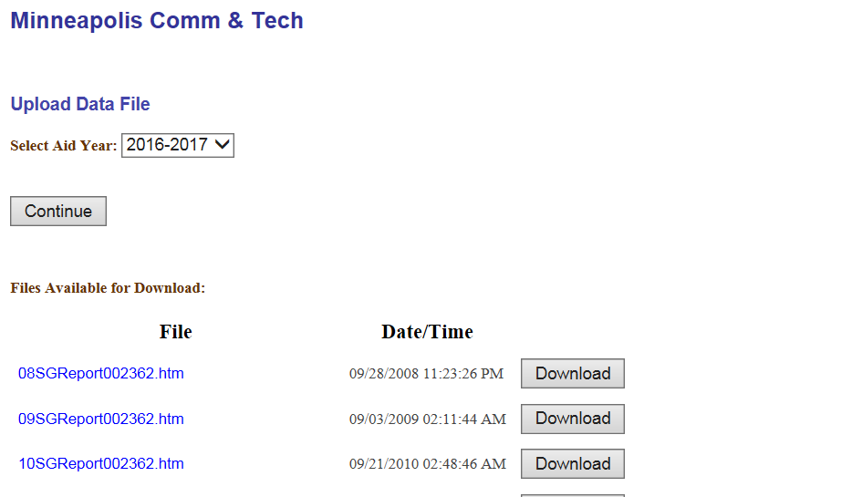
State Grant DDS Batch Upload
https://www.ohe.state.mn.us/SSL/SG/index.cfm
Make sure to select correct aid year then click ‘Continue’

Slide 122
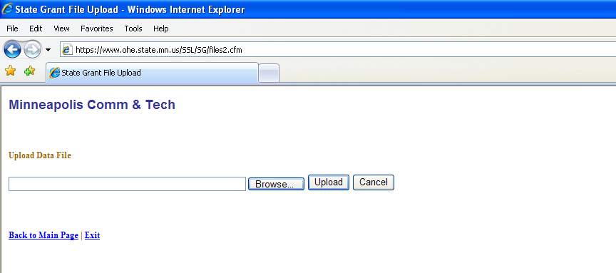
State Grant DDS Batch Upload
Browse for DDS batch file on your computer and select file. There is no required naming convention. Then click ‘Upload.’

Slide 123
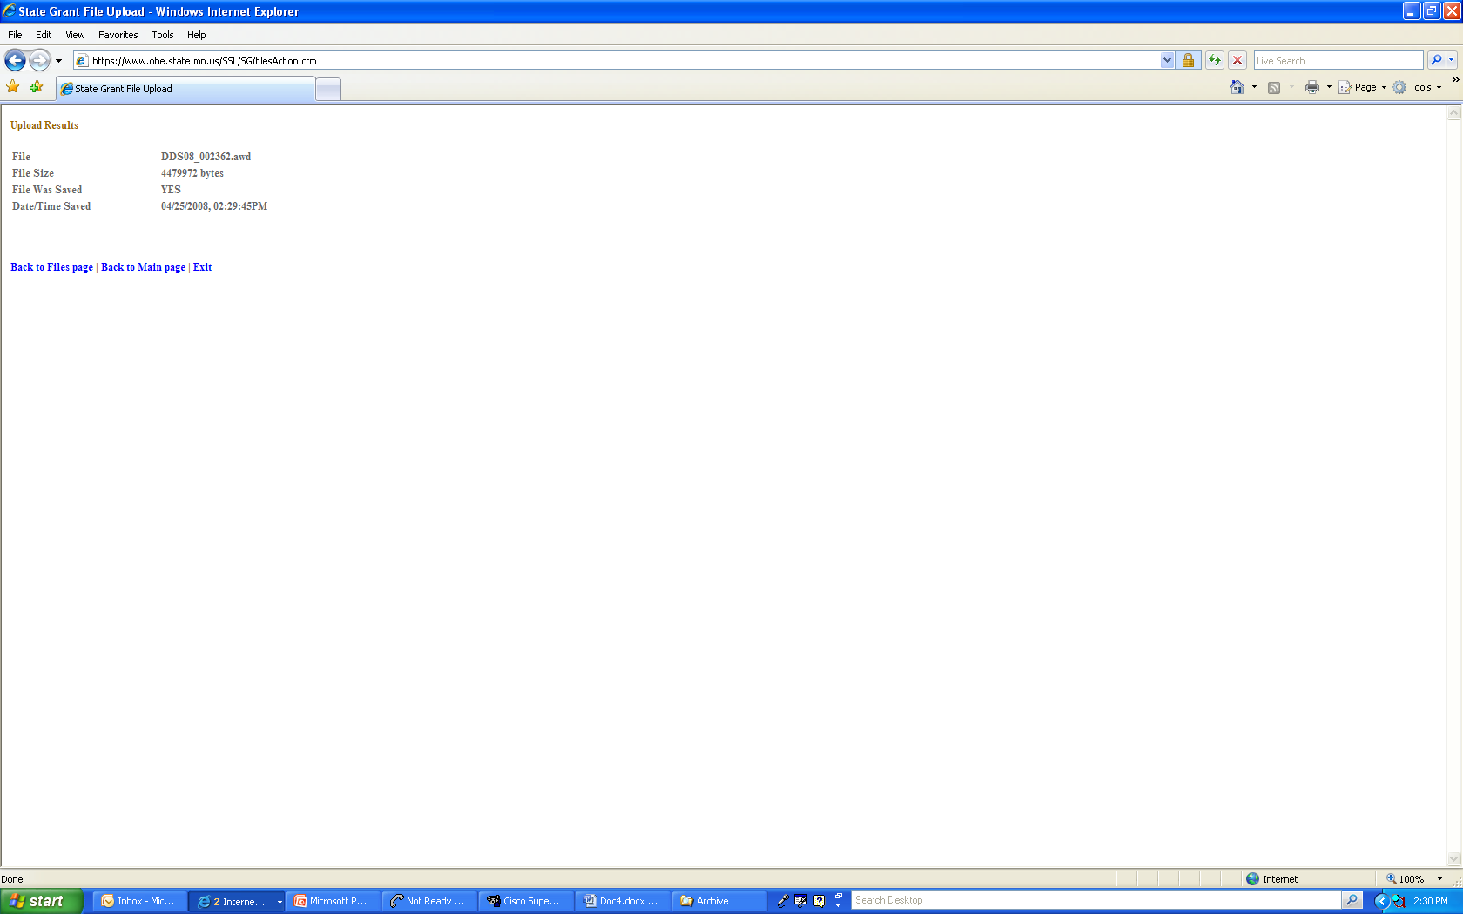
State Grant DDS Batch Upload
File upload was successful. Batches must be submitted by 6:00 p.m. to run that evening.
To request funds

Slide 124

DDS Batch Output Reports

Slide 125
DDS Batch Output Reports
Output reports available morning after DDS batch submitted to OHE
Batches run in the test environment do NOT produce output reports for schools
To view output reports, log into SG web access screen and choose ‘Upload/Download Data’
Report files appear under download section of screen
Reports can be viewed on-line, printed, or downloaded
Contact the Grant Unit if output reports were not generated

Slide 126
State Grant DDS Batch Output Reports Download
Select this then click ‘Go’
https://www.ohe.state.mn.us/SSL/SG/index.cfm

Slide 127
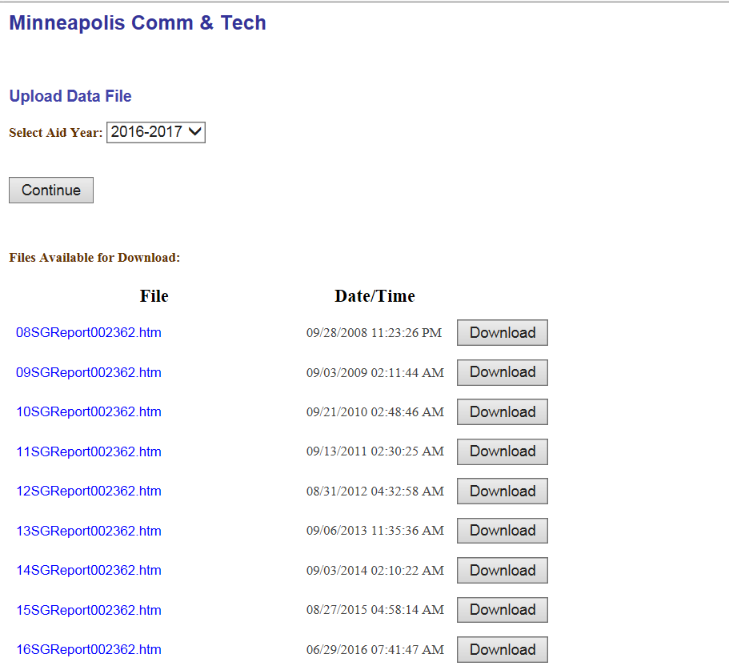
State Grant DDS Batch Output Reports Download
https://www.ohe.state.mn.us/SSL/SG/index.cfm
Files available for download appear under ‘File.’ Select and hit ‘Download.’ Reports remain in download directory until next DDS batch submitted.

Slide 128
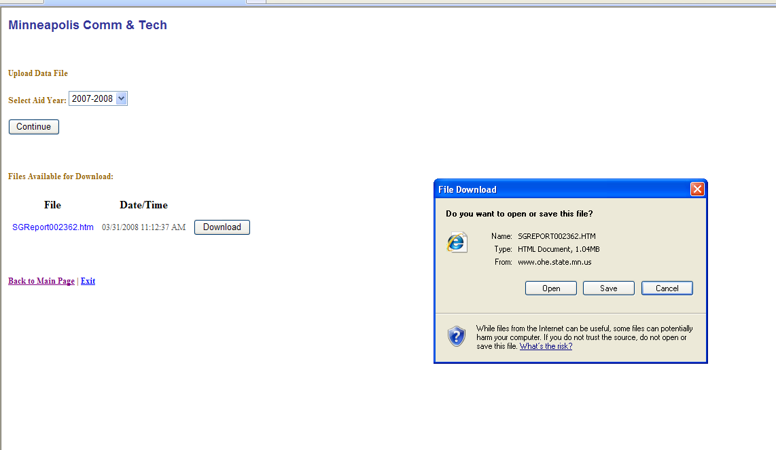
State Grant DDS Batch Output Reports Download
Click ‘Open’ to view report on-line. Click ‘Save’ to save report on your computer.

Slide 129
DDS Batch Output Reports- 4 output reports
The school should review the reports and correct any errors prior to submission of its next monthly batch
Roster of Rejected Awards/Payments App 17
All warnings and errors
Award Error Detail Roster
Greater detail on award errors
Roster of Accepted Payments App 18
Reconciliation Report App 19
Accounting totals for batch

Slide 130

End of Year Process

Slide 131
End of Year Process
School must return excess State Grant funds and submit error-free final batch to OHE by August 31
Schools should allow adequate time for closing out due to high volume
Schools should use SG web access screen file upload procedure to provide spending figures for final batch when uploading batch
Do not have to upload batch if school uses automated FTP process
Failure to meet close-out deadline will hold fund advances for the next aid year

Slide 132
Post-Closure Refunds
Return any post-closure refunds to OHE using Refund Return Form
(on web page under Financial Aid Administrator Resources)
School does NOT need to re-open batch activity
School should NOT subtract new (post-closure) payments from post-closure refunds

Slide 133
Post-Closure Payments
It may be possible for OHE to issue a manual payment to the school
Contact Grant Unit for assistance
Once State Grant activity is closed out for aid year, school must keep all associated student records for 3 years or until all audit findings for that school year are resolved

Slide 134

Office of Higher Education Websites
Just for you!

Slide 135
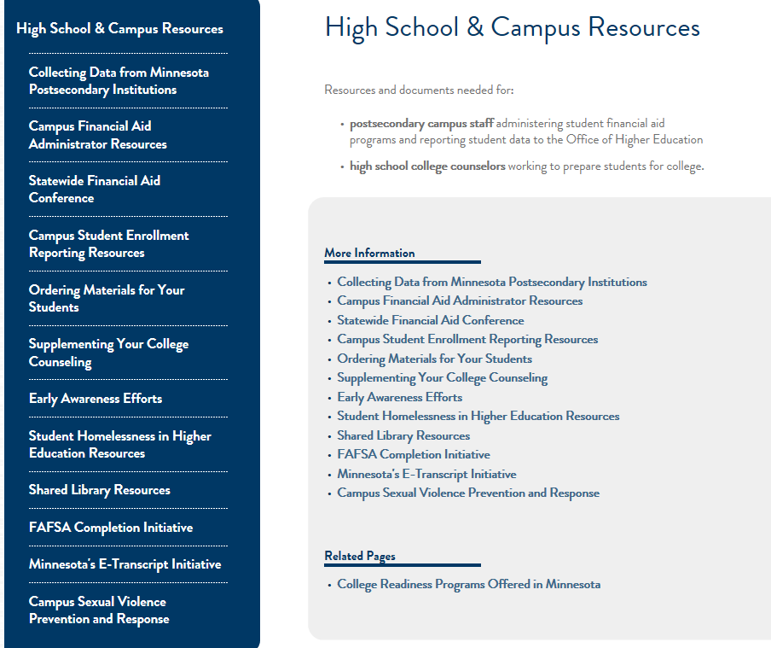
OHE.State.MN.US

Slide 136
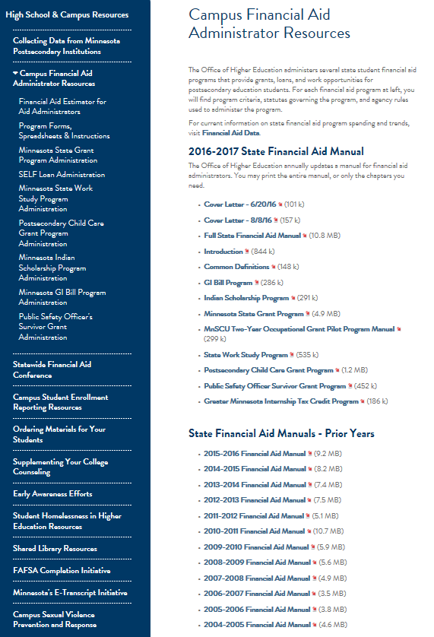
Office of Higher Education Web Sites FAA Resources
Financial Aid Estimator
Program Forms, Spreadsheets, and Instructions
Administrative Information for Each State Financial Aid Program
Financial Aid Program Manual Chapters (Prior Years are Available Below.)

Slide 137
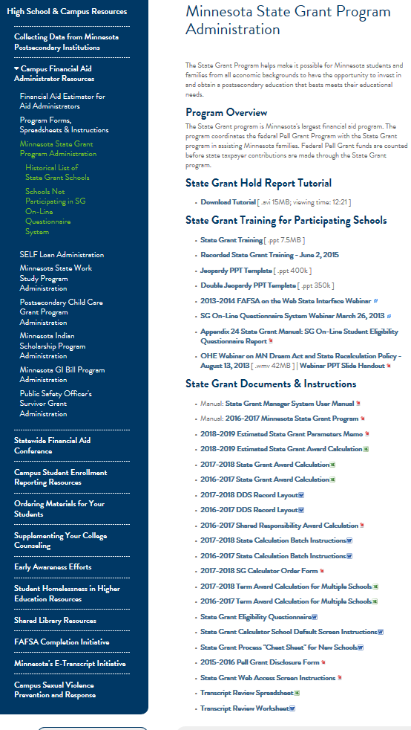
Office of Higher Education Websites State Grant Page
Contact information for locating closed school transcripts.
State Grant Research Data (Historical, Spending, Spending by College, Award Parameters etc.)
State Grant Manual (Includes Laws/Rules) Historical List of All Schools Participating in State Grant.
State Grant PowerPoint Presentation.

Slide 138
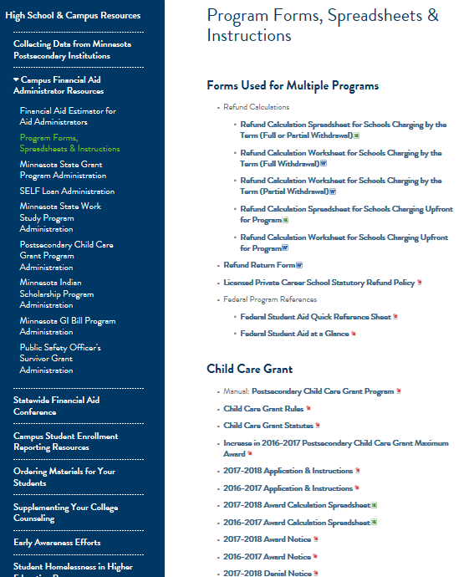
Office of Higher Education Websites Forms for FAAs
Refund Forms, Transcript Review Spreadsheet/Worksheet
Child Care Grant Forms

Slide 139
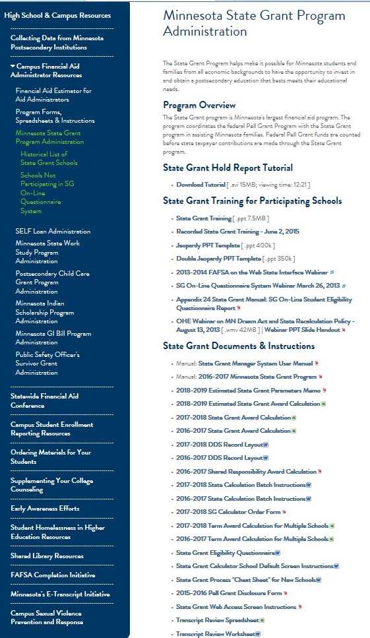
Office of Higher Education Web Sites Forms for FAAs
State Grant Documents and Instructions

Slide 140
Office of Higher Education Grant Unit (651) 642-0567 Option 2
Meghan Flores: State Grant, MN Dream Act, Tuition Reciprocity, OHE FA Estimators, FAFSA implications for State Meghan.flores@state.mn.us (651) 355-0610
Nancy Johnson: SG eligibility questions, SG batch processing, SG fund advances, SG online budget questionnaire, Dream Act processing (status of application) Nancy.a.johnson@state.mn.us (651) 355-0611
Brenda Larter: Work-study, Childcare Grant, Safety Officer’s Survivor, Summer Academic Enrichment, Dream Act processing (status of application AND payment) brenda.larter@state.mn.us 651) 355-0612
Jodi Rouland: Tuition Reciprocity applications, enrollment data collection, eligibility reports, Dream Act processing (status of application) Jodi.Rouland@state.mn.us (651)355-0614

Slide 141
Office of Higher Education Grant Unit (651) 642-0567 Option 2
Megan FitzGibbon: MISP, Teacher Shortage Loan Forgiveness, Greater MN Internship Tax Credit Program megan.fitzgibbon@state.mn.us (651) 355-0606 Jaquelynn Mol Sletten: Dual Training Grant, MN State MNReconnect, Teacher Shortage Loan Forgiveness, Intellectual & Developmental Disability Grant jacquelynn.mol.sletten@state.mn.us (651) 355-0609 Joanna Moua: Grants to Teacher Candidates Program, Ag Educators Loan Forgiveness Program, Aviation Degree Loan Repayment Program, John R Justice Federal Loan Repayment Program, MISP Joanna.moua@state.mn.us
(651) 355-0613

Slide 142

Clock Hour Schools

Slide 143
Definition of Academic Year
School must define the full-time academic year as number of clock hours
Hours in academic year don’t necessarily match hours in program
Minimum academic year length is 900 clock hours and 26 weeks
Most schools use 900, 1200 or 1550 hours
The school must use the same academic year for all financial aid programs

Slide 144
Definition of Academic Year
Academic year is divided into 2 or 3 equal payment periods (similar to semesters or quarters)
Examples:
1200 hour academic year
Two 600-hour payment periods (semesters) if full-time
Three 400-hour payment periods (quarters) if full-time
900 hour academic year
Two 450-hour payment periods (semesters) if full-time
Three 300-hour payment periods (quarters) if full-time
1550 hour academic year
Two 775-hour payment periods (semesters) if full-time
517, 517, 516 hour payment periods (quarters) if full-time

Slide 145
Academic Year and Payment Period for Less than Full-Time Enrollment
Payment period hours reduced if student enrolled less than full-time (30+ hours per week)
Appendix 16 of State Grant manual has academic year/ payment period charts
Example:
School uses 900-hr academic year
School uses 450-hr full-time payment period
Student enrolled 24 hours per week – Level 12
Full-time payment period hours multiplied by 12/15ths
450 X .80 = 360 hours

Slide 146
Payment Period for Less than Full-Time Enrollment
Student attending 30 hours per week will complete 450 hour payment period in 15 weeks
Student attending 24 hours per week will complete 360 hour payment period in 15 weeks

Slide 147
Sample Payment Periods 900-Hour Academic Year-2 Pay Periods
 |  |  |  | State Payment Periods
State Grant Enrollment Level | Hours Per Week | % State Budget | Hrs State Acad Yr | Pay Period 1 | Pay Period 2
Level 15 | 30 + | 100% | 900 | 450 (1-450) | 450 (451-900)
Level 14 | 28-29 | 93.3% | 840 | 420 (1-420) | 420 (421-840)
Level 13 | 26-27 | 86.7% | 780 | 390 (1-390) | 390 (391-780)
Level 12 | 24-25 | 80% | 720 | 360 (1-360) | 360 (361-720)
Level 11 | 22-23 | 73.3% | 660 | 330 (1-330) | 330 (331-660)
Level 10 | 20-21 | 66.7% | 600 | 300 (1-300) | 300 (301-600)
Level 9 | 18-19 | 60% | 540 | 270 (1-270) | 270 (271-540)
Level 8 | 16-17 | 53.3% | 480 | 240 (1-240) | 240 (241-480)
Level 7 | 14-15 | 46.7% | 420 | 210 (1-210) | 210 (211-420)
Level 6 | 12-13 | 40.0% | 360 | 180 (1-180) | 180 (181-360)
Level 5 | 10-11 | 33.3% | 300 | 150 (1-150) | 150 (150-300)
Level 4 | 8-9 | 26.7% | 240 | 120 (1-120) | 120 (121-240)
Level 3 | 6-7 | 20.0% | 180 | 90 (1-90) | 90 (91-180)

Slide 148
Tuition and Fees
Tuition and fees used for annual full-time State Grant budget are:
Tuition and fees* for program
Divided by hours in program
Multiplied by hours in full-time academic year
Subject to tuition and fee caps
*Mandatory fees are fees charged to ALL students and CANNOT include fees for the purchase of supplies, equipment or kits when the student retains ownership

Slide 149
Tuition Fees Example
Cosmetology program tuition and fees $13,000 for 1550 hours
Hours in Full-Time Academic Year = 900
FT Annual Tuition and Fees for State Grant = $7,548 ($13,000/1,550 X 900)
FT Tuition and Fees for 450-hr Payment Period = $3,774 ($7,548/2)

Slide 150
Prorating Term/Period Award
Term award in SG Calculator covers the number of hours in the payment period for enrollment level entered
If student’s remaining program hours are less than the payment period hours, the award for payment period must be prorated
Divide remaining program hours by hours in payment period to determine proration percentage (e.g. 200/450 = 44.4 %)
If remaining hours in program exceed hours in payment period, the award for payment period is NOT prorated

Slide 151
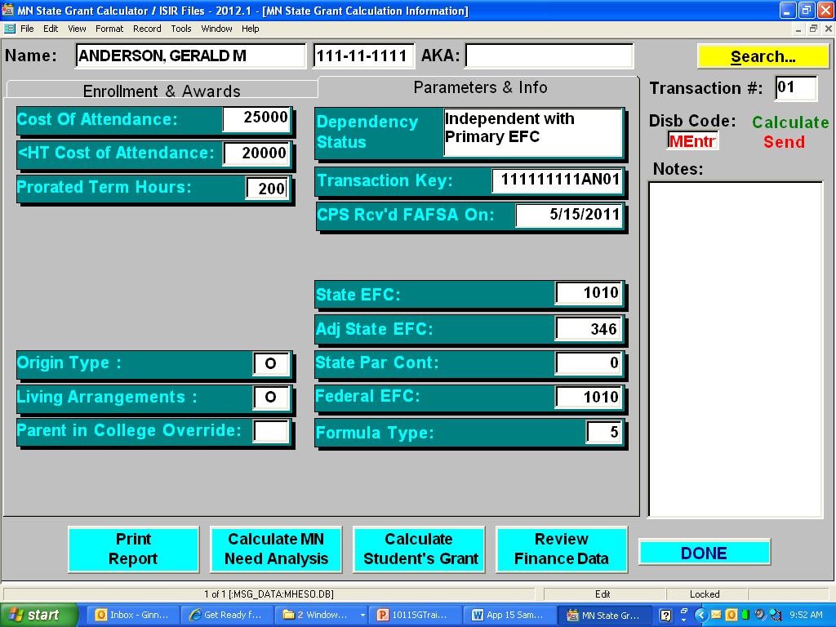
Prorating Term/Period Award on State Grant Calculator

Slide 152
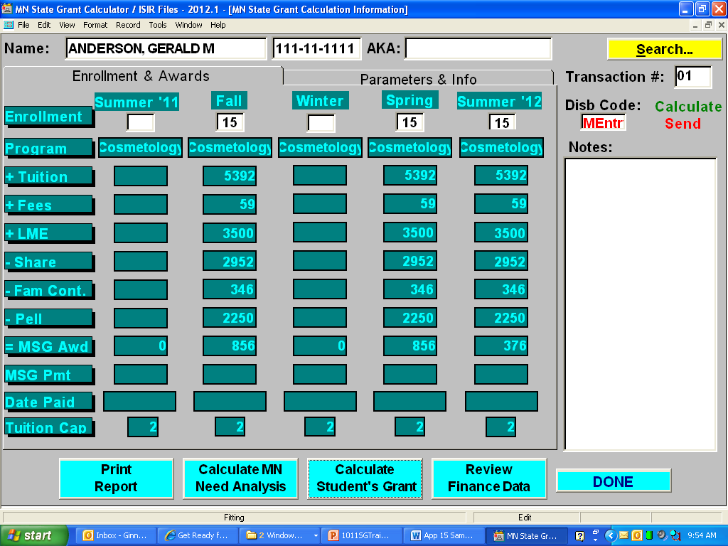
Sample State Grant Calculator Screen Last Payment Period Prorated

Slide 153
Determining Initial Enrollment Level
If disbursement takes place within first 2 weeks of initial payment period, enrollment level and award based on contracted hours per week
If disbursement takes place after first 2 weeks of initial payment period, enrollment level and award based on average hours per week to date

Slide 154
Average Hours Per Week
To determine average hours per week:
Divide student’s total hours attended by number of scheduled weeks
Number of scheduled weeks = Number of scheduled days X .20 (1 day divided by standard 5-day week)
Scheduled days do NOT include approved leave of absences, excused absences, vacations, school closings, holidays or breaks

Slide 155
Average Hours Per Week
EXAMPLE:
Student has attended 58 of 62 scheduled days and completed 336 hours
Student had 4 days of unexcused absences
62 scheduled days X .20 = 12.4 weeks
336 hours divided by 12.4 weeks = 27.10 hours per week = Level 13 for State Grant

Slide 156
Hours in Payment Period
Determine number of hours in payment period for enrollment level
Appendix 15 of State Grant Manual shows payment period lengths for 900, 1100, 1200 and 1550 hour academic years
OHE can assist school with developing similar chart if school has different academic year
Enter term enrollment level in SG Calculator and calculate award
If remaining hours in program less than payment period hours, award is prorated

Slide 157
Prorating Award Payment
EXAMPLE:
The State Grant calculated for a 450-hour payment period is $500
The student has 200 hours remaining in the program
The $500 award for the payment period would be prorated by 200/450
$500 X 44.4% = $222

Slide 158
Determining Enrollment Level Throughout Program
Enrollment level for next payment period based on actual average hours per week during previous payment period
Award for next payment period is then calculated and disbursed in the same manner described for the first payment period

Slide 159
Determining Enrollment Level Throughout Program
However:
If State Grant is NOT disbursed within 2 weeks of starting the next payment period, then base enrollment level on average hours per week during previous payment period UP THROUGH THE CURRENT DATE OF DISBURSEMENT
If State Grant funds have not yet been disbursed for aid year, base enrollment level and payment periods on average hours per week to date

Slide 160
Sample Student
Hours in Award for
Hours Hours in Pay Period Payment
Level Per Week Acad Year (2 Periods) Period
15 30+ 900 450 $1,296
14 28-29 840 420 $1,196
13 26-27 780 390 $1,097
12 24-25 720 360 $ 997
11 22-23 660 330 $ 896
10 20-21 600 300 $ 798
9 18-19 540 270 $ 698
8 16-17 480 240 $ 797
7 14-15 420 210 $ 699
6 12-13 360 180 $ 599
5 10-11 300 150 $ 498
4 8-9 240 120 $ 400
3 6-7 180 90 $ 299

Slide 161
Example 1: Constant Enrollment Level
Student’s program is 1550 hours; academic year is 900 hrs
Student initially contracts for 40 hours per week
Student is considered full-time Level 15 for State Grant if award is disbursed at onset of 1st payment period
If disbursement delayed more than 2 weeks, enrollment level must be based on average hours per week to date
First payment period is set at 450 hours
Level 15 State Grant for payment period is $1,296
Student will receive $1,296 for first payment period to cover 450 hours

Slide 162
Example 1: Constant Enrollment Level
When first payment period completed, school goes back and averages hours
School determines student averaged 38 hours per week during previous period
Student is still considered Level 15 for State Grant if award will be disbursed at onset of second payment period
If disbursement delayed beyond 2 weeks into 2nd payment period, enrollment level must be based on average hours per week from beginning of previous payment period to date
Second payment period is set at 450 hours
Student has 1,100 hours remaining in program
Student will receive $1,296 for second payment period to cover 450 hours

Slide 163
Example 1: Constant Enrollment Level
When the second payment period is completed, school goes back and averages hours during the second payment period
School determines student averaged 40 hours per week
Student is still considered Level 15 for State Grant if award is disbursed at the onset of 3rd payment period
If disbursement delayed beyond 2 weeks into 3rd payment period, enrollment level must be based on average hours per week from beginning of previous payment period to date
Third payment period is set at 450 hours
Student has 650 hours remaining in program
Student will receive $1,296 for third payment period to cover 450 hours

Slide 164
Example 1: Constant Enrollment Level
When the third payment period is completed, school goes back and averages hours during the third payment period
School determines student averaged 40 hours per week
Student is still considered Level 15 for State Grant if award is disbursed at the onset of 4th payment period
If disbursement delayed beyond 2 weeks into 4th payment period, enrollment level must be based on average hours per week from beginning of previous payment period to date
Fourth payment period is set at 450 hours
Student has only 200 hours remaining in program

Slide 165
Example 1: Constant Enrollment Level
Award for fourth payment period is prorated by 200/450 or 44.4%
Student’s award is $1,296 x 44.4% = $575
Student’s program completed and no further disbursement is needed

Slide 166
Example 2: Changing Enrollment Level
Academic year is 900 hours
Student’s program is 600 hours
Student initially contracts for 12 hours per week (Level 6)
If disbursement delayed more than 2 weeks, enrollment level must be based on average hours per week to date
First payment period is set at 180 hours (450 X 6/15ths)
Level 6 award for payment period is $599
Student will receive $599 for first payment period to cover 180 hours

Slide 167
Example 2: Changing Enrollment Level
When first payment period completed, school goes back and averages hours for that period
School determines student averaged 14 hours per week from the beginning of the previous payment period to 4 weeks into the second payment period
Student’s new enrollment status is Level 7
Next payment period is set at 210 hours (450 X 7/15ths)
Student has 420 hours remaining in program
Award for second payment period does not have to be prorated
Payment period award for Level 7 is $699
Student will receive $699 for second payment period to cover 210 hours

Slide 168
Example 2: Changing Enrollment Level
Disbursement for the third payment period has been delayed for 4 weeks
School goes back and averages hours per week during second payment period and 4 weeks of third payment period
School determines student averaged 18 hours per week
Student’s new enrollment status is Level 9
Payment period award for Level 9 is $698
Next payment period is set at 270 hours
Student has 210 hours remaining in program

Slide 169
Example 2: Changing Enrollment Level
Award for third payment period must be prorated by 210/270 or 77.8%
Student’s award for third payment period is $698 X 77.8% = $543
Student completes program

Slide 170
Withdrawal Refund
If student withdraws from school, school should complete OHE Refund Calculation worksheet/spreadsheet
If school charges by the payment period (rather than for entire program) must calculate amount of other financial aid disbursed for State Grant payment period
If academic year 900 hrs, FT payment period 450 hrs
If student enrolled Level 14, payment period 420 hrs
Determine hourly amount of other financial aid and multiply by 420 hours

